Slide 1
ELEC5566M FPGA Design for System-on-Chip
Mini-Project – Next steps
Unit 3.2
Prof Steven Freear Module Leader s.freear@leeds.ac.uk
Dr David Cowell

Slide 2
Mini-Project Next Steps
You will receive an email confirming your group listed today.
If correct – DO NOT REPLY.
If incorrect – REPLY IMMEDIATELY listing changes required.
Before next week, you will receive a link to a shared GitHub repository for your group.
WARNING – Group working requires communication.

Slide 3
Unit 3.2 IP Cores
Digital Buses
IP Core Generation
LT24 Display Interface

Slide 4
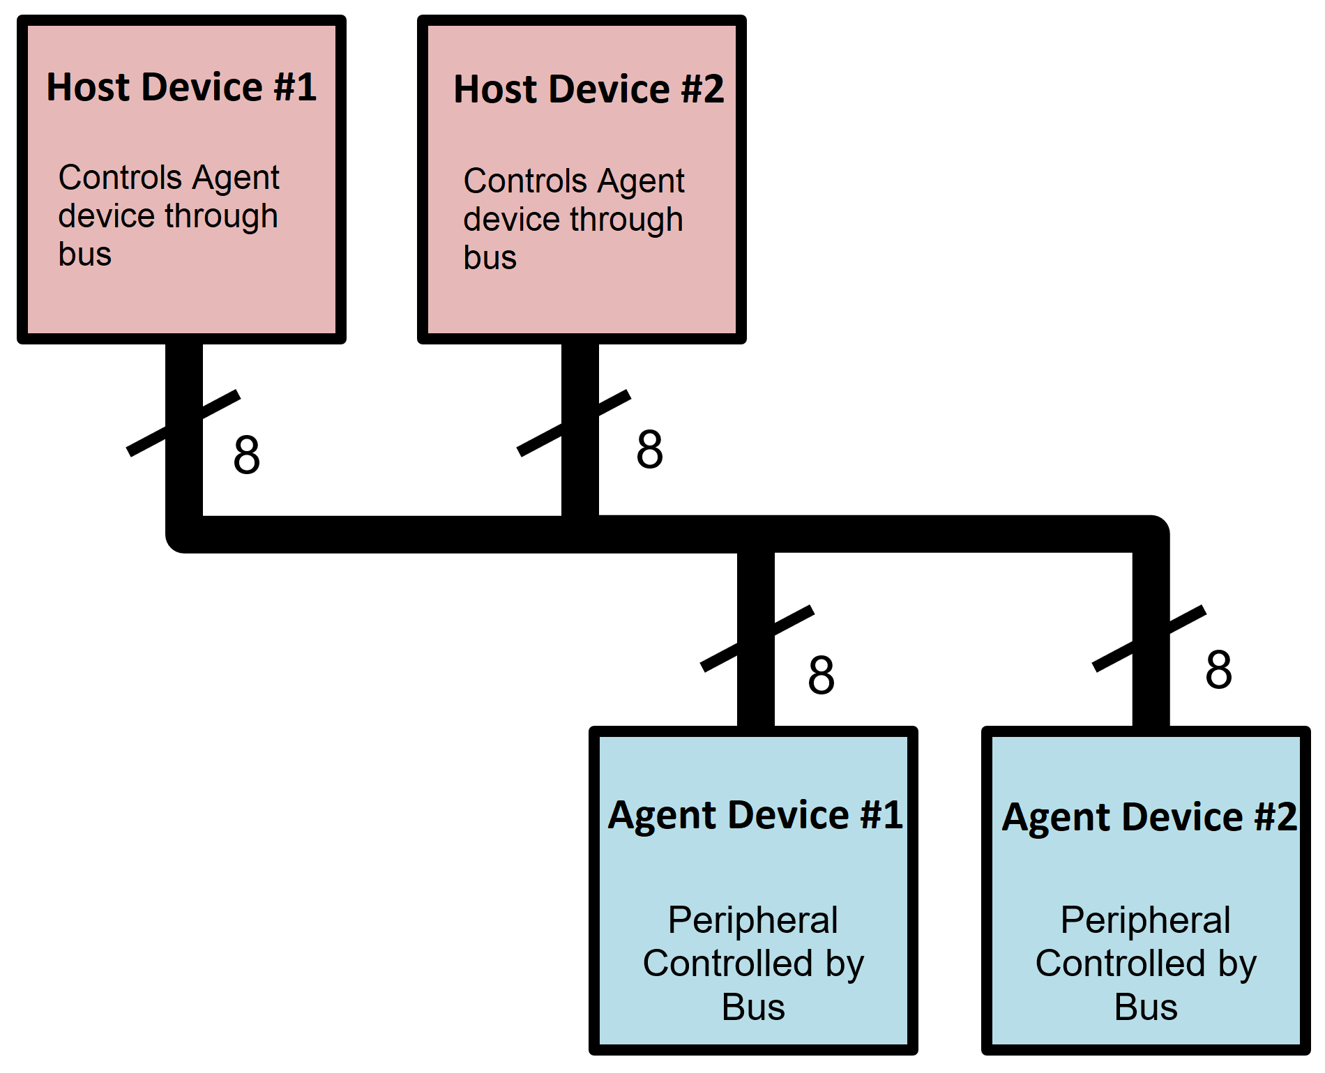
General Digital Bus

Slide 5
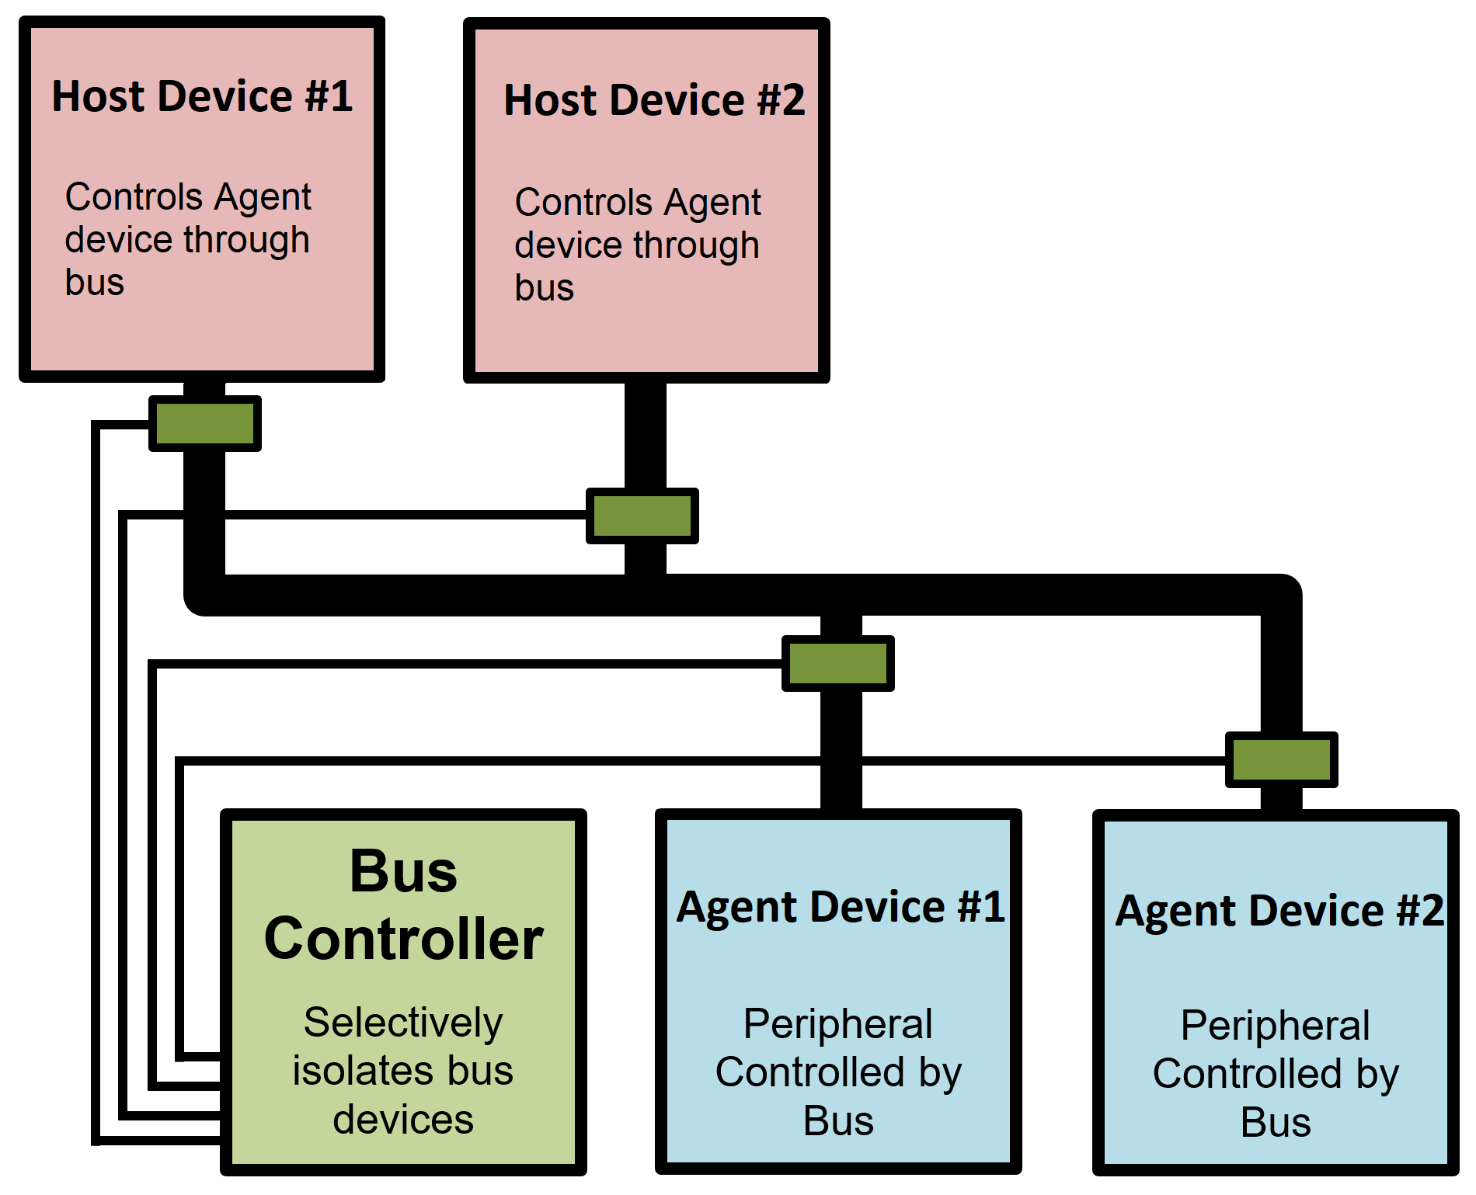
Bus Arbitration

Slide 6
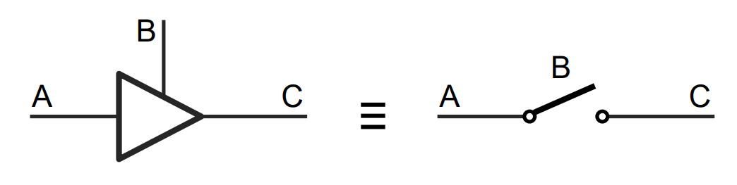
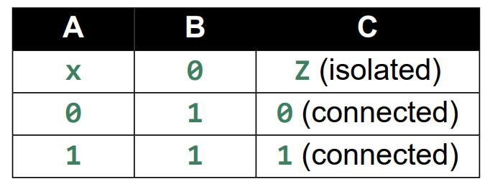
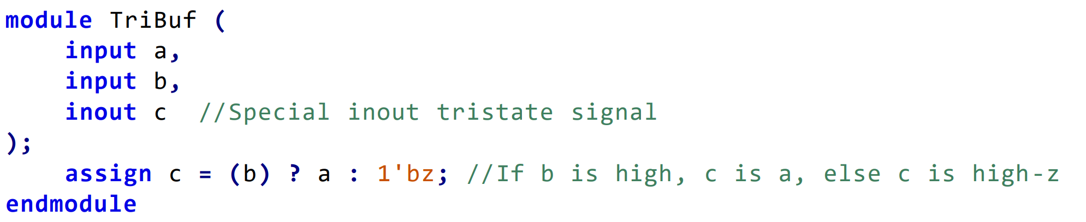
Tristate Buffer
Can be used when interfacing with external bidirectional IO such as I2C.

Slide 7
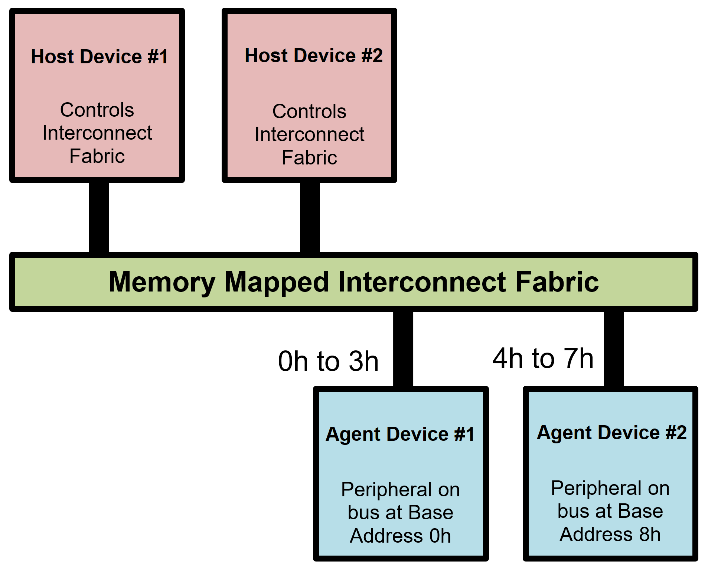
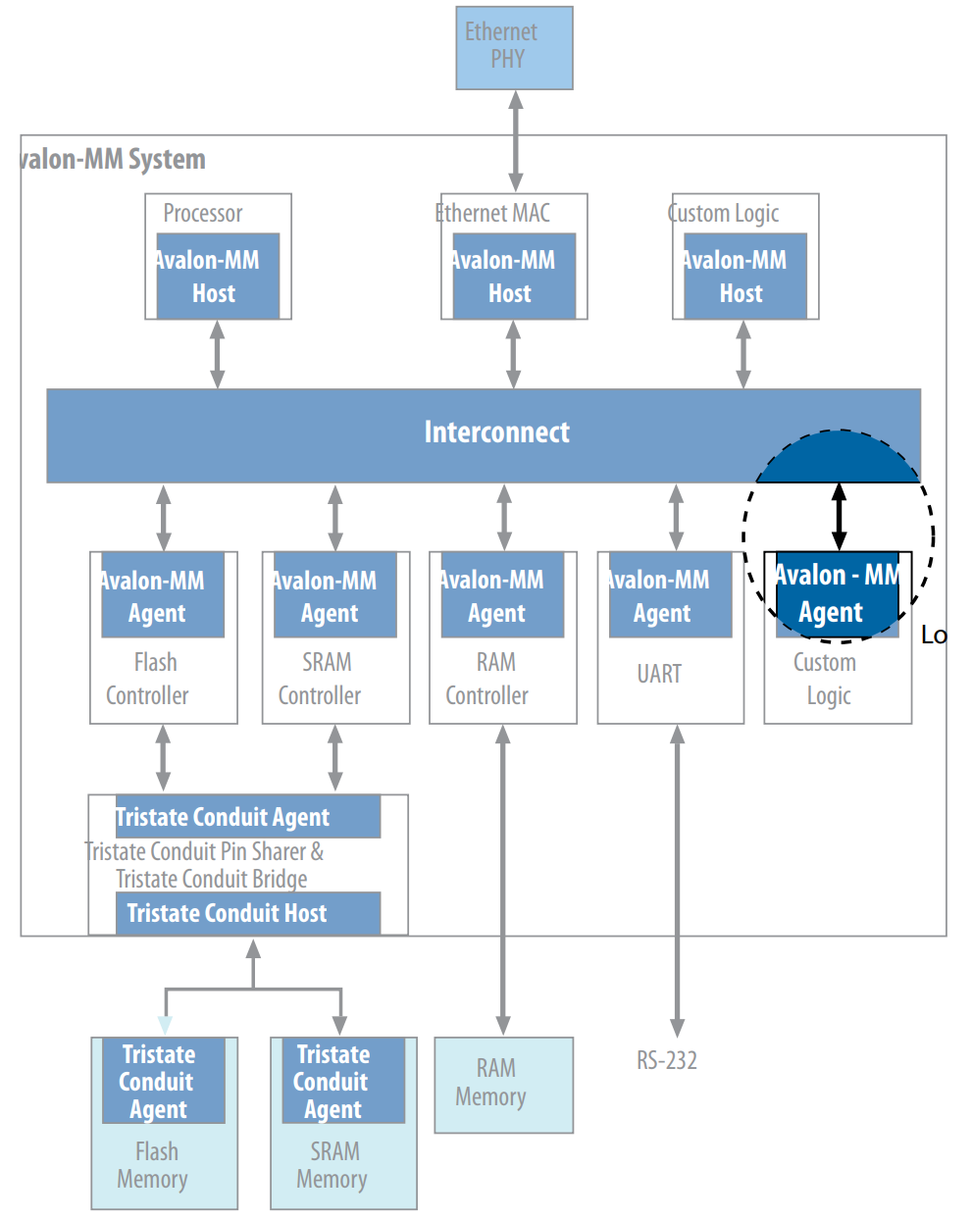
Memory Mapped Interconnects
https://www.intel.com/content/www/us/en/docs/programmable/683091/22-3/introduction-to-the-interface-specifications.html

Slide 8
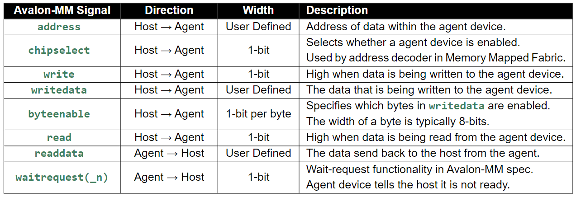
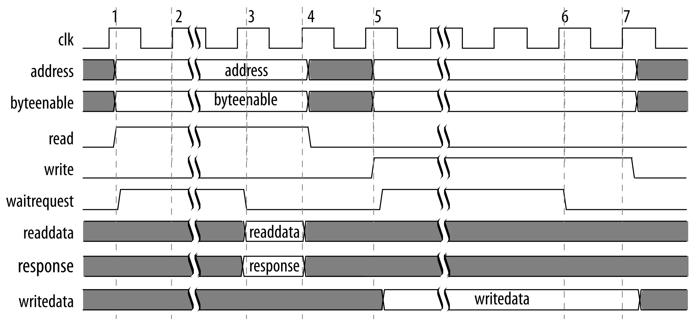
Avalon MM Interface

Slide 9
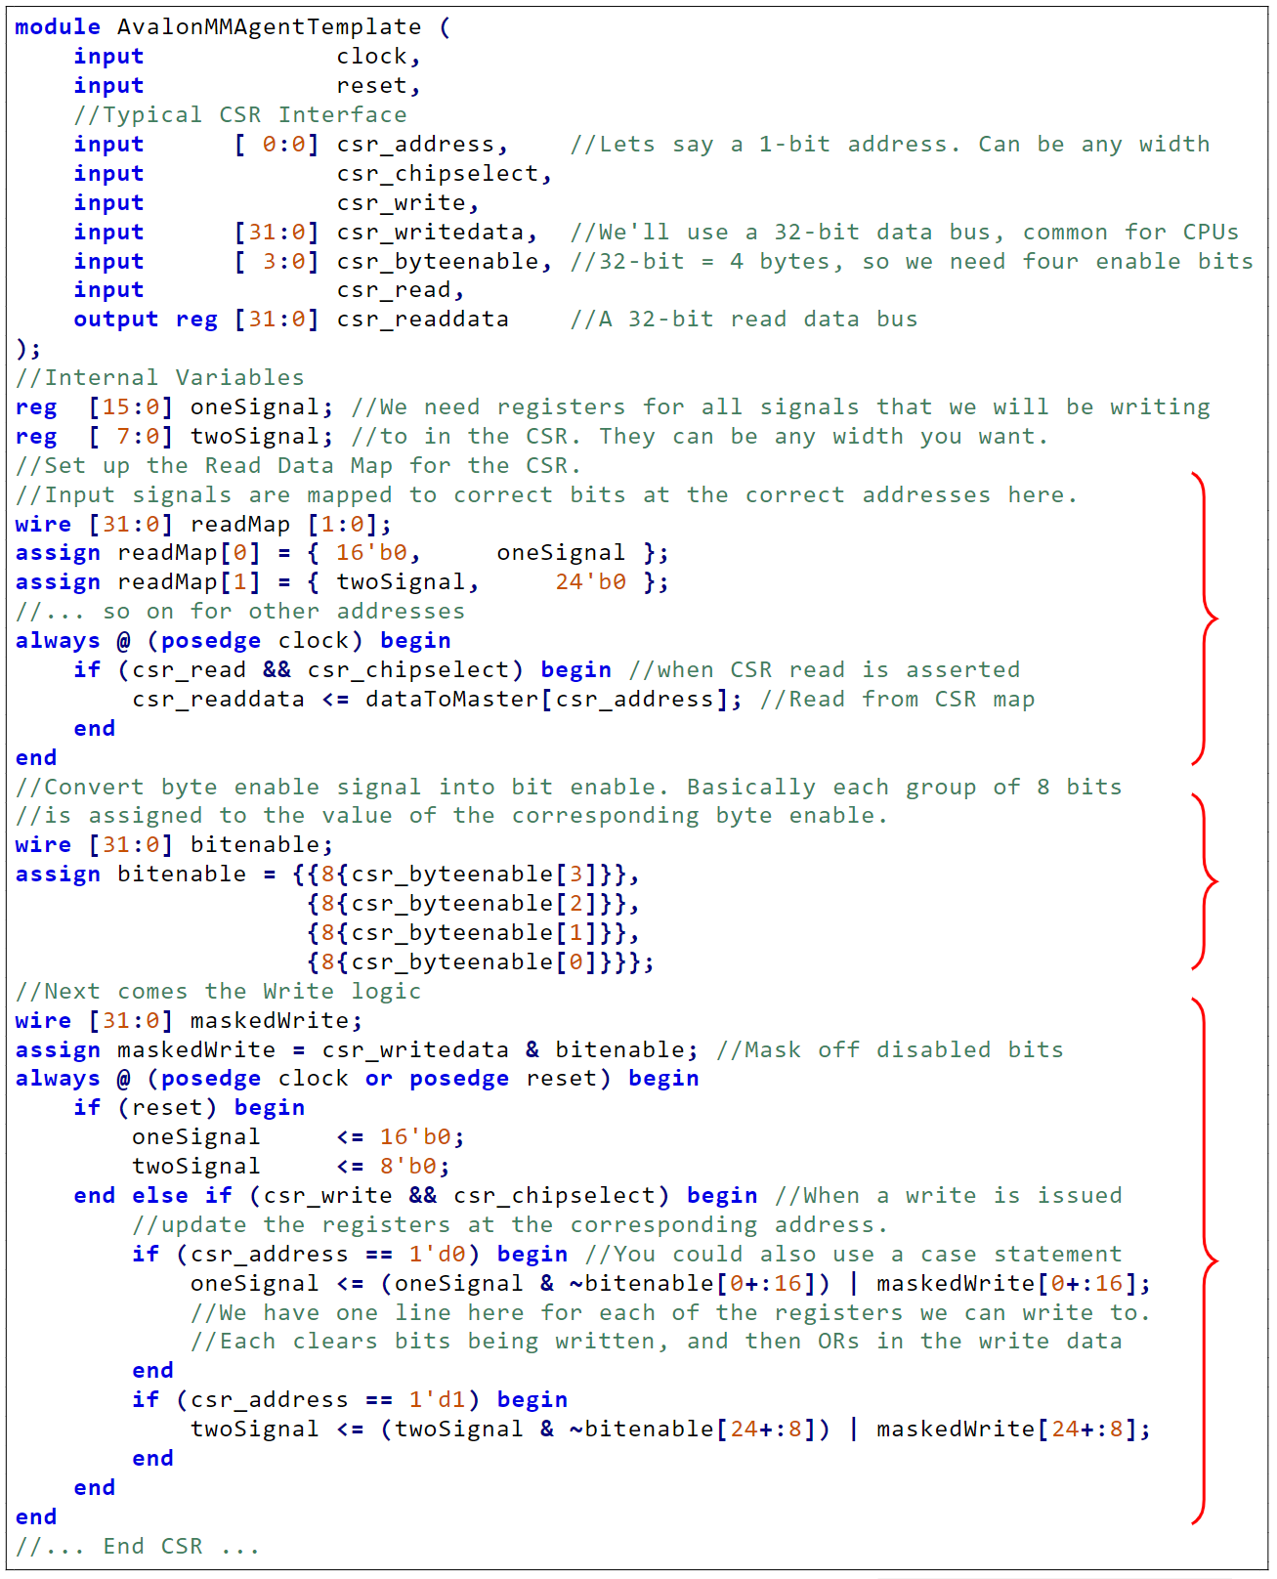
Avalon MM Agent Template

Slide 10
Avalon MM Agent Template

Slide 11
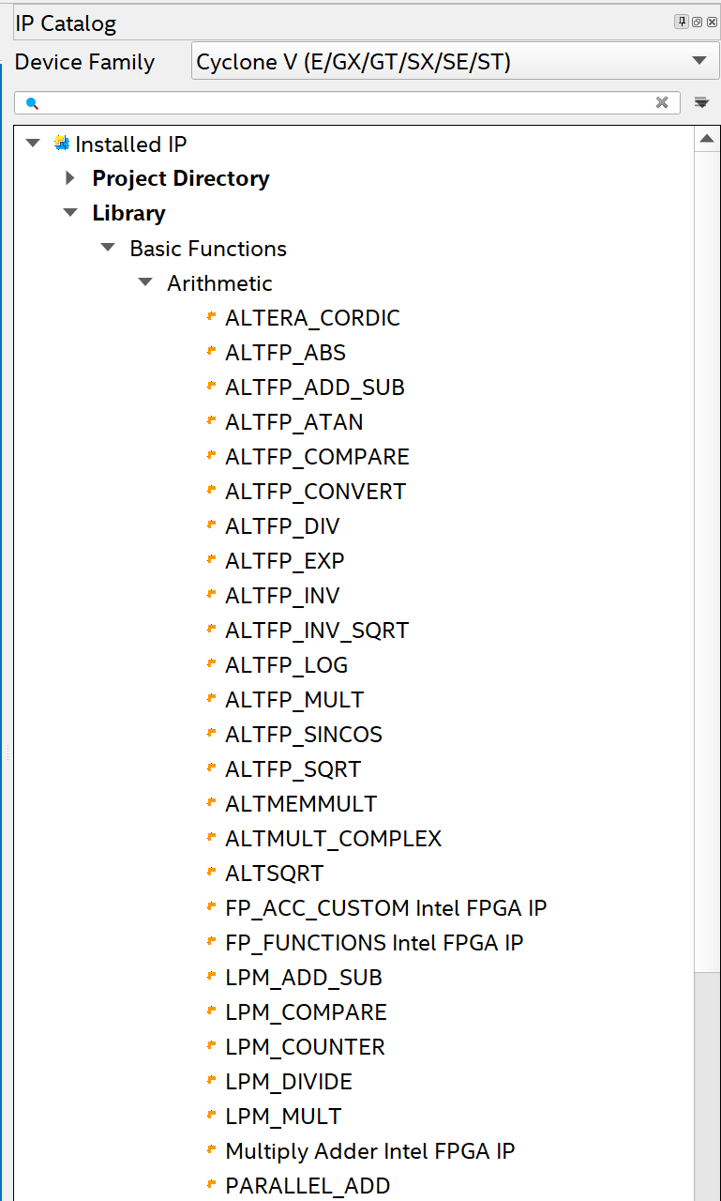
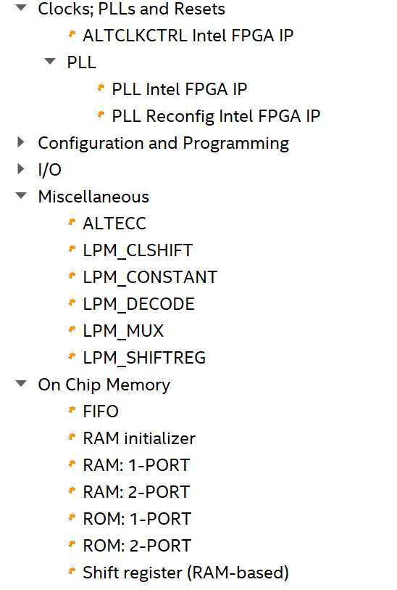
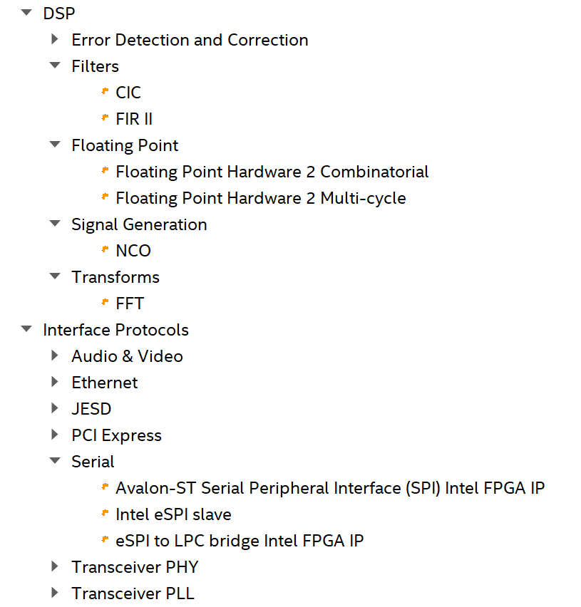
Quartus IP Catalog

Slide 12
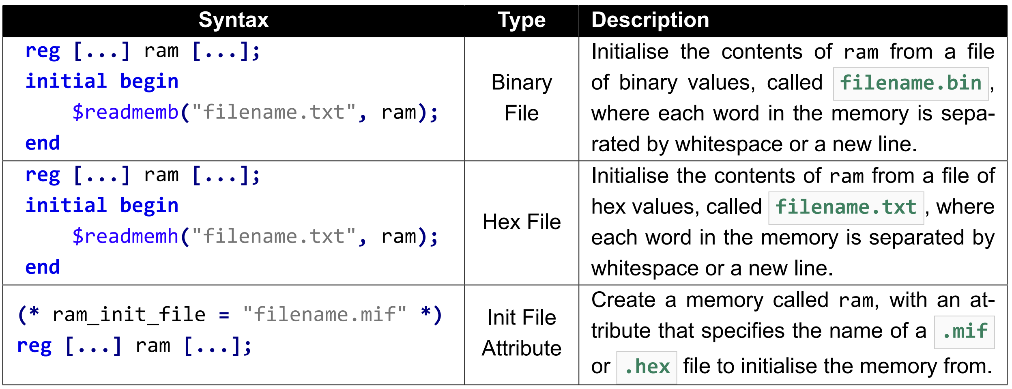
ROM, RAM

Slide 13
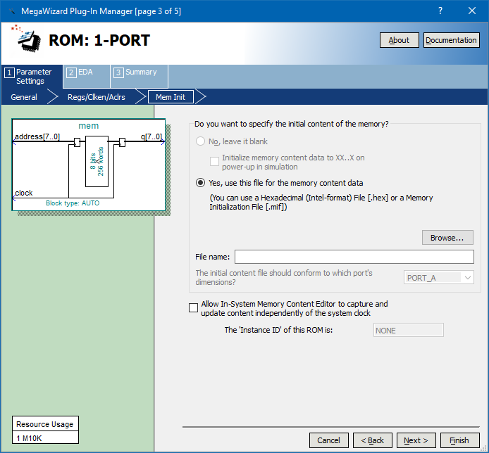
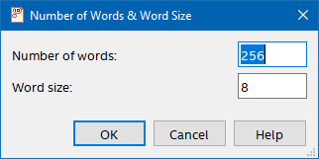
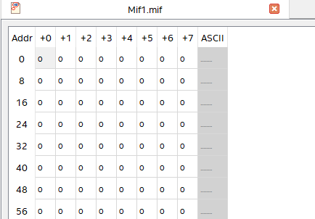
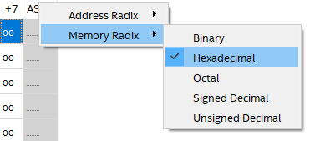
IP Cores – 1 port ROM

Slide 14
MIF File Generation? Write a quick MATLAB function?
function [] = mat2mif(filename,memory_width,memory_depth,data)
%mat2mif Convert Matlab matrix to Altera/Intel Memory Initialisation Format
% Input arguments:
%
% filename : File name of output file e.g. 'data.mif'.
% memory_width : Width of target memory in bits.
% memory_depth : Depth of target memory in words.
% data : Data for encoding into mif file.
% Check data can fit within target memory size
data = round(data(:));
data_depth = numel(data);
if data_depth > memory_depth
error('Length of input data depth greater than target memory depth.')
end
% Check data can fit within target memory width
max_unsigned_value = (2^memory_width)-1;
data_range_errors = find( data > max_unsigned_value );
if any(data_range_errors)
error('Input data value at index %d exceeds target data width.',...
data_range_errors(1));
end
% Check data values are all positive
data_sign_errors = find( data < 0 );
if any(data_sign_errors)
error('Input data value at index %d is negative. Values must be unsigned.',...
data_sign_errors(1));
end
% Check filename valid
if ~endsWith(filename,'.mif')
filename = [filename '.mif'];
End
% Generate output file
fileID = fopen(filename,'w');
if fileID == -1
error('Failed to open file.')
end
fprintf(fileID,'DEPTH = %u;\n',memory_depth);
fprintf(fileID,'WIDTH = %u;\n',memory_width);
fprintf(fileID,'ADDRESS_RADIX = UNS;\n');
fprintf(fileID,'DATA_RADIX = HEX;\n');
fprintf(fileID,'CONTENT BEGIN\n');
% Initialise all memory values as 0
fprintf(fileID,'[0..%u] : 0;\n',memory_depth-1);
% Output non zero data values
non_zero_data = find( data > 0 );
for idx = non_zero_data(:)'
fprintf(fileID,'%u : %x;\n', idx-1, data(idx) );
end
fprintf(fileID,'END;\n');
fclose(fileID);
end

Slide 15
function [] = mat2mif(filename,memory_width,memory_depth,data)
%mat2mif Convert Matlab matrix to Altera/Intel Memory Initialisation Format
% Input arguments:
%
% filename : File name of output file e.g. 'data.mif'.
% memory_width : Width of target memory in bits.
% memory_depth : Depth of target memory in words.
% data : Data for encoding into mif file.
% Check data can fit within target memory size
data = round(data(:));
data_depth = numel(data);
if data_depth > memory_depth
error('Length of input data depth greater than target memory depth.')
end
% Check data can fit within target memory width
max_unsigned_value = (2^memory_width)-1;
data_range_errors = find( data > max_unsigned_value );
if any(data_range_errors)
error('Input data value at index %d exceeds target data width.',...
data_range_errors(1));
end
% Check data values are all positive
data_sign_errors = find( data < 0 );
if any(data_sign_errors)
error('Input data value at index %d is negative. Values must be unsigned.',...
data_sign_errors(1));
end
% Check filename valid
if ~endsWith(filename,'.mif')
filename = [filename '.mif'];
End
% Generate output file
fileID = fopen(filename,'w');
if fileID == -1
error('Failed to open file.')
end
fprintf(fileID,'DEPTH = %u;\n',memory_depth);
fprintf(fileID,'WIDTH = %u;\n',memory_width);
fprintf(fileID,'ADDRESS_RADIX = UNS;\n');
fprintf(fileID,'DATA_RADIX = HEX;\n');
fprintf(fileID,'CONTENT BEGIN\n');
% Initialise all memory values as 0
fprintf(fileID,'[0..%u] : 0;\n',memory_depth-1);
% Output non zero data values
non_zero_data = find( data > 0 );
for idx = non_zero_data(:)'
fprintf(fileID,'%u : %x;\n', idx-1, data(idx) );
end
fprintf(fileID,'END;\n');
fclose(fileID);
end

Slide 16
function [] = mat2mif(filename,memory_width,memory_depth,data)
%mat2mif Convert Matlab matrix to Altera/Intel Memory Initialisation Format
% Input arguments:
%
% filename : File name of output file e.g. 'data.mif'.
% memory_width : Width of target memory in bits.
% memory_depth : Depth of target memory in words.
% data : Data for encoding into mif file.
% Check data can fit within target memory size
data = round(data(:));
data_depth = numel(data);
if data_depth > memory_depth
error('Length of input data depth greater than target memory depth.')
end
% Check data can fit within target memory width
max_unsigned_value = (2^memory_width)-1;
data_range_errors = find( data > max_unsigned_value );
if any(data_range_errors)
error('Input data value at index %d exceeds target data width.',...
data_range_errors(1));
end
% Check data values are all positive
data_sign_errors = find( data < 0 );
if any(data_sign_errors)
error('Input data value at index %d is negative. Values must be unsigned.',...
data_sign_errors(1));
end
% Check filename valid
if ~endsWith(filename,'.mif')
filename = [filename '.mif'];
End
% Generate output file
fileID = fopen(filename,'w');
if fileID == -1
error('Failed to open file.')
end
fprintf(fileID,'DEPTH = %u;\n',memory_depth);
fprintf(fileID,'WIDTH = %u;\n',memory_width);
fprintf(fileID,'ADDRESS_RADIX = UNS;\n');
fprintf(fileID,'DATA_RADIX = HEX;\n');
fprintf(fileID,'CONTENT BEGIN\n');
% Initialise all memory values as 0
fprintf(fileID,'[0..%u] : 0;\n',memory_depth-1);
% Output non zero data values
non_zero_data = find( data > 0 );
for idx = non_zero_data(:)'
fprintf(fileID,'%u : %x;\n', idx-1, data(idx) );
end
fprintf(fileID,'END;\n');
fclose(fileID);
end

Slide 17
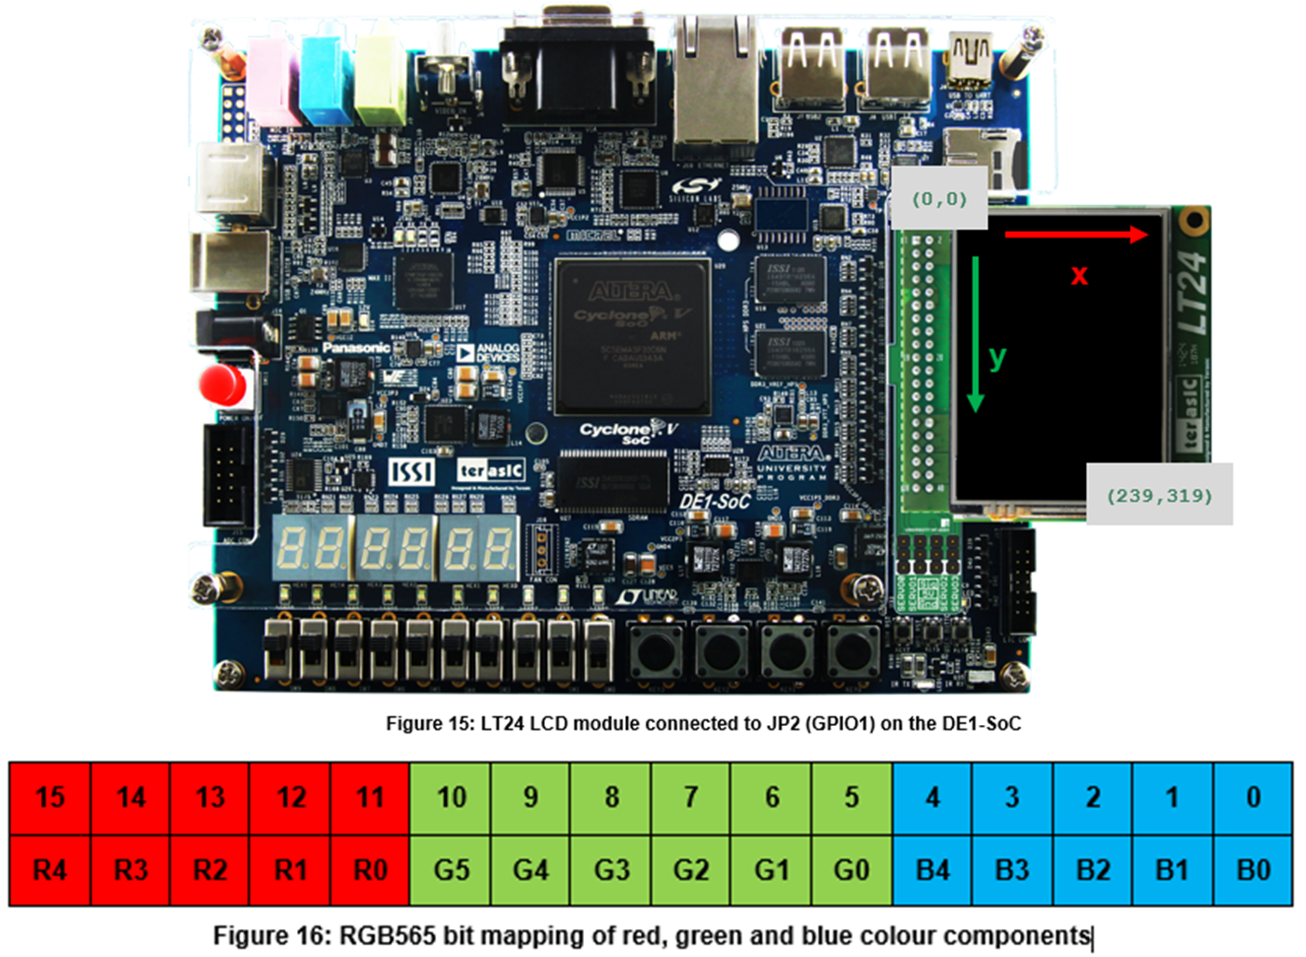
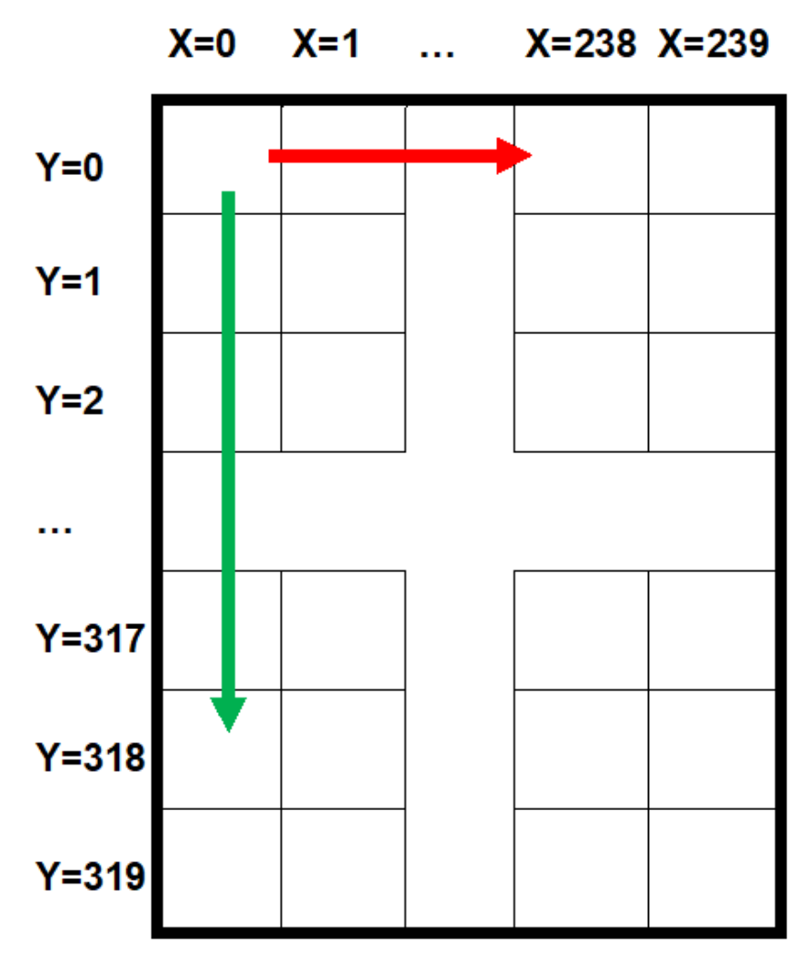
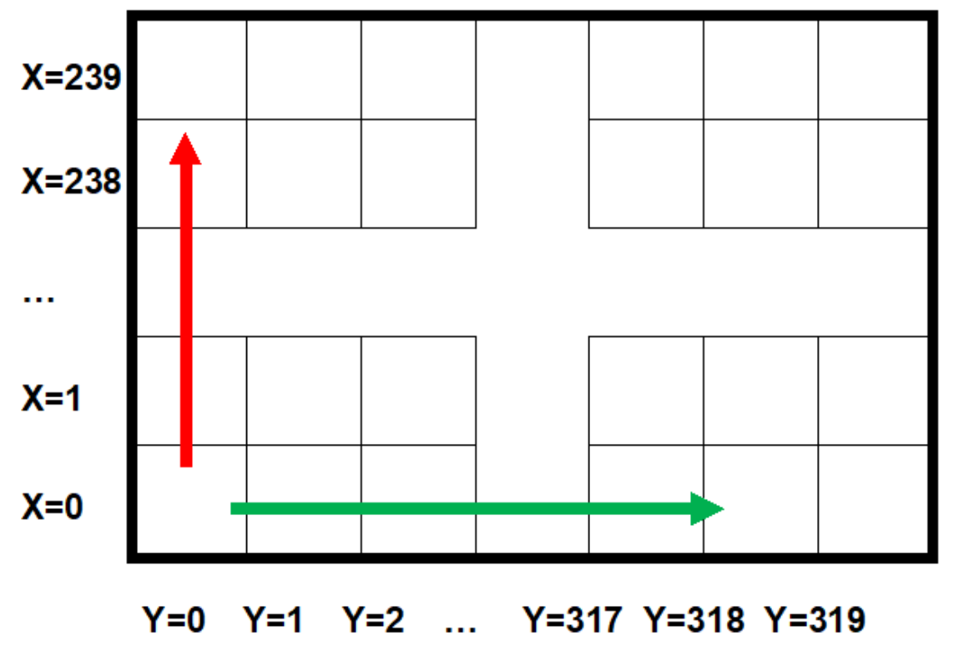
Terasic LT24 Display Module
Notes:
The LT24 has a resolution of 320 × 240 — known as “QVGA” — as shown in Figure 2.1. The LT24 board consists of the LCD panel itself, and an ILI9341 display controller for which the datasheet is on Minerva
The LT24 has a resolution of 320 × 240 — known as “QVGA” — as shown in Figure 2.1. The LT24 board consists of the LCD panel itself, and an ILI9341 display controller for which the datasheet is on Minerva

Slide 18
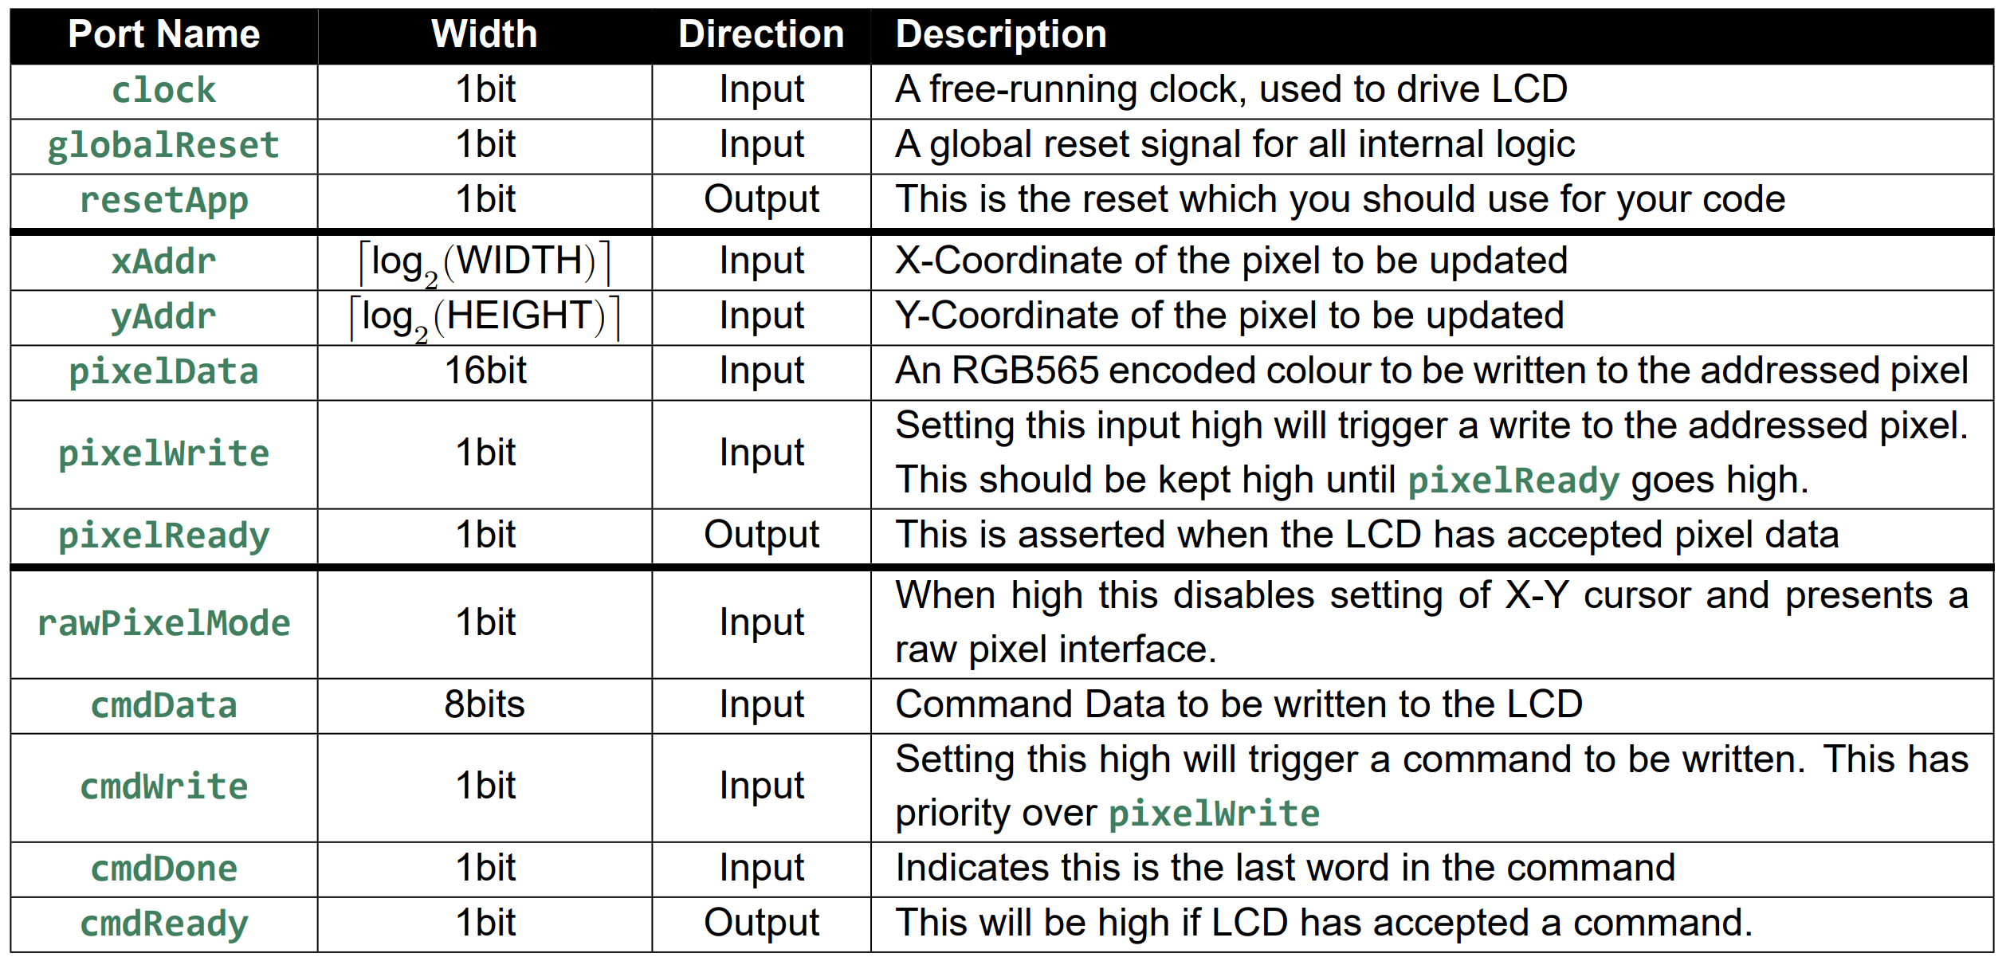
LT24 Display Driver Intellectual Property (IP) Core
Notes:
An LT24 Display Driver IP core has been written to assist you with interfacing with the display. You can find this in the Unit 3 Tasks repository, in the folder named 3-2-LT24TestProject

Slide 19
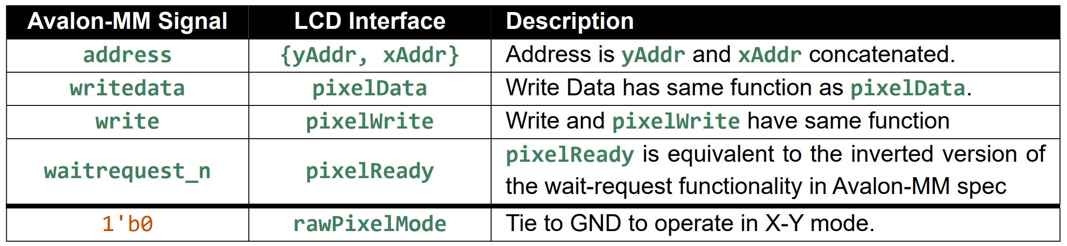
Memory Mapped Interface?

Slide 20
LT24 Interface
/*
* LT24 Display Driver
* ------------------------
* By: Thomas Carpenter
* For: University of Leeds
* Date: 13th March 2017
*
* Short Description
* -----------------
* This module is designed to interface with the LT24 Display Module
* from Terasic. It provides functionality to initialise the display
* and to allow individually addressed pixels to be written to the
* internal frame buffer of the LT24.
*
* Interfaces
* ----------
* The following interfaces are provided:
*
* clock - Input - 1bit
* A free-running clock. This will be used to general logic clock
* globalReset - Input - 1bit
* A global reset signal to reset the entire logic herein.
* resetApp - Output - 1bit
* This is the reset which you should use for your code
*
* xAddr - Input - XBITS (parameterised)
* X-Coordinate of the pixel to be updated
* yAddr - Input - YBITS (parameterised)
* Y-Coordinate of the pixel to be updated
* pixelData - Input - 16bit
* An RGB565 encoded colour to be written to the addressed pixel
* pixelWrite - Input - 1bit
* Setting this input high will trigger a write to the addressed pixel.
* This should be kept high until pixelReady goes high.
* pixelReady - Output - 1bit
* This will be asserted when the LCD has accepted pixel data
* pixelRawMode - Input - 1bit
* When high this disables setting of X-Y cursor and presents a raw pixel interface.
*
* cmdData - Input - 8bit
* Command Data to be written to the LCD
* cmdWrite - Input - 1bit
* Setting this high will trigger a command to be written. This has priority over pixelWrite
* cmdDone - Input - 1bit
* Indicates this is the last word in the command
* cmdReady - Output - 1bit
* This will be high if LCD has accepted a command
*
* LT24* - Outputs
* LT24 external display interface
*/
//Useful Macro - calculates ceil(log2(x))
`define CLOG2(x) \
(x <= 2) ? 1 : \
(x <= 4) ? 2 : \
(x <= 8) ? 3 : \
(x <= 16) ? 4 : \
(x <= 32) ? 5 : \
(x <= 64) ? 6 : \
(x <= 128) ? 7 : \
(x <= 256) ? 8 : \
(x <= 512) ? 9 : \
(x <= 1024) ? 10 : \
(x <= 2048) ? 11 : \
(x <= 4096) ? 12 : \
(x <= 8192) ? 13 : \
(x <= 16384) ? 14 : \
(x <= 32768) ? 15 : \
(x <= 65536) ? 16 : \
(x <= 131072) ? 17 : \
(x <= 262144) ? 18 : \
(x <= 524288) ? 19 : \
(x <= 1048576) ? 20 : \
(x <= 2097152) ? 21 : \
(x <= 4194304) ? 22 : \
(x <= 8388608) ? 23 : \
(x <= 16777216) ? 24 : \
-1 //This one will trigger compiler error.
//This is to suppress a warning about a missing port on the inferred rom.
//You should not suppress warnings this way.
(* altera_attribute = "-name MESSAGE_DISABLE 10030" *)
//Main Display Module. This is the one that you should infer.
module LT24Display #(
//Clock frequency
parameter CLOCK_FREQ = 50000000,
//Display Specs
parameter WIDTH = 240,
parameter HEIGHT = 320,
parameter XBITS = `CLOG2(WIDTH),
parameter YBITS = `CLOG2(HEIGHT)
)(
//
// Global Clock/Reset
// - Clock
input clock,
// - Global Reset
input globalReset,
// - Application Reset
output resetApp,
//
// FPGA Data Interface
// - Address
input [XBITS-1:0] xAddr,
input [YBITS-1:0] yAddr,
// - Data
input [ 15:0] pixelData,
// - Write Request
input pixelWrite,
// - Write Done
output reg pixelReady,
// - Raw Pixel Mode
input pixelRawMode,
//
// FPGA Command Interface
// - Data
input [ 7:0] cmdData,
// - Write Request
input cmdWrite,
// - Command Done
input cmdDone,
// - Ready for command
output reg cmdReady,
//
// LT24 Interface
// - Write Strobe (inverted)
output LT24Wr_n,
// - Read Strobe (inverted)
output LT24Rd_n,
// - Chip Select (inverted)
output LT24CS_n,
// - Register Select
output LT24RS,
// - LCD Reset
output LT24Reset_n,
// - LCD Data
output [ 15:0] LT24Data,
// - LCD Backlight On/Off
output LT24LCDOn
);
assign LT24LCDOn = 1'b1; //Backlight always on.
/*
* Create power-on synchronous reset
*/
wire reset; //Synchronised Reset
ResetSynchroniser resetGen (
.clock (clock ), //Global clock
.resetIn (globalReset), //Global reset
.resetOut(reset ) //Synchronised reset
);
/*
* LCD Initialisation Data
*/
reg [6:0] initDataRomAddr;
wire [6:0] initRomMaxAddr;
wire [8:0] initData;
LT24InitialData #(
.WIDTH(WIDTH),
.HEIGHT(HEIGHT)
) initDataRom (
.clock (clock ),
.addr (initDataRomAddr),
.initData(initData ),
.maxAddr (initRomMaxAddr )
);
/*
* State Machine for display interface
*/
reg displayInitialised;
wire displayReady;
reg displayRegSelect;
reg [15:0] displayData;
reg displayWrite;
reg [15:0] xAddrTemp; //Temp address registers are 16 bits wide so that address is correctly
reg [15:0] yAddrTemp; //padded for sending to the LT24 display.
reg [15:0] pixelDataTemp;
//State Machine
reg [3:0] stateMachine;
//General States
localparam INIT_STATE = 4'b0000; //Display Initialisation
localparam LOAD_STATE = 4'b0001; //Load Initialisation Data
localparam IDLE_STATE = 4'b1111; //Idle
//Pixel Write States
localparam CASET_STATE = 4'b1110; //Column Select
localparam XHADDR_STATE = 4'b1101; //Load X-High Address
localparam XLADDR_STATE = 4'b1100; //Load X-Low Address
localparam PASET_STATE = 4'b1011; //Row Select
localparam YHADDR_STATE = 4'b1010; //Load Y-High Address
localparam YLADDR_STATE = 4'b1001; //Load Y-Low Address
localparam WRITE_STATE = 4'b1000; //Memory Write Enable
//Command Write States
localparam CMD_STATE = 4'b0111; //Send command
//State Machine Code
always @ (posedge clock or posedge reset) begin
if (reset) begin
displayRegSelect <= 1'b1;
displayData <= 16'b0;
displayWrite <= 1'b0;
displayInitialised <= 1'b0;
initDataRomAddr <= 7'b0;
cmdReady <= 1'b0; //Not ready for a command
pixelReady <= 1'b0; //Not ready for data
stateMachine <= INIT_STATE; //Come out of reset into initial state
end else begin
case (stateMachine)
INIT_STATE: begin //Power on state - initialise pins
displayInitialised <= 1'b0; //Display not yet initialised
initDataRomAddr <= 7'b0; //Set initial ROM address one cycle early
stateMachine <= LOAD_STATE; //Begin load of ROM data into LT24
end
LOAD_STATE: begin //Load the initialisation data
if (displayReady) begin //Load next cycle when display is ready
//Send initialisation command/data for previous address. (ROM has one cycle latency)
displayData <= {8'b0,initData[7:0]}; //Repackage ROM payload
displayRegSelect <= initData[8]; //Select command or data
displayWrite <= 1'b1; //Issue a write
//Prepare next address and state
if (initDataRomAddr < initRomMaxAddr) begin
//If we have not yet sent all ROM data
initDataRomAddr <= initDataRomAddr + 7'b1; //Increment to address
end else begin
//Otherwise all initialisation data has been loaded
stateMachine <= IDLE_STATE; //Move to Idle state to await commands.
end
end
end
IDLE_STATE: begin
displayInitialised <= 1'b1; //Display is fully initialised once in Idle state.
if (displayReady && cmdWrite) begin
//If command write requested (this has priority)
cmdReady <= 1'b1; //Accepted command
pixelReady <= 1'b0; //Not ready for data
//Issue first write in sequence
displayData <= {8'b0,cmdData}; //Load command data onto display output
displayWrite <= 1'b1; //Issue a write
displayRegSelect <= 1'b0; //Loading a command word
stateMachine <= CMD_STATE; //Jump to command state for payload
end else if (displayReady && pixelWrite) begin
//Otherwise if pixel write requested
cmdReady <= 1'b0; //Not ready for a command
pixelReady <= 1'b1; //Accepted data
//Backup pixel information for later in the state machine
xAddrTemp <= {{(16-XBITS){1'b0}},xAddr}; //Store the current x
yAddrTemp <= {{(16-YBITS){1'b0}},yAddr}; //and y addresses
pixelDataTemp <= pixelData; //Store the current pixel data
if (pixelRawMode) begin
//If in raw pixel mode, just load the data
displayRegSelect<= 1'b1; //Loading a pixel data word
displayData <= pixelData; //Load raw pixel data
end else begin
//If in normal mode, go through setting of X-Y coordinates.
displayRegSelect<= 1'b0; //Loading a command word
displayData <= 16'h2A; //Load CASET command onto display output
stateMachine <= CASET_STATE; //Jump to CASET state
end
//Issue first write in sequence
displayWrite <= 1'b1; //Issue a write
end else begin
//Otherwise we are not ready until an access is requested
cmdReady <= 1'b0; //Not ready for a command
pixelReady <= 1'b0; //Not ready for data
displayWrite <= 1'b0; //Don't perform write while in Idle
end
end
CMD_STATE: begin
cmdReady <= displayReady; //Control flow of data into command port based on when display is ready
if (displayReady && cmdWrite) begin
//If additional payload, load next byte
displayData <= {8'b0,cmdData}; //Load command data onto display output
displayWrite <= 1'b1; //Issue a write
if (cmdDone) begin
//If this is the last command, go to cleanup state
stateMachine <= IDLE_STATE;
end
end else begin
displayWrite <= 1'b0; //Write done
end
end
CASET_STATE: begin //Column Select
pixelReady <= 1'b0; //Not ready for next pixel.
if (displayReady) begin
//Once the display is ready for next transfer
displayRegSelect <= 1'b1; //Next display write is a payload
displayData <= {8'b0,xAddrTemp[15:8]}; //Load X-High payload onto display output
displayWrite <= 1'b1; //Issue a write
stateMachine <= XHADDR_STATE; //Next payload will be X-High
end
end
XHADDR_STATE: begin //Load X-High Address
if (displayReady) begin
//Once the display is ready for next transfer
displayRegSelect <= 1'b1; //Next display write is a payload
displayData <= {8'b0,xAddrTemp[7:0]}; //Load X-Low payload onto display output
displayWrite <= 1'b1; //Issue a write
stateMachine <= XLADDR_STATE; //Next payload will be X-Low
end
end
XLADDR_STATE: begin //Load X-Low Address
if (displayReady) begin
//Once the display is ready for next transfer
stateMachine <= PASET_STATE; //Next command will be PASET
displayRegSelect <= 1'b0; //Next display write is a command
displayData <= 16'h2B; //Load PASET command onto display output
displayWrite <= 1'b1; //Issue a write
end
end
PASET_STATE: begin //Row Select
if (displayReady) begin
//Once the display is ready for next transfer
stateMachine <= YHADDR_STATE; //Next payload will be Y-High
displayRegSelect <= 1'b1; //Next display write is a payload
displayData <= {8'b0,yAddrTemp[15:8]}; //Load Y-High payload onto display output
displayWrite <= 1'b1; //Issue a write
end
end
YHADDR_STATE: begin //Load Y-High Address
if (displayReady) begin
//Once the display is ready for next transfer
stateMachine <= YLADDR_STATE; //Next payload will be Y-Low
displayRegSelect <= 1'b1; //Next display write is a payload
displayData <= {8'b0,yAddrTemp[7:0]}; //Load Y-Low payload onto display output
displayWrite <= 1'b1; //Issue a write
end
end
YLADDR_STATE: begin //Load Y-Low Address
if (displayReady) begin
//Once the display is ready for next transfer
stateMachine <= WRITE_STATE; //Next command will be Memory Write
displayRegSelect <= 1'b0; //Next display write is a command
displayData <= 16'h2C; //Load WRITE command onto display output
displayWrite <= 1'b1; //Issue a write
end
end
WRITE_STATE: begin //Memory Write Enable
if (displayReady) begin
//Once the display is ready for next transfer
stateMachine <= IDLE_STATE; //Next payload will be Pixel Data and we are done.
displayRegSelect <= 1'b1; //Next display write is pixel data
displayData <= pixelDataTemp; //Load pixel data onto display output
displayWrite <= 1'b1; //Issue a write
end
end
default: begin
stateMachine <= INIT_STATE; //If something goes wrong, reinit the display.
end
endcase
end
end
//Hold application in reset until display initialised.
assign resetApp = reset || !displayInitialised;
/*
* Generate interface signals for LT24
*/
LT24DisplayInterface #(
.CLOCK_FREQ(CLOCK_FREQ)
) LT24Interface (
//Clock/Reset
.clock (clock ), //Global clock
.reset (reset ), //Synchronised reset
//FPGA Display Interface
.regSelect (displayRegSelect),
.data (displayData ),
.write (displayWrite ),
.ready (displayReady ),
//LT24 Interface
.LT24Wr_n (LT24Wr_n ),
.LT24Rd_n (LT24Rd_n ),
.LT24CS_n (LT24CS_n ),
.LT24RS (LT24RS ),
.LT24Reset_n(LT24Reset_n ),
.LT24Data (LT24Data )
);
endmodule
/*
* LT24 Display Interface
* --------------------------------
* Generates transations on the LT24 display interface to
* send data or commands.
*
* The FPGA interface signals should not change while ready is 0
*/
module LT24DisplayInterface #(
parameter CLOCK_FREQ = 64'd50000000
)(
input clock,
input reset,
//FPGA Interface
input regSelect, //1 = Pixel Data, 0 = Command
input [ 15:0] data,
input write, //Assert for 1 cycle to initialise write
output ready, //Indicates the LCD is ready to receive data/command
//LCD Interface
output LT24Wr_n,
output LT24Rd_n,
output LT24CS_n,
output LT24RS,
output LT24Reset_n,
output [ 15:0] LT24Data
);
/*
* Reset pause timing
*/
//Determine requirements for power on reset
`ifdef MODEL_TECH //For Simulation
localparam RESETTIME = 64'd0; //ms - Skip delay during simulation.
`else //For Synthesis
localparam RESETTIME = 64'd120; //ms - 120ms is required by display
`endif //End preprocessor block
localparam RESETCOUNT = (RESETTIME * CLOCK_FREQ) / 64'd1000;
localparam RESETBITS = `CLOG2(RESETCOUNT+1); //The +1 ensures we always have room for counter to == RESETCOUNT
//These help make parameterised widths easier.
localparam ZERO = 0;
localparam ONE = 1;
//Reset delay counter
reg [RESETBITS-1:0] counter;
always @ (posedge clock or posedge reset) begin
if (reset) begin
counter <= ZERO[RESETBITS-1:0]; //Initially counter is zero
end else if (counter < RESETCOUNT) begin //Once we are out of reset
//If we haven't had a long enough reset pause
counter <= counter + ONE[RESETBITS-1:0]; //Increment counter
end
end
/*
* Write control
*/
//Writes take two cycles, so track second cycle.
reg writeDly = 1'b0;
always @ (posedge clock) begin
writeDly <= write && !writeDly;
end
//Assert ready after the reset pause and when we are not in the first write cycle
assign ready = !(counter < RESETCOUNT) && !(write && !writeDly);
/*
* External interface
*/
assign LT24CS_n = 1'b0;
assign LT24Rd_n = 1'b1;
assign LT24Data = data;
assign LT24RS = regSelect;
assign LT24Wr_n = writeDly;
assign LT24Reset_n = !reset;
endmodule
/*
* Simple Reset Synchroniser
* --------------------------------
* This will generate a few clock cycle reset at power on
* or when the input reset is asserted.
*/
module ResetSynchroniser (
input clock,
input resetIn,
output resetOut
);
//Reset synchroniser to avoid metastability if external push-button used
reg [3:0] resetSync = 4'hF;
always @ (posedge clock or posedge resetIn) begin
if (resetIn) begin
resetSync <= 4'hF; //Assert reset asynchronously
end else begin
resetSync <= {resetSync[2:0],1'b0}; //Deassert reset synchronously
end
end
assign resetOut = resetSync[3];
endmodule
/*
* Initialisation Data Lookup Table
* --------------------------------
* Contains initialisation data for LT24 Display
*/
module LT24InitialData #(
parameter WIDTH = 240,
parameter HEIGHT = 320
)(
input clock,
input [6:0] addr,
output reg [8:0] initData,
output [6:0] maxAddr
);
localparam MAX_X_PIXEL = WIDTH - 1;
localparam MAX_Y_PIXEL = HEIGHT - 1;
localparam INIT_LENGTH = 102;
assign maxAddr = INIT_LENGTH[6:0]; //This can be used to determine when full ROM has been read.
localparam ROM_LENGTH = 2**(`CLOG2(INIT_LENGTH)); //Find next highest power of two that will fit the init data.
reg [8:0] ROM [ROM_LENGTH-1:0];
integer i;
initial begin
//Note - this is ugly. A better approach is to use a .mif file.
ROM[7'd000] <= {1'b0,8'hEF};
ROM[7'd001] <= {1'b1,8'h03};
ROM[7'd002] <= {1'b1,8'h80};
ROM[7'd003] <= {1'b1,8'h02};
ROM[7'd004] <= {1'b0,8'hCF};
ROM[7'd005] <= {1'b1,8'h00};
ROM[7'd006] <= {1'b1,8'h81};
ROM[7'd007] <= {1'b1,8'hc0};
ROM[7'd008] <= {1'b0,8'hED};
ROM[7'd009] <= {1'b1,8'h64};
ROM[7'd010] <= {1'b1,8'h03};
ROM[7'd011] <= {1'b1,8'h12};
ROM[7'd012] <= {1'b1,8'h81};
ROM[7'd013] <= {1'b0,8'hE8};
ROM[7'd014] <= {1'b1,8'h85};
ROM[7'd015] <= {1'b1,8'h01};
ROM[7'd016] <= {1'b1,8'h78};
ROM[7'd017] <= {1'b0,8'hCB};
ROM[7'd018] <= {1'b1,8'h39};
ROM[7'd019] <= {1'b1,8'h2C};
ROM[7'd020] <= {1'b1,8'h00};
ROM[7'd021] <= {1'b1,8'h34};
ROM[7'd022] <= {1'b1,8'h02};
ROM[7'd023] <= {1'b0,8'hF7};
ROM[7'd024] <= {1'b1,8'h20};
ROM[7'd025] <= {1'b0,8'hEA};
ROM[7'd026] <= {1'b1,8'h00};
ROM[7'd027] <= {1'b1,8'h00};
ROM[7'd028] <= {1'b0,8'hC0};
ROM[7'd029] <= {1'b1,8'h23};
ROM[7'd030] <= {1'b0,8'hC1};
ROM[7'd031] <= {1'b1,8'h10};
ROM[7'd032] <= {1'b0,8'hC5};
ROM[7'd033] <= {1'b1,8'h3E};
ROM[7'd034] <= {1'b1,8'h28};
ROM[7'd035] <= {1'b0,8'hC7};
ROM[7'd036] <= {1'b1,8'h86};
ROM[7'd037] <= {1'b0,8'h36};
ROM[7'd038] <= {1'b1,8'h48};
ROM[7'd039] <= {1'b0,8'h3A};
ROM[7'd040] <= {1'b1,8'h55};
ROM[7'd041] <= {1'b0,8'hB1};
ROM[7'd042] <= {1'b1,8'h00};
ROM[7'd043] <= {1'b1,8'h1b};
ROM[7'd044] <= {1'b0,8'hB6};
ROM[7'd045] <= {1'b1,8'h08};
ROM[7'd046] <= {1'b1,8'h82};
ROM[7'd047] <= {1'b1,8'h27};
ROM[7'd048] <= {1'b0,8'hF2};
ROM[7'd049] <= {1'b1,8'h00};
ROM[7'd050] <= {1'b0,8'h26};
ROM[7'd051] <= {1'b1,8'h01};
ROM[7'd052] <= {1'b0,8'hE0};
ROM[7'd053] <= {1'b1,8'h0F};
ROM[7'd054] <= {1'b1,8'h31};
ROM[7'd055] <= {1'b1,8'h2B};
ROM[7'd056] <= {1'b1,8'h0C};
ROM[7'd057] <= {1'b1,8'h0E};
ROM[7'd058] <= {1'b1,8'h08};
ROM[7'd059] <= {1'b1,8'h4E};
ROM[7'd060] <= {1'b1,8'hF1};
ROM[7'd061] <= {1'b1,8'h37};
ROM[7'd062] <= {1'b1,8'h07};
ROM[7'd063] <= {1'b1,8'h10};
ROM[7'd064] <= {1'b1,8'h03};
ROM[7'd065] <= {1'b1,8'h0E};
ROM[7'd066] <= {1'b1,8'h09};
ROM[7'd067] <= {1'b1,8'h00};
ROM[7'd068] <= {1'b0,8'hE1};
ROM[7'd069] <= {1'b1,8'h00};
ROM[7'd070] <= {1'b1,8'h0E};
ROM[7'd071] <= {1'b1,8'h14};
ROM[7'd072] <= {1'b1,8'h03};
ROM[7'd073] <= {1'b1,8'h11};
ROM[7'd074] <= {1'b1,8'h07};
ROM[7'd075] <= {1'b1,8'h31};
ROM[7'd076] <= {1'b1,8'hC1};
ROM[7'd077] <= {1'b1,8'h48};
ROM[7'd078] <= {1'b1,8'h08};
ROM[7'd079] <= {1'b1,8'h0F};
ROM[7'd080] <= {1'b1,8'h0C};
ROM[7'd081] <= {1'b1,8'h31};
ROM[7'd082] <= {1'b1,8'h36};
ROM[7'd083] <= {1'b1,8'h0f};
ROM[7'd084] <= {1'b0,8'hB1};
ROM[7'd085] <= {1'b1,8'h00};
ROM[7'd086] <= {1'b1,8'h01};
ROM[7'd087] <= {1'b0,8'hf6};
ROM[7'd088] <= {1'b1,8'h01};
ROM[7'd089] <= {1'b1,8'h10};
ROM[7'd090] <= {1'b1,8'h00};
ROM[7'd091] <= {1'b0,8'h11};
ROM[7'd092] <= {1'b0,8'h2A};
ROM[7'd093] <= {1'b1,8'h00};
ROM[7'd094] <= {1'b1,8'h00};
ROM[7'd095] <= {1'b1,MAX_X_PIXEL[15:8]};
ROM[7'd096] <= {1'b1,MAX_X_PIXEL[ 7:0]};
ROM[7'd097] <= {1'b0,8'h2B};
ROM[7'd098] <= {1'b1,8'h00};
ROM[7'd099] <= {1'b1,8'h00};
ROM[7'd100] <= {1'b1,MAX_Y_PIXEL[15:8]};
ROM[7'd101] <= {1'b1,MAX_Y_PIXEL[ 7:0]};
ROM[7'd102] <= {1'b0,8'h29};
for (i = INIT_LENGTH+1; i < ROM_LENGTH; i=i+1) begin
ROM[i] <= {1'b0,8'h00}; //Pad others as NOP command.
end
end
always @ (posedge clock) begin
initData <= ROM[addr];
end
endmodule

Slide 21
LT24 Interface
/*
* LT24 Display Driver
* ------------------------
* By: Thomas Carpenter
* For: University of Leeds
* Date: 13th March 2017
*
* Short Description
* -----------------
* This module is designed to interface with the LT24 Display Module
* from Terasic. It provides functionality to initialise the display
* and to allow individually addressed pixels to be written to the
* internal frame buffer of the LT24.
*
* Interfaces
* ----------
* The following interfaces are provided:
*
* clock - Input - 1bit
* A free-running clock. This will be used to general logic clock
* globalReset - Input - 1bit
* A global reset signal to reset the entire logic herein.
* resetApp - Output - 1bit
* This is the reset which you should use for your code
*
* xAddr - Input - XBITS (parameterised)
* X-Coordinate of the pixel to be updated
* yAddr - Input - YBITS (parameterised)
* Y-Coordinate of the pixel to be updated
* pixelData - Input - 16bit
* An RGB565 encoded colour to be written to the addressed pixel
* pixelWrite - Input - 1bit
* Setting this input high will trigger a write to the addressed pixel.
* This should be kept high until pixelReady goes high.
* pixelReady - Output - 1bit
* This will be asserted when the LCD has accepted pixel data
* pixelRawMode - Input - 1bit
* When high this disables setting of X-Y cursor and presents a raw pixel interface.
*
* cmdData - Input - 8bit
* Command Data to be written to the LCD
* cmdWrite - Input - 1bit
* Setting this high will trigger a command to be written. This has priority over pixelWrite
* cmdDone - Input - 1bit
* Indicates this is the last word in the command
* cmdReady - Output - 1bit
* This will be high if LCD has accepted a command
*
* LT24* - Outputs
* LT24 external display interface
*/
//Useful Macro - calculates ceil(log2(x))
`define CLOG2(x) \
(x <= 2) ? 1 : \
(x <= 4) ? 2 : \
(x <= 8) ? 3 : \
(x <= 16) ? 4 : \
(x <= 32) ? 5 : \
(x <= 64) ? 6 : \
(x <= 128) ? 7 : \
(x <= 256) ? 8 : \
(x <= 512) ? 9 : \
(x <= 1024) ? 10 : \
(x <= 2048) ? 11 : \
(x <= 4096) ? 12 : \
(x <= 8192) ? 13 : \
(x <= 16384) ? 14 : \
(x <= 32768) ? 15 : \
(x <= 65536) ? 16 : \
(x <= 131072) ? 17 : \
(x <= 262144) ? 18 : \
(x <= 524288) ? 19 : \
(x <= 1048576) ? 20 : \
(x <= 2097152) ? 21 : \
(x <= 4194304) ? 22 : \
(x <= 8388608) ? 23 : \
(x <= 16777216) ? 24 : \
-1 //This one will trigger compiler error.
//This is to suppress a warning about a missing port on the inferred rom.
//You should not suppress warnings this way.
(* altera_attribute = "-name MESSAGE_DISABLE 10030" *)
//Main Display Module. This is the one that you should infer.
module LT24Display #(
//Clock frequency
parameter CLOCK_FREQ = 50000000,
//Display Specs
parameter WIDTH = 240,
parameter HEIGHT = 320,
parameter XBITS = `CLOG2(WIDTH),
parameter YBITS = `CLOG2(HEIGHT)
)(
//
// Global Clock/Reset
// - Clock
input clock,
// - Global Reset
input globalReset,
// - Application Reset
output resetApp,
//
// FPGA Data Interface
// - Address
input [XBITS-1:0] xAddr,
input [YBITS-1:0] yAddr,
// - Data
input [ 15:0] pixelData,
// - Write Request
input pixelWrite,
// - Write Done
output reg pixelReady,
// - Raw Pixel Mode
input pixelRawMode,
//
// FPGA Command Interface
// - Data
input [ 7:0] cmdData,
// - Write Request
input cmdWrite,
// - Command Done
input cmdDone,
// - Ready for command
output reg cmdReady,
//
// LT24 Interface
// - Write Strobe (inverted)
output LT24Wr_n,
// - Read Strobe (inverted)
output LT24Rd_n,
// - Chip Select (inverted)
output LT24CS_n,
// - Register Select
output LT24RS,
// - LCD Reset
output LT24Reset_n,
// - LCD Data
output [ 15:0] LT24Data,
// - LCD Backlight On/Off
output LT24LCDOn
);
assign LT24LCDOn = 1'b1; //Backlight always on.
/*
* Create power-on synchronous reset
*/
wire reset; //Synchronised Reset
ResetSynchroniser resetGen (
.clock (clock ), //Global clock
.resetIn (globalReset), //Global reset
.resetOut(reset ) //Synchronised reset
);
/*
* LCD Initialisation Data
*/
reg [6:0] initDataRomAddr;
wire [6:0] initRomMaxAddr;
wire [8:0] initData;
LT24InitialData #(
.WIDTH(WIDTH),
.HEIGHT(HEIGHT)
) initDataRom (
.clock (clock ),
.addr (initDataRomAddr),
.initData(initData ),
.maxAddr (initRomMaxAddr )
);
/*
* State Machine for display interface
*/
reg displayInitialised;
wire displayReady;
reg displayRegSelect;
reg [15:0] displayData;
reg displayWrite;
reg [15:0] xAddrTemp; //Temp address registers are 16 bits wide so that address is correctly
reg [15:0] yAddrTemp; //padded for sending to the LT24 display.
reg [15:0] pixelDataTemp;
//State Machine
reg [3:0] stateMachine;
//General States
localparam INIT_STATE = 4'b0000; //Display Initialisation
localparam LOAD_STATE = 4'b0001; //Load Initialisation Data
localparam IDLE_STATE = 4'b1111; //Idle
//Pixel Write States
localparam CASET_STATE = 4'b1110; //Column Select
localparam XHADDR_STATE = 4'b1101; //Load X-High Address
localparam XLADDR_STATE = 4'b1100; //Load X-Low Address
localparam PASET_STATE = 4'b1011; //Row Select
localparam YHADDR_STATE = 4'b1010; //Load Y-High Address
localparam YLADDR_STATE = 4'b1001; //Load Y-Low Address
localparam WRITE_STATE = 4'b1000; //Memory Write Enable
//Command Write States
localparam CMD_STATE = 4'b0111; //Send command
//State Machine Code
always @ (posedge clock or posedge reset) begin
if (reset) begin
displayRegSelect <= 1'b1;
displayData <= 16'b0;
displayWrite <= 1'b0;
displayInitialised <= 1'b0;
initDataRomAddr <= 7'b0;
cmdReady <= 1'b0; //Not ready for a command
pixelReady <= 1'b0; //Not ready for data
stateMachine <= INIT_STATE; //Come out of reset into initial state
end else begin
case (stateMachine)
INIT_STATE: begin //Power on state - initialise pins
displayInitialised <= 1'b0; //Display not yet initialised
initDataRomAddr <= 7'b0; //Set initial ROM address one cycle early
stateMachine <= LOAD_STATE; //Begin load of ROM data into LT24
end
LOAD_STATE: begin //Load the initialisation data
if (displayReady) begin //Load next cycle when display is ready
//Send initialisation command/data for previous address. (ROM has one cycle latency)
displayData <= {8'b0,initData[7:0]}; //Repackage ROM payload
displayRegSelect <= initData[8]; //Select command or data
displayWrite <= 1'b1; //Issue a write
//Prepare next address and state
if (initDataRomAddr < initRomMaxAddr) begin
//If we have not yet sent all ROM data
initDataRomAddr <= initDataRomAddr + 7'b1; //Increment to address
end else begin
//Otherwise all initialisation data has been loaded
stateMachine <= IDLE_STATE; //Move to Idle state to await commands.
end
end
end
IDLE_STATE: begin
displayInitialised <= 1'b1; //Display is fully initialised once in Idle state.
if (displayReady && cmdWrite) begin
//If command write requested (this has priority)
cmdReady <= 1'b1; //Accepted command
pixelReady <= 1'b0; //Not ready for data
//Issue first write in sequence
displayData <= {8'b0,cmdData}; //Load command data onto display output
displayWrite <= 1'b1; //Issue a write
displayRegSelect <= 1'b0; //Loading a command word
stateMachine <= CMD_STATE; //Jump to command state for payload
end else if (displayReady && pixelWrite) begin
//Otherwise if pixel write requested
cmdReady <= 1'b0; //Not ready for a command
pixelReady <= 1'b1; //Accepted data
//Backup pixel information for later in the state machine
xAddrTemp <= {{(16-XBITS){1'b0}},xAddr}; //Store the current x
yAddrTemp <= {{(16-YBITS){1'b0}},yAddr}; //and y addresses
pixelDataTemp <= pixelData; //Store the current pixel data
if (pixelRawMode) begin
//If in raw pixel mode, just load the data
displayRegSelect<= 1'b1; //Loading a pixel data word
displayData <= pixelData; //Load raw pixel data
end else begin
//If in normal mode, go through setting of X-Y coordinates.
displayRegSelect<= 1'b0; //Loading a command word
displayData <= 16'h2A; //Load CASET command onto display output
stateMachine <= CASET_STATE; //Jump to CASET state
end
//Issue first write in sequence
displayWrite <= 1'b1; //Issue a write
end else begin
//Otherwise we are not ready until an access is requested
cmdReady <= 1'b0; //Not ready for a command
pixelReady <= 1'b0; //Not ready for data
displayWrite <= 1'b0; //Don't perform write while in Idle
end
end
CMD_STATE: begin
cmdReady <= displayReady; //Control flow of data into command port based on when display is ready
if (displayReady && cmdWrite) begin
//If additional payload, load next byte
displayData <= {8'b0,cmdData}; //Load command data onto display output
displayWrite <= 1'b1; //Issue a write
if (cmdDone) begin
//If this is the last command, go to cleanup state
stateMachine <= IDLE_STATE;
end
end else begin
displayWrite <= 1'b0; //Write done
end
end
CASET_STATE: begin //Column Select
pixelReady <= 1'b0; //Not ready for next pixel.
if (displayReady) begin
//Once the display is ready for next transfer
displayRegSelect <= 1'b1; //Next display write is a payload
displayData <= {8'b0,xAddrTemp[15:8]}; //Load X-High payload onto display output
displayWrite <= 1'b1; //Issue a write
stateMachine <= XHADDR_STATE; //Next payload will be X-High
end
end
XHADDR_STATE: begin //Load X-High Address
if (displayReady) begin
//Once the display is ready for next transfer
displayRegSelect <= 1'b1; //Next display write is a payload
displayData <= {8'b0,xAddrTemp[7:0]}; //Load X-Low payload onto display output
displayWrite <= 1'b1; //Issue a write
stateMachine <= XLADDR_STATE; //Next payload will be X-Low
end
end
XLADDR_STATE: begin //Load X-Low Address
if (displayReady) begin
//Once the display is ready for next transfer
stateMachine <= PASET_STATE; //Next command will be PASET
displayRegSelect <= 1'b0; //Next display write is a command
displayData <= 16'h2B; //Load PASET command onto display output
displayWrite <= 1'b1; //Issue a write
end
end
PASET_STATE: begin //Row Select
if (displayReady) begin
//Once the display is ready for next transfer
stateMachine <= YHADDR_STATE; //Next payload will be Y-High
displayRegSelect <= 1'b1; //Next display write is a payload
displayData <= {8'b0,yAddrTemp[15:8]}; //Load Y-High payload onto display output
displayWrite <= 1'b1; //Issue a write
end
end
YHADDR_STATE: begin //Load Y-High Address
if (displayReady) begin
//Once the display is ready for next transfer
stateMachine <= YLADDR_STATE; //Next payload will be Y-Low
displayRegSelect <= 1'b1; //Next display write is a payload
displayData <= {8'b0,yAddrTemp[7:0]}; //Load Y-Low payload onto display output
displayWrite <= 1'b1; //Issue a write
end
end
YLADDR_STATE: begin //Load Y-Low Address
if (displayReady) begin
//Once the display is ready for next transfer
stateMachine <= WRITE_STATE; //Next command will be Memory Write
displayRegSelect <= 1'b0; //Next display write is a command
displayData <= 16'h2C; //Load WRITE command onto display output
displayWrite <= 1'b1; //Issue a write
end
end
WRITE_STATE: begin //Memory Write Enable
if (displayReady) begin
//Once the display is ready for next transfer
stateMachine <= IDLE_STATE; //Next payload will be Pixel Data and we are done.
displayRegSelect <= 1'b1; //Next display write is pixel data
displayData <= pixelDataTemp; //Load pixel data onto display output
displayWrite <= 1'b1; //Issue a write
end
end
default: begin
stateMachine <= INIT_STATE; //If something goes wrong, reinit the display.
end
endcase
end
end
//Hold application in reset until display initialised.
assign resetApp = reset || !displayInitialised;
/*
* Generate interface signals for LT24
*/
LT24DisplayInterface #(
.CLOCK_FREQ(CLOCK_FREQ)
) LT24Interface (
//Clock/Reset
.clock (clock ), //Global clock
.reset (reset ), //Synchronised reset
//FPGA Display Interface
.regSelect (displayRegSelect),
.data (displayData ),
.write (displayWrite ),
.ready (displayReady ),
//LT24 Interface
.LT24Wr_n (LT24Wr_n ),
.LT24Rd_n (LT24Rd_n ),
.LT24CS_n (LT24CS_n ),
.LT24RS (LT24RS ),
.LT24Reset_n(LT24Reset_n ),
.LT24Data (LT24Data )
);
endmodule
/*
* LT24 Display Interface
* --------------------------------
* Generates transations on the LT24 display interface to
* send data or commands.
*
* The FPGA interface signals should not change while ready is 0
*/
module LT24DisplayInterface #(
parameter CLOCK_FREQ = 64'd50000000
)(
input clock,
input reset,
//FPGA Interface
input regSelect, //1 = Pixel Data, 0 = Command
input [ 15:0] data,
input write, //Assert for 1 cycle to initialise write
output ready, //Indicates the LCD is ready to receive data/command
//LCD Interface
output LT24Wr_n,
output LT24Rd_n,
output LT24CS_n,
output LT24RS,
output LT24Reset_n,
output [ 15:0] LT24Data
);
/*
* Reset pause timing
*/
//Determine requirements for power on reset
`ifdef MODEL_TECH //For Simulation
localparam RESETTIME = 64'd0; //ms - Skip delay during simulation.
`else //For Synthesis
localparam RESETTIME = 64'd120; //ms - 120ms is required by display
`endif //End preprocessor block
localparam RESETCOUNT = (RESETTIME * CLOCK_FREQ) / 64'd1000;
localparam RESETBITS = `CLOG2(RESETCOUNT+1); //The +1 ensures we always have room for counter to == RESETCOUNT
//These help make parameterised widths easier.
localparam ZERO = 0;
localparam ONE = 1;
//Reset delay counter
reg [RESETBITS-1:0] counter;
always @ (posedge clock or posedge reset) begin
if (reset) begin
counter <= ZERO[RESETBITS-1:0]; //Initially counter is zero
end else if (counter < RESETCOUNT) begin //Once we are out of reset
//If we haven't had a long enough reset pause
counter <= counter + ONE[RESETBITS-1:0]; //Increment counter
end
end
/*
* Write control
*/
//Writes take two cycles, so track second cycle.
reg writeDly = 1'b0;
always @ (posedge clock) begin
writeDly <= write && !writeDly;
end
//Assert ready after the reset pause and when we are not in the first write cycle
assign ready = !(counter < RESETCOUNT) && !(write && !writeDly);
/*
* External interface
*/
assign LT24CS_n = 1'b0;
assign LT24Rd_n = 1'b1;
assign LT24Data = data;
assign LT24RS = regSelect;
assign LT24Wr_n = writeDly;
assign LT24Reset_n = !reset;
endmodule
/*
* Simple Reset Synchroniser
* --------------------------------
* This will generate a few clock cycle reset at power on
* or when the input reset is asserted.
*/
module ResetSynchroniser (
input clock,
input resetIn,
output resetOut
);
//Reset synchroniser to avoid metastability if external push-button used
reg [3:0] resetSync = 4'hF;
always @ (posedge clock or posedge resetIn) begin
if (resetIn) begin
resetSync <= 4'hF; //Assert reset asynchronously
end else begin
resetSync <= {resetSync[2:0],1'b0}; //Deassert reset synchronously
end
end
assign resetOut = resetSync[3];
endmodule
/*
* Initialisation Data Lookup Table
* --------------------------------
* Contains initialisation data for LT24 Display
*/
module LT24InitialData #(
parameter WIDTH = 240,
parameter HEIGHT = 320
)(
input clock,
input [6:0] addr,
output reg [8:0] initData,
output [6:0] maxAddr
);
localparam MAX_X_PIXEL = WIDTH - 1;
localparam MAX_Y_PIXEL = HEIGHT - 1;
localparam INIT_LENGTH = 102;
assign maxAddr = INIT_LENGTH[6:0]; //This can be used to determine when full ROM has been read.
localparam ROM_LENGTH = 2**(`CLOG2(INIT_LENGTH)); //Find next highest power of two that will fit the init data.
reg [8:0] ROM [ROM_LENGTH-1:0];
integer i;
initial begin
//Note - this is ugly. A better approach is to use a .mif file.
ROM[7'd000] <= {1'b0,8'hEF};
ROM[7'd001] <= {1'b1,8'h03};
ROM[7'd002] <= {1'b1,8'h80};
ROM[7'd003] <= {1'b1,8'h02};
ROM[7'd004] <= {1'b0,8'hCF};
ROM[7'd005] <= {1'b1,8'h00};
ROM[7'd006] <= {1'b1,8'h81};
ROM[7'd007] <= {1'b1,8'hc0};
ROM[7'd008] <= {1'b0,8'hED};
ROM[7'd009] <= {1'b1,8'h64};
ROM[7'd010] <= {1'b1,8'h03};
ROM[7'd011] <= {1'b1,8'h12};
ROM[7'd012] <= {1'b1,8'h81};
ROM[7'd013] <= {1'b0,8'hE8};
ROM[7'd014] <= {1'b1,8'h85};
ROM[7'd015] <= {1'b1,8'h01};
ROM[7'd016] <= {1'b1,8'h78};
ROM[7'd017] <= {1'b0,8'hCB};
ROM[7'd018] <= {1'b1,8'h39};
ROM[7'd019] <= {1'b1,8'h2C};
ROM[7'd020] <= {1'b1,8'h00};
ROM[7'd021] <= {1'b1,8'h34};
ROM[7'd022] <= {1'b1,8'h02};
ROM[7'd023] <= {1'b0,8'hF7};
ROM[7'd024] <= {1'b1,8'h20};
ROM[7'd025] <= {1'b0,8'hEA};
ROM[7'd026] <= {1'b1,8'h00};
ROM[7'd027] <= {1'b1,8'h00};
ROM[7'd028] <= {1'b0,8'hC0};
ROM[7'd029] <= {1'b1,8'h23};
ROM[7'd030] <= {1'b0,8'hC1};
ROM[7'd031] <= {1'b1,8'h10};
ROM[7'd032] <= {1'b0,8'hC5};
ROM[7'd033] <= {1'b1,8'h3E};
ROM[7'd034] <= {1'b1,8'h28};
ROM[7'd035] <= {1'b0,8'hC7};
ROM[7'd036] <= {1'b1,8'h86};
ROM[7'd037] <= {1'b0,8'h36};
ROM[7'd038] <= {1'b1,8'h48};
ROM[7'd039] <= {1'b0,8'h3A};
ROM[7'd040] <= {1'b1,8'h55};
ROM[7'd041] <= {1'b0,8'hB1};
ROM[7'd042] <= {1'b1,8'h00};
ROM[7'd043] <= {1'b1,8'h1b};
ROM[7'd044] <= {1'b0,8'hB6};
ROM[7'd045] <= {1'b1,8'h08};
ROM[7'd046] <= {1'b1,8'h82};
ROM[7'd047] <= {1'b1,8'h27};
ROM[7'd048] <= {1'b0,8'hF2};
ROM[7'd049] <= {1'b1,8'h00};
ROM[7'd050] <= {1'b0,8'h26};
ROM[7'd051] <= {1'b1,8'h01};
ROM[7'd052] <= {1'b0,8'hE0};
ROM[7'd053] <= {1'b1,8'h0F};
ROM[7'd054] <= {1'b1,8'h31};
ROM[7'd055] <= {1'b1,8'h2B};
ROM[7'd056] <= {1'b1,8'h0C};
ROM[7'd057] <= {1'b1,8'h0E};
ROM[7'd058] <= {1'b1,8'h08};
ROM[7'd059] <= {1'b1,8'h4E};
ROM[7'd060] <= {1'b1,8'hF1};
ROM[7'd061] <= {1'b1,8'h37};
ROM[7'd062] <= {1'b1,8'h07};
ROM[7'd063] <= {1'b1,8'h10};
ROM[7'd064] <= {1'b1,8'h03};
ROM[7'd065] <= {1'b1,8'h0E};
ROM[7'd066] <= {1'b1,8'h09};
ROM[7'd067] <= {1'b1,8'h00};
ROM[7'd068] <= {1'b0,8'hE1};
ROM[7'd069] <= {1'b1,8'h00};
ROM[7'd070] <= {1'b1,8'h0E};
ROM[7'd071] <= {1'b1,8'h14};
ROM[7'd072] <= {1'b1,8'h03};
ROM[7'd073] <= {1'b1,8'h11};
ROM[7'd074] <= {1'b1,8'h07};
ROM[7'd075] <= {1'b1,8'h31};
ROM[7'd076] <= {1'b1,8'hC1};
ROM[7'd077] <= {1'b1,8'h48};
ROM[7'd078] <= {1'b1,8'h08};
ROM[7'd079] <= {1'b1,8'h0F};
ROM[7'd080] <= {1'b1,8'h0C};
ROM[7'd081] <= {1'b1,8'h31};
ROM[7'd082] <= {1'b1,8'h36};
ROM[7'd083] <= {1'b1,8'h0f};
ROM[7'd084] <= {1'b0,8'hB1};
ROM[7'd085] <= {1'b1,8'h00};
ROM[7'd086] <= {1'b1,8'h01};
ROM[7'd087] <= {1'b0,8'hf6};
ROM[7'd088] <= {1'b1,8'h01};
ROM[7'd089] <= {1'b1,8'h10};
ROM[7'd090] <= {1'b1,8'h00};
ROM[7'd091] <= {1'b0,8'h11};
ROM[7'd092] <= {1'b0,8'h2A};
ROM[7'd093] <= {1'b1,8'h00};
ROM[7'd094] <= {1'b1,8'h00};
ROM[7'd095] <= {1'b1,MAX_X_PIXEL[15:8]};
ROM[7'd096] <= {1'b1,MAX_X_PIXEL[ 7:0]};
ROM[7'd097] <= {1'b0,8'h2B};
ROM[7'd098] <= {1'b1,8'h00};
ROM[7'd099] <= {1'b1,8'h00};
ROM[7'd100] <= {1'b1,MAX_Y_PIXEL[15:8]};
ROM[7'd101] <= {1'b1,MAX_Y_PIXEL[ 7:0]};
ROM[7'd102] <= {1'b0,8'h29};
for (i = INIT_LENGTH+1; i < ROM_LENGTH; i=i+1) begin
ROM[i] <= {1'b0,8'h00}; //Pad others as NOP command.
end
end
always @ (posedge clock) begin
initData <= ROM[addr];
end
endmodule

Slide 22
LT24 Interface
/*
* LT24 Display Driver
* ------------------------
* By: Thomas Carpenter
* For: University of Leeds
* Date: 13th March 2017
*
* Short Description
* -----------------
* This module is designed to interface with the LT24 Display Module
* from Terasic. It provides functionality to initialise the display
* and to allow individually addressed pixels to be written to the
* internal frame buffer of the LT24.
*
* Interfaces
* ----------
* The following interfaces are provided:
*
* clock - Input - 1bit
* A free-running clock. This will be used to general logic clock
* globalReset - Input - 1bit
* A global reset signal to reset the entire logic herein.
* resetApp - Output - 1bit
* This is the reset which you should use for your code
*
* xAddr - Input - XBITS (parameterised)
* X-Coordinate of the pixel to be updated
* yAddr - Input - YBITS (parameterised)
* Y-Coordinate of the pixel to be updated
* pixelData - Input - 16bit
* An RGB565 encoded colour to be written to the addressed pixel
* pixelWrite - Input - 1bit
* Setting this input high will trigger a write to the addressed pixel.
* This should be kept high until pixelReady goes high.
* pixelReady - Output - 1bit
* This will be asserted when the LCD has accepted pixel data
* pixelRawMode - Input - 1bit
* When high this disables setting of X-Y cursor and presents a raw pixel interface.
*
* cmdData - Input - 8bit
* Command Data to be written to the LCD
* cmdWrite - Input - 1bit
* Setting this high will trigger a command to be written. This has priority over pixelWrite
* cmdDone - Input - 1bit
* Indicates this is the last word in the command
* cmdReady - Output - 1bit
* This will be high if LCD has accepted a command
*
* LT24* - Outputs
* LT24 external display interface
*/
//Useful Macro - calculates ceil(log2(x))
`define CLOG2(x) \
(x <= 2) ? 1 : \
(x <= 4) ? 2 : \
(x <= 8) ? 3 : \
(x <= 16) ? 4 : \
(x <= 32) ? 5 : \
(x <= 64) ? 6 : \
(x <= 128) ? 7 : \
(x <= 256) ? 8 : \
(x <= 512) ? 9 : \
(x <= 1024) ? 10 : \
(x <= 2048) ? 11 : \
(x <= 4096) ? 12 : \
(x <= 8192) ? 13 : \
(x <= 16384) ? 14 : \
(x <= 32768) ? 15 : \
(x <= 65536) ? 16 : \
(x <= 131072) ? 17 : \
(x <= 262144) ? 18 : \
(x <= 524288) ? 19 : \
(x <= 1048576) ? 20 : \
(x <= 2097152) ? 21 : \
(x <= 4194304) ? 22 : \
(x <= 8388608) ? 23 : \
(x <= 16777216) ? 24 : \
-1 //This one will trigger compiler error.
//This is to suppress a warning about a missing port on the inferred rom.
//You should not suppress warnings this way.
(* altera_attribute = "-name MESSAGE_DISABLE 10030" *)
//Main Display Module. This is the one that you should infer.
module LT24Display #(
//Clock frequency
parameter CLOCK_FREQ = 50000000,
//Display Specs
parameter WIDTH = 240,
parameter HEIGHT = 320,
parameter XBITS = `CLOG2(WIDTH),
parameter YBITS = `CLOG2(HEIGHT)
)(
//
// Global Clock/Reset
// - Clock
input clock,
// - Global Reset
input globalReset,
// - Application Reset
output resetApp,
//
// FPGA Data Interface
// - Address
input [XBITS-1:0] xAddr,
input [YBITS-1:0] yAddr,
// - Data
input [ 15:0] pixelData,
// - Write Request
input pixelWrite,
// - Write Done
output reg pixelReady,
// - Raw Pixel Mode
input pixelRawMode,
//
// FPGA Command Interface
// - Data
input [ 7:0] cmdData,
// - Write Request
input cmdWrite,
// - Command Done
input cmdDone,
// - Ready for command
output reg cmdReady,
//
// LT24 Interface
// - Write Strobe (inverted)
output LT24Wr_n,
// - Read Strobe (inverted)
output LT24Rd_n,
// - Chip Select (inverted)
output LT24CS_n,
// - Register Select
output LT24RS,
// - LCD Reset
output LT24Reset_n,
// - LCD Data
output [ 15:0] LT24Data,
// - LCD Backlight On/Off
output LT24LCDOn
);
assign LT24LCDOn = 1'b1; //Backlight always on.
/*
* Create power-on synchronous reset
*/
wire reset; //Synchronised Reset
ResetSynchroniser resetGen (
.clock (clock ), //Global clock
.resetIn (globalReset), //Global reset
.resetOut(reset ) //Synchronised reset
);
/*
* LCD Initialisation Data
*/
reg [6:0] initDataRomAddr;
wire [6:0] initRomMaxAddr;
wire [8:0] initData;
LT24InitialData #(
.WIDTH(WIDTH),
.HEIGHT(HEIGHT)
) initDataRom (
.clock (clock ),
.addr (initDataRomAddr),
.initData(initData ),
.maxAddr (initRomMaxAddr )
);
/*
* State Machine for display interface
*/
reg displayInitialised;
wire displayReady;
reg displayRegSelect;
reg [15:0] displayData;
reg displayWrite;
reg [15:0] xAddrTemp; //Temp address registers are 16 bits wide so that address is correctly
reg [15:0] yAddrTemp; //padded for sending to the LT24 display.
reg [15:0] pixelDataTemp;
//State Machine
reg [3:0] stateMachine;
//General States
localparam INIT_STATE = 4'b0000; //Display Initialisation
localparam LOAD_STATE = 4'b0001; //Load Initialisation Data
localparam IDLE_STATE = 4'b1111; //Idle
//Pixel Write States
localparam CASET_STATE = 4'b1110; //Column Select
localparam XHADDR_STATE = 4'b1101; //Load X-High Address
localparam XLADDR_STATE = 4'b1100; //Load X-Low Address
localparam PASET_STATE = 4'b1011; //Row Select
localparam YHADDR_STATE = 4'b1010; //Load Y-High Address
localparam YLADDR_STATE = 4'b1001; //Load Y-Low Address
localparam WRITE_STATE = 4'b1000; //Memory Write Enable
//Command Write States
localparam CMD_STATE = 4'b0111; //Send command
//State Machine Code
always @ (posedge clock or posedge reset) begin
if (reset) begin
displayRegSelect <= 1'b1;
displayData <= 16'b0;
displayWrite <= 1'b0;
displayInitialised <= 1'b0;
initDataRomAddr <= 7'b0;
cmdReady <= 1'b0; //Not ready for a command
pixelReady <= 1'b0; //Not ready for data
stateMachine <= INIT_STATE; //Come out of reset into initial state
end else begin
case (stateMachine)
INIT_STATE: begin //Power on state - initialise pins
displayInitialised <= 1'b0; //Display not yet initialised
initDataRomAddr <= 7'b0; //Set initial ROM address one cycle early
stateMachine <= LOAD_STATE; //Begin load of ROM data into LT24
end
LOAD_STATE: begin //Load the initialisation data
if (displayReady) begin //Load next cycle when display is ready
//Send initialisation command/data for previous address. (ROM has one cycle latency)
displayData <= {8'b0,initData[7:0]}; //Repackage ROM payload
displayRegSelect <= initData[8]; //Select command or data
displayWrite <= 1'b1; //Issue a write
//Prepare next address and state
if (initDataRomAddr < initRomMaxAddr) begin
//If we have not yet sent all ROM data
initDataRomAddr <= initDataRomAddr + 7'b1; //Increment to address
end else begin
//Otherwise all initialisation data has been loaded
stateMachine <= IDLE_STATE; //Move to Idle state to await commands.
end
end
end
IDLE_STATE: begin
displayInitialised <= 1'b1; //Display is fully initialised once in Idle state.
if (displayReady && cmdWrite) begin
//If command write requested (this has priority)
cmdReady <= 1'b1; //Accepted command
pixelReady <= 1'b0; //Not ready for data
//Issue first write in sequence
displayData <= {8'b0,cmdData}; //Load command data onto display output
displayWrite <= 1'b1; //Issue a write
displayRegSelect <= 1'b0; //Loading a command word
stateMachine <= CMD_STATE; //Jump to command state for payload
end else if (displayReady && pixelWrite) begin
//Otherwise if pixel write requested
cmdReady <= 1'b0; //Not ready for a command
pixelReady <= 1'b1; //Accepted data
//Backup pixel information for later in the state machine
xAddrTemp <= {{(16-XBITS){1'b0}},xAddr}; //Store the current x
yAddrTemp <= {{(16-YBITS){1'b0}},yAddr}; //and y addresses
pixelDataTemp <= pixelData; //Store the current pixel data
if (pixelRawMode) begin
//If in raw pixel mode, just load the data
displayRegSelect<= 1'b1; //Loading a pixel data word
displayData <= pixelData; //Load raw pixel data
end else begin
//If in normal mode, go through setting of X-Y coordinates.
displayRegSelect<= 1'b0; //Loading a command word
displayData <= 16'h2A; //Load CASET command onto display output
stateMachine <= CASET_STATE; //Jump to CASET state
end
//Issue first write in sequence
displayWrite <= 1'b1; //Issue a write
end else begin
//Otherwise we are not ready until an access is requested
cmdReady <= 1'b0; //Not ready for a command
pixelReady <= 1'b0; //Not ready for data
displayWrite <= 1'b0; //Don't perform write while in Idle
end
end
CMD_STATE: begin
cmdReady <= displayReady; //Control flow of data into command port based on when display is ready
if (displayReady && cmdWrite) begin
//If additional payload, load next byte
displayData <= {8'b0,cmdData}; //Load command data onto display output
displayWrite <= 1'b1; //Issue a write
if (cmdDone) begin
//If this is the last command, go to cleanup state
stateMachine <= IDLE_STATE;
end
end else begin
displayWrite <= 1'b0; //Write done
end
end
CASET_STATE: begin //Column Select
pixelReady <= 1'b0; //Not ready for next pixel.
if (displayReady) begin
//Once the display is ready for next transfer
displayRegSelect <= 1'b1; //Next display write is a payload
displayData <= {8'b0,xAddrTemp[15:8]}; //Load X-High payload onto display output
displayWrite <= 1'b1; //Issue a write
stateMachine <= XHADDR_STATE; //Next payload will be X-High
end
end
XHADDR_STATE: begin //Load X-High Address
if (displayReady) begin
//Once the display is ready for next transfer
displayRegSelect <= 1'b1; //Next display write is a payload
displayData <= {8'b0,xAddrTemp[7:0]}; //Load X-Low payload onto display output
displayWrite <= 1'b1; //Issue a write
stateMachine <= XLADDR_STATE; //Next payload will be X-Low
end
end
XLADDR_STATE: begin //Load X-Low Address
if (displayReady) begin
//Once the display is ready for next transfer
stateMachine <= PASET_STATE; //Next command will be PASET
displayRegSelect <= 1'b0; //Next display write is a command
displayData <= 16'h2B; //Load PASET command onto display output
displayWrite <= 1'b1; //Issue a write
end
end
PASET_STATE: begin //Row Select
if (displayReady) begin
//Once the display is ready for next transfer
stateMachine <= YHADDR_STATE; //Next payload will be Y-High
displayRegSelect <= 1'b1; //Next display write is a payload
displayData <= {8'b0,yAddrTemp[15:8]}; //Load Y-High payload onto display output
displayWrite <= 1'b1; //Issue a write
end
end
YHADDR_STATE: begin //Load Y-High Address
if (displayReady) begin
//Once the display is ready for next transfer
stateMachine <= YLADDR_STATE; //Next payload will be Y-Low
displayRegSelect <= 1'b1; //Next display write is a payload
displayData <= {8'b0,yAddrTemp[7:0]}; //Load Y-Low payload onto display output
displayWrite <= 1'b1; //Issue a write
end
end
YLADDR_STATE: begin //Load Y-Low Address
if (displayReady) begin
//Once the display is ready for next transfer
stateMachine <= WRITE_STATE; //Next command will be Memory Write
displayRegSelect <= 1'b0; //Next display write is a command
displayData <= 16'h2C; //Load WRITE command onto display output
displayWrite <= 1'b1; //Issue a write
end
end
WRITE_STATE: begin //Memory Write Enable
if (displayReady) begin
//Once the display is ready for next transfer
stateMachine <= IDLE_STATE; //Next payload will be Pixel Data and we are done.
displayRegSelect <= 1'b1; //Next display write is pixel data
displayData <= pixelDataTemp; //Load pixel data onto display output
displayWrite <= 1'b1; //Issue a write
end
end
default: begin
stateMachine <= INIT_STATE; //If something goes wrong, reinit the display.
end
endcase
end
end
//Hold application in reset until display initialised.
assign resetApp = reset || !displayInitialised;
/*
* Generate interface signals for LT24
*/
LT24DisplayInterface #(
.CLOCK_FREQ(CLOCK_FREQ)
) LT24Interface (
//Clock/Reset
.clock (clock ), //Global clock
.reset (reset ), //Synchronised reset
//FPGA Display Interface
.regSelect (displayRegSelect),
.data (displayData ),
.write (displayWrite ),
.ready (displayReady ),
//LT24 Interface
.LT24Wr_n (LT24Wr_n ),
.LT24Rd_n (LT24Rd_n ),
.LT24CS_n (LT24CS_n ),
.LT24RS (LT24RS ),
.LT24Reset_n(LT24Reset_n ),
.LT24Data (LT24Data )
);
endmodule
/*
* LT24 Display Interface
* --------------------------------
* Generates transations on the LT24 display interface to
* send data or commands.
*
* The FPGA interface signals should not change while ready is 0
*/
module LT24DisplayInterface #(
parameter CLOCK_FREQ = 64'd50000000
)(
input clock,
input reset,
//FPGA Interface
input regSelect, //1 = Pixel Data, 0 = Command
input [ 15:0] data,
input write, //Assert for 1 cycle to initialise write
output ready, //Indicates the LCD is ready to receive data/command
//LCD Interface
output LT24Wr_n,
output LT24Rd_n,
output LT24CS_n,
output LT24RS,
output LT24Reset_n,
output [ 15:0] LT24Data
);
/*
* Reset pause timing
*/
//Determine requirements for power on reset
`ifdef MODEL_TECH //For Simulation
localparam RESETTIME = 64'd0; //ms - Skip delay during simulation.
`else //For Synthesis
localparam RESETTIME = 64'd120; //ms - 120ms is required by display
`endif //End preprocessor block
localparam RESETCOUNT = (RESETTIME * CLOCK_FREQ) / 64'd1000;
localparam RESETBITS = `CLOG2(RESETCOUNT+1); //The +1 ensures we always have room for counter to == RESETCOUNT
//These help make parameterised widths easier.
localparam ZERO = 0;
localparam ONE = 1;
//Reset delay counter
reg [RESETBITS-1:0] counter;
always @ (posedge clock or posedge reset) begin
if (reset) begin
counter <= ZERO[RESETBITS-1:0]; //Initially counter is zero
end else if (counter < RESETCOUNT) begin //Once we are out of reset
//If we haven't had a long enough reset pause
counter <= counter + ONE[RESETBITS-1:0]; //Increment counter
end
end
/*
* Write control
*/
//Writes take two cycles, so track second cycle.
reg writeDly = 1'b0;
always @ (posedge clock) begin
writeDly <= write && !writeDly;
end
//Assert ready after the reset pause and when we are not in the first write cycle
assign ready = !(counter < RESETCOUNT) && !(write && !writeDly);
/*
* External interface
*/
assign LT24CS_n = 1'b0;
assign LT24Rd_n = 1'b1;
assign LT24Data = data;
assign LT24RS = regSelect;
assign LT24Wr_n = writeDly;
assign LT24Reset_n = !reset;
endmodule
/*
* Simple Reset Synchroniser
* --------------------------------
* This will generate a few clock cycle reset at power on
* or when the input reset is asserted.
*/
module ResetSynchroniser (
input clock,
input resetIn,
output resetOut
);
//Reset synchroniser to avoid metastability if external push-button used
reg [3:0] resetSync = 4'hF;
always @ (posedge clock or posedge resetIn) begin
if (resetIn) begin
resetSync <= 4'hF; //Assert reset asynchronously
end else begin
resetSync <= {resetSync[2:0],1'b0}; //Deassert reset synchronously
end
end
assign resetOut = resetSync[3];
endmodule
/*
* Initialisation Data Lookup Table
* --------------------------------
* Contains initialisation data for LT24 Display
*/
module LT24InitialData #(
parameter WIDTH = 240,
parameter HEIGHT = 320
)(
input clock,
input [6:0] addr,
output reg [8:0] initData,
output [6:0] maxAddr
);
localparam MAX_X_PIXEL = WIDTH - 1;
localparam MAX_Y_PIXEL = HEIGHT - 1;
localparam INIT_LENGTH = 102;
assign maxAddr = INIT_LENGTH[6:0]; //This can be used to determine when full ROM has been read.
localparam ROM_LENGTH = 2**(`CLOG2(INIT_LENGTH)); //Find next highest power of two that will fit the init data.
reg [8:0] ROM [ROM_LENGTH-1:0];
integer i;
initial begin
//Note - this is ugly. A better approach is to use a .mif file.
ROM[7'd000] <= {1'b0,8'hEF};
ROM[7'd001] <= {1'b1,8'h03};
ROM[7'd002] <= {1'b1,8'h80};
ROM[7'd003] <= {1'b1,8'h02};
ROM[7'd004] <= {1'b0,8'hCF};
ROM[7'd005] <= {1'b1,8'h00};
ROM[7'd006] <= {1'b1,8'h81};
ROM[7'd007] <= {1'b1,8'hc0};
ROM[7'd008] <= {1'b0,8'hED};
ROM[7'd009] <= {1'b1,8'h64};
ROM[7'd010] <= {1'b1,8'h03};
ROM[7'd011] <= {1'b1,8'h12};
ROM[7'd012] <= {1'b1,8'h81};
ROM[7'd013] <= {1'b0,8'hE8};
ROM[7'd014] <= {1'b1,8'h85};
ROM[7'd015] <= {1'b1,8'h01};
ROM[7'd016] <= {1'b1,8'h78};
ROM[7'd017] <= {1'b0,8'hCB};
ROM[7'd018] <= {1'b1,8'h39};
ROM[7'd019] <= {1'b1,8'h2C};
ROM[7'd020] <= {1'b1,8'h00};
ROM[7'd021] <= {1'b1,8'h34};
ROM[7'd022] <= {1'b1,8'h02};
ROM[7'd023] <= {1'b0,8'hF7};
ROM[7'd024] <= {1'b1,8'h20};
ROM[7'd025] <= {1'b0,8'hEA};
ROM[7'd026] <= {1'b1,8'h00};
ROM[7'd027] <= {1'b1,8'h00};
ROM[7'd028] <= {1'b0,8'hC0};
ROM[7'd029] <= {1'b1,8'h23};
ROM[7'd030] <= {1'b0,8'hC1};
ROM[7'd031] <= {1'b1,8'h10};
ROM[7'd032] <= {1'b0,8'hC5};
ROM[7'd033] <= {1'b1,8'h3E};
ROM[7'd034] <= {1'b1,8'h28};
ROM[7'd035] <= {1'b0,8'hC7};
ROM[7'd036] <= {1'b1,8'h86};
ROM[7'd037] <= {1'b0,8'h36};
ROM[7'd038] <= {1'b1,8'h48};
ROM[7'd039] <= {1'b0,8'h3A};
ROM[7'd040] <= {1'b1,8'h55};
ROM[7'd041] <= {1'b0,8'hB1};
ROM[7'd042] <= {1'b1,8'h00};
ROM[7'd043] <= {1'b1,8'h1b};
ROM[7'd044] <= {1'b0,8'hB6};
ROM[7'd045] <= {1'b1,8'h08};
ROM[7'd046] <= {1'b1,8'h82};
ROM[7'd047] <= {1'b1,8'h27};
ROM[7'd048] <= {1'b0,8'hF2};
ROM[7'd049] <= {1'b1,8'h00};
ROM[7'd050] <= {1'b0,8'h26};
ROM[7'd051] <= {1'b1,8'h01};
ROM[7'd052] <= {1'b0,8'hE0};
ROM[7'd053] <= {1'b1,8'h0F};
ROM[7'd054] <= {1'b1,8'h31};
ROM[7'd055] <= {1'b1,8'h2B};
ROM[7'd056] <= {1'b1,8'h0C};
ROM[7'd057] <= {1'b1,8'h0E};
ROM[7'd058] <= {1'b1,8'h08};
ROM[7'd059] <= {1'b1,8'h4E};
ROM[7'd060] <= {1'b1,8'hF1};
ROM[7'd061] <= {1'b1,8'h37};
ROM[7'd062] <= {1'b1,8'h07};
ROM[7'd063] <= {1'b1,8'h10};
ROM[7'd064] <= {1'b1,8'h03};
ROM[7'd065] <= {1'b1,8'h0E};
ROM[7'd066] <= {1'b1,8'h09};
ROM[7'd067] <= {1'b1,8'h00};
ROM[7'd068] <= {1'b0,8'hE1};
ROM[7'd069] <= {1'b1,8'h00};
ROM[7'd070] <= {1'b1,8'h0E};
ROM[7'd071] <= {1'b1,8'h14};
ROM[7'd072] <= {1'b1,8'h03};
ROM[7'd073] <= {1'b1,8'h11};
ROM[7'd074] <= {1'b1,8'h07};
ROM[7'd075] <= {1'b1,8'h31};
ROM[7'd076] <= {1'b1,8'hC1};
ROM[7'd077] <= {1'b1,8'h48};
ROM[7'd078] <= {1'b1,8'h08};
ROM[7'd079] <= {1'b1,8'h0F};
ROM[7'd080] <= {1'b1,8'h0C};
ROM[7'd081] <= {1'b1,8'h31};
ROM[7'd082] <= {1'b1,8'h36};
ROM[7'd083] <= {1'b1,8'h0f};
ROM[7'd084] <= {1'b0,8'hB1};
ROM[7'd085] <= {1'b1,8'h00};
ROM[7'd086] <= {1'b1,8'h01};
ROM[7'd087] <= {1'b0,8'hf6};
ROM[7'd088] <= {1'b1,8'h01};
ROM[7'd089] <= {1'b1,8'h10};
ROM[7'd090] <= {1'b1,8'h00};
ROM[7'd091] <= {1'b0,8'h11};
ROM[7'd092] <= {1'b0,8'h2A};
ROM[7'd093] <= {1'b1,8'h00};
ROM[7'd094] <= {1'b1,8'h00};
ROM[7'd095] <= {1'b1,MAX_X_PIXEL[15:8]};
ROM[7'd096] <= {1'b1,MAX_X_PIXEL[ 7:0]};
ROM[7'd097] <= {1'b0,8'h2B};
ROM[7'd098] <= {1'b1,8'h00};
ROM[7'd099] <= {1'b1,8'h00};
ROM[7'd100] <= {1'b1,MAX_Y_PIXEL[15:8]};
ROM[7'd101] <= {1'b1,MAX_Y_PIXEL[ 7:0]};
ROM[7'd102] <= {1'b0,8'h29};
for (i = INIT_LENGTH+1; i < ROM_LENGTH; i=i+1) begin
ROM[i] <= {1'b0,8'h00}; //Pad others as NOP command.
end
end
always @ (posedge clock) begin
initData <= ROM[addr];
end
endmodule

Slide 23
LT24 Interface
/*
* LT24 Display Driver
* ------------------------
* By: Thomas Carpenter
* For: University of Leeds
* Date: 13th March 2017
*
* Short Description
* -----------------
* This module is designed to interface with the LT24 Display Module
* from Terasic. It provides functionality to initialise the display
* and to allow individually addressed pixels to be written to the
* internal frame buffer of the LT24.
*
* Interfaces
* ----------
* The following interfaces are provided:
*
* clock - Input - 1bit
* A free-running clock. This will be used to general logic clock
* globalReset - Input - 1bit
* A global reset signal to reset the entire logic herein.
* resetApp - Output - 1bit
* This is the reset which you should use for your code
*
* xAddr - Input - XBITS (parameterised)
* X-Coordinate of the pixel to be updated
* yAddr - Input - YBITS (parameterised)
* Y-Coordinate of the pixel to be updated
* pixelData - Input - 16bit
* An RGB565 encoded colour to be written to the addressed pixel
* pixelWrite - Input - 1bit
* Setting this input high will trigger a write to the addressed pixel.
* This should be kept high until pixelReady goes high.
* pixelReady - Output - 1bit
* This will be asserted when the LCD has accepted pixel data
* pixelRawMode - Input - 1bit
* When high this disables setting of X-Y cursor and presents a raw pixel interface.
*
* cmdData - Input - 8bit
* Command Data to be written to the LCD
* cmdWrite - Input - 1bit
* Setting this high will trigger a command to be written. This has priority over pixelWrite
* cmdDone - Input - 1bit
* Indicates this is the last word in the command
* cmdReady - Output - 1bit
* This will be high if LCD has accepted a command
*
* LT24* - Outputs
* LT24 external display interface
*/
//Useful Macro - calculates ceil(log2(x))
`define CLOG2(x) \
(x <= 2) ? 1 : \
(x <= 4) ? 2 : \
(x <= 8) ? 3 : \
(x <= 16) ? 4 : \
(x <= 32) ? 5 : \
(x <= 64) ? 6 : \
(x <= 128) ? 7 : \
(x <= 256) ? 8 : \
(x <= 512) ? 9 : \
(x <= 1024) ? 10 : \
(x <= 2048) ? 11 : \
(x <= 4096) ? 12 : \
(x <= 8192) ? 13 : \
(x <= 16384) ? 14 : \
(x <= 32768) ? 15 : \
(x <= 65536) ? 16 : \
(x <= 131072) ? 17 : \
(x <= 262144) ? 18 : \
(x <= 524288) ? 19 : \
(x <= 1048576) ? 20 : \
(x <= 2097152) ? 21 : \
(x <= 4194304) ? 22 : \
(x <= 8388608) ? 23 : \
(x <= 16777216) ? 24 : \
-1 //This one will trigger compiler error.
//This is to suppress a warning about a missing port on the inferred rom.
//You should not suppress warnings this way.
(* altera_attribute = "-name MESSAGE_DISABLE 10030" *)
//Main Display Module. This is the one that you should infer.
module LT24Display #(
//Clock frequency
parameter CLOCK_FREQ = 50000000,
//Display Specs
parameter WIDTH = 240,
parameter HEIGHT = 320,
parameter XBITS = `CLOG2(WIDTH),
parameter YBITS = `CLOG2(HEIGHT)
)(
//
// Global Clock/Reset
// - Clock
input clock,
// - Global Reset
input globalReset,
// - Application Reset
output resetApp,
//
// FPGA Data Interface
// - Address
input [XBITS-1:0] xAddr,
input [YBITS-1:0] yAddr,
// - Data
input [ 15:0] pixelData,
// - Write Request
input pixelWrite,
// - Write Done
output reg pixelReady,
// - Raw Pixel Mode
input pixelRawMode,
//
// FPGA Command Interface
// - Data
input [ 7:0] cmdData,
// - Write Request
input cmdWrite,
// - Command Done
input cmdDone,
// - Ready for command
output reg cmdReady,
//
// LT24 Interface
// - Write Strobe (inverted)
output LT24Wr_n,
// - Read Strobe (inverted)
output LT24Rd_n,
// - Chip Select (inverted)
output LT24CS_n,
// - Register Select
output LT24RS,
// - LCD Reset
output LT24Reset_n,
// - LCD Data
output [ 15:0] LT24Data,
// - LCD Backlight On/Off
output LT24LCDOn
);
assign LT24LCDOn = 1'b1; //Backlight always on.
/*
* Create power-on synchronous reset
*/
wire reset; //Synchronised Reset
ResetSynchroniser resetGen (
.clock (clock ), //Global clock
.resetIn (globalReset), //Global reset
.resetOut(reset ) //Synchronised reset
);
/*
* LCD Initialisation Data
*/
reg [6:0] initDataRomAddr;
wire [6:0] initRomMaxAddr;
wire [8:0] initData;
LT24InitialData #(
.WIDTH(WIDTH),
.HEIGHT(HEIGHT)
) initDataRom (
.clock (clock ),
.addr (initDataRomAddr),
.initData(initData ),
.maxAddr (initRomMaxAddr )
);
/*
* State Machine for display interface
*/
reg displayInitialised;
wire displayReady;
reg displayRegSelect;
reg [15:0] displayData;
reg displayWrite;
reg [15:0] xAddrTemp; //Temp address registers are 16 bits wide so that address is correctly
reg [15:0] yAddrTemp; //padded for sending to the LT24 display.
reg [15:0] pixelDataTemp;
//State Machine
reg [3:0] stateMachine;
//General States
localparam INIT_STATE = 4'b0000; //Display Initialisation
localparam LOAD_STATE = 4'b0001; //Load Initialisation Data
localparam IDLE_STATE = 4'b1111; //Idle
//Pixel Write States
localparam CASET_STATE = 4'b1110; //Column Select
localparam XHADDR_STATE = 4'b1101; //Load X-High Address
localparam XLADDR_STATE = 4'b1100; //Load X-Low Address
localparam PASET_STATE = 4'b1011; //Row Select
localparam YHADDR_STATE = 4'b1010; //Load Y-High Address
localparam YLADDR_STATE = 4'b1001; //Load Y-Low Address
localparam WRITE_STATE = 4'b1000; //Memory Write Enable
//Command Write States
localparam CMD_STATE = 4'b0111; //Send command
//State Machine Code
always @ (posedge clock or posedge reset) begin
if (reset) begin
displayRegSelect <= 1'b1;
displayData <= 16'b0;
displayWrite <= 1'b0;
displayInitialised <= 1'b0;
initDataRomAddr <= 7'b0;
cmdReady <= 1'b0; //Not ready for a command
pixelReady <= 1'b0; //Not ready for data
stateMachine <= INIT_STATE; //Come out of reset into initial state
end else begin
case (stateMachine)
INIT_STATE: begin //Power on state - initialise pins
displayInitialised <= 1'b0; //Display not yet initialised
initDataRomAddr <= 7'b0; //Set initial ROM address one cycle early
stateMachine <= LOAD_STATE; //Begin load of ROM data into LT24
end
LOAD_STATE: begin //Load the initialisation data
if (displayReady) begin //Load next cycle when display is ready
//Send initialisation command/data for previous address. (ROM has one cycle latency)
displayData <= {8'b0,initData[7:0]}; //Repackage ROM payload
displayRegSelect <= initData[8]; //Select command or data
displayWrite <= 1'b1; //Issue a write
//Prepare next address and state
if (initDataRomAddr < initRomMaxAddr) begin
//If we have not yet sent all ROM data
initDataRomAddr <= initDataRomAddr + 7'b1; //Increment to address
end else begin
//Otherwise all initialisation data has been loaded
stateMachine <= IDLE_STATE; //Move to Idle state to await commands.
end
end
end
IDLE_STATE: begin
displayInitialised <= 1'b1; //Display is fully initialised once in Idle state.
if (displayReady && cmdWrite) begin
//If command write requested (this has priority)
cmdReady <= 1'b1; //Accepted command
pixelReady <= 1'b0; //Not ready for data
//Issue first write in sequence
displayData <= {8'b0,cmdData}; //Load command data onto display output
displayWrite <= 1'b1; //Issue a write
displayRegSelect <= 1'b0; //Loading a command word
stateMachine <= CMD_STATE; //Jump to command state for payload
end else if (displayReady && pixelWrite) begin
//Otherwise if pixel write requested
cmdReady <= 1'b0; //Not ready for a command
pixelReady <= 1'b1; //Accepted data
//Backup pixel information for later in the state machine
xAddrTemp <= {{(16-XBITS){1'b0}},xAddr}; //Store the current x
yAddrTemp <= {{(16-YBITS){1'b0}},yAddr}; //and y addresses
pixelDataTemp <= pixelData; //Store the current pixel data
if (pixelRawMode) begin
//If in raw pixel mode, just load the data
displayRegSelect<= 1'b1; //Loading a pixel data word
displayData <= pixelData; //Load raw pixel data
end else begin
//If in normal mode, go through setting of X-Y coordinates.
displayRegSelect<= 1'b0; //Loading a command word
displayData <= 16'h2A; //Load CASET command onto display output
stateMachine <= CASET_STATE; //Jump to CASET state
end
//Issue first write in sequence
displayWrite <= 1'b1; //Issue a write
end else begin
//Otherwise we are not ready until an access is requested
cmdReady <= 1'b0; //Not ready for a command
pixelReady <= 1'b0; //Not ready for data
displayWrite <= 1'b0; //Don't perform write while in Idle
end
end
CMD_STATE: begin
cmdReady <= displayReady; //Control flow of data into command port based on when display is ready
if (displayReady && cmdWrite) begin
//If additional payload, load next byte
displayData <= {8'b0,cmdData}; //Load command data onto display output
displayWrite <= 1'b1; //Issue a write
if (cmdDone) begin
//If this is the last command, go to cleanup state
stateMachine <= IDLE_STATE;
end
end else begin
displayWrite <= 1'b0; //Write done
end
end
CASET_STATE: begin //Column Select
pixelReady <= 1'b0; //Not ready for next pixel.
if (displayReady) begin
//Once the display is ready for next transfer
displayRegSelect <= 1'b1; //Next display write is a payload
displayData <= {8'b0,xAddrTemp[15:8]}; //Load X-High payload onto display output
displayWrite <= 1'b1; //Issue a write
stateMachine <= XHADDR_STATE; //Next payload will be X-High
end
end
XHADDR_STATE: begin //Load X-High Address
if (displayReady) begin
//Once the display is ready for next transfer
displayRegSelect <= 1'b1; //Next display write is a payload
displayData <= {8'b0,xAddrTemp[7:0]}; //Load X-Low payload onto display output
displayWrite <= 1'b1; //Issue a write
stateMachine <= XLADDR_STATE; //Next payload will be X-Low
end
end
XLADDR_STATE: begin //Load X-Low Address
if (displayReady) begin
//Once the display is ready for next transfer
stateMachine <= PASET_STATE; //Next command will be PASET
displayRegSelect <= 1'b0; //Next display write is a command
displayData <= 16'h2B; //Load PASET command onto display output
displayWrite <= 1'b1; //Issue a write
end
end
PASET_STATE: begin //Row Select
if (displayReady) begin
//Once the display is ready for next transfer
stateMachine <= YHADDR_STATE; //Next payload will be Y-High
displayRegSelect <= 1'b1; //Next display write is a payload
displayData <= {8'b0,yAddrTemp[15:8]}; //Load Y-High payload onto display output
displayWrite <= 1'b1; //Issue a write
end
end
YHADDR_STATE: begin //Load Y-High Address
if (displayReady) begin
//Once the display is ready for next transfer
stateMachine <= YLADDR_STATE; //Next payload will be Y-Low
displayRegSelect <= 1'b1; //Next display write is a payload
displayData <= {8'b0,yAddrTemp[7:0]}; //Load Y-Low payload onto display output
displayWrite <= 1'b1; //Issue a write
end
end
YLADDR_STATE: begin //Load Y-Low Address
if (displayReady) begin
//Once the display is ready for next transfer
stateMachine <= WRITE_STATE; //Next command will be Memory Write
displayRegSelect <= 1'b0; //Next display write is a command
displayData <= 16'h2C; //Load WRITE command onto display output
displayWrite <= 1'b1; //Issue a write
end
end
WRITE_STATE: begin //Memory Write Enable
if (displayReady) begin
//Once the display is ready for next transfer
stateMachine <= IDLE_STATE; //Next payload will be Pixel Data and we are done.
displayRegSelect <= 1'b1; //Next display write is pixel data
displayData <= pixelDataTemp; //Load pixel data onto display output
displayWrite <= 1'b1; //Issue a write
end
end
default: begin
stateMachine <= INIT_STATE; //If something goes wrong, reinit the display.
end
endcase
end
end
//Hold application in reset until display initialised.
assign resetApp = reset || !displayInitialised;
/*
* Generate interface signals for LT24
*/
LT24DisplayInterface #(
.CLOCK_FREQ(CLOCK_FREQ)
) LT24Interface (
//Clock/Reset
.clock (clock ), //Global clock
.reset (reset ), //Synchronised reset
//FPGA Display Interface
.regSelect (displayRegSelect),
.data (displayData ),
.write (displayWrite ),
.ready (displayReady ),
//LT24 Interface
.LT24Wr_n (LT24Wr_n ),
.LT24Rd_n (LT24Rd_n ),
.LT24CS_n (LT24CS_n ),
.LT24RS (LT24RS ),
.LT24Reset_n(LT24Reset_n ),
.LT24Data (LT24Data )
);
endmodule
/*
* LT24 Display Interface
* --------------------------------
* Generates transations on the LT24 display interface to
* send data or commands.
*
* The FPGA interface signals should not change while ready is 0
*/
module LT24DisplayInterface #(
parameter CLOCK_FREQ = 64'd50000000
)(
input clock,
input reset,
//FPGA Interface
input regSelect, //1 = Pixel Data, 0 = Command
input [ 15:0] data,
input write, //Assert for 1 cycle to initialise write
output ready, //Indicates the LCD is ready to receive data/command
//LCD Interface
output LT24Wr_n,
output LT24Rd_n,
output LT24CS_n,
output LT24RS,
output LT24Reset_n,
output [ 15:0] LT24Data
);
/*
* Reset pause timing
*/
//Determine requirements for power on reset
`ifdef MODEL_TECH //For Simulation
localparam RESETTIME = 64'd0; //ms - Skip delay during simulation.
`else //For Synthesis
localparam RESETTIME = 64'd120; //ms - 120ms is required by display
`endif //End preprocessor block
localparam RESETCOUNT = (RESETTIME * CLOCK_FREQ) / 64'd1000;
localparam RESETBITS = `CLOG2(RESETCOUNT+1); //The +1 ensures we always have room for counter to == RESETCOUNT
//These help make parameterised widths easier.
localparam ZERO = 0;
localparam ONE = 1;
//Reset delay counter
reg [RESETBITS-1:0] counter;
always @ (posedge clock or posedge reset) begin
if (reset) begin
counter <= ZERO[RESETBITS-1:0]; //Initially counter is zero
end else if (counter < RESETCOUNT) begin //Once we are out of reset
//If we haven't had a long enough reset pause
counter <= counter + ONE[RESETBITS-1:0]; //Increment counter
end
end
/*
* Write control
*/
//Writes take two cycles, so track second cycle.
reg writeDly = 1'b0;
always @ (posedge clock) begin
writeDly <= write && !writeDly;
end
//Assert ready after the reset pause and when we are not in the first write cycle
assign ready = !(counter < RESETCOUNT) && !(write && !writeDly);
/*
* External interface
*/
assign LT24CS_n = 1'b0;
assign LT24Rd_n = 1'b1;
assign LT24Data = data;
assign LT24RS = regSelect;
assign LT24Wr_n = writeDly;
assign LT24Reset_n = !reset;
endmodule
/*
* Simple Reset Synchroniser
* --------------------------------
* This will generate a few clock cycle reset at power on
* or when the input reset is asserted.
*/
module ResetSynchroniser (
input clock,
input resetIn,
output resetOut
);
//Reset synchroniser to avoid metastability if external push-button used
reg [3:0] resetSync = 4'hF;
always @ (posedge clock or posedge resetIn) begin
if (resetIn) begin
resetSync <= 4'hF; //Assert reset asynchronously
end else begin
resetSync <= {resetSync[2:0],1'b0}; //Deassert reset synchronously
end
end
assign resetOut = resetSync[3];
endmodule
/*
* Initialisation Data Lookup Table
* --------------------------------
* Contains initialisation data for LT24 Display
*/
module LT24InitialData #(
parameter WIDTH = 240,
parameter HEIGHT = 320
)(
input clock,
input [6:0] addr,
output reg [8:0] initData,
output [6:0] maxAddr
);
localparam MAX_X_PIXEL = WIDTH - 1;
localparam MAX_Y_PIXEL = HEIGHT - 1;
localparam INIT_LENGTH = 102;
assign maxAddr = INIT_LENGTH[6:0]; //This can be used to determine when full ROM has been read.
localparam ROM_LENGTH = 2**(`CLOG2(INIT_LENGTH)); //Find next highest power of two that will fit the init data.
reg [8:0] ROM [ROM_LENGTH-1:0];
integer i;
initial begin
//Note - this is ugly. A better approach is to use a .mif file.
ROM[7'd000] <= {1'b0,8'hEF};
ROM[7'd001] <= {1'b1,8'h03};
ROM[7'd002] <= {1'b1,8'h80};
ROM[7'd003] <= {1'b1,8'h02};
ROM[7'd004] <= {1'b0,8'hCF};
ROM[7'd005] <= {1'b1,8'h00};
ROM[7'd006] <= {1'b1,8'h81};
ROM[7'd007] <= {1'b1,8'hc0};
ROM[7'd008] <= {1'b0,8'hED};
ROM[7'd009] <= {1'b1,8'h64};
ROM[7'd010] <= {1'b1,8'h03};
ROM[7'd011] <= {1'b1,8'h12};
ROM[7'd012] <= {1'b1,8'h81};
ROM[7'd013] <= {1'b0,8'hE8};
ROM[7'd014] <= {1'b1,8'h85};
ROM[7'd015] <= {1'b1,8'h01};
ROM[7'd016] <= {1'b1,8'h78};
ROM[7'd017] <= {1'b0,8'hCB};
ROM[7'd018] <= {1'b1,8'h39};
ROM[7'd019] <= {1'b1,8'h2C};
ROM[7'd020] <= {1'b1,8'h00};
ROM[7'd021] <= {1'b1,8'h34};
ROM[7'd022] <= {1'b1,8'h02};
ROM[7'd023] <= {1'b0,8'hF7};
ROM[7'd024] <= {1'b1,8'h20};
ROM[7'd025] <= {1'b0,8'hEA};
ROM[7'd026] <= {1'b1,8'h00};
ROM[7'd027] <= {1'b1,8'h00};
ROM[7'd028] <= {1'b0,8'hC0};
ROM[7'd029] <= {1'b1,8'h23};
ROM[7'd030] <= {1'b0,8'hC1};
ROM[7'd031] <= {1'b1,8'h10};
ROM[7'd032] <= {1'b0,8'hC5};
ROM[7'd033] <= {1'b1,8'h3E};
ROM[7'd034] <= {1'b1,8'h28};
ROM[7'd035] <= {1'b0,8'hC7};
ROM[7'd036] <= {1'b1,8'h86};
ROM[7'd037] <= {1'b0,8'h36};
ROM[7'd038] <= {1'b1,8'h48};
ROM[7'd039] <= {1'b0,8'h3A};
ROM[7'd040] <= {1'b1,8'h55};
ROM[7'd041] <= {1'b0,8'hB1};
ROM[7'd042] <= {1'b1,8'h00};
ROM[7'd043] <= {1'b1,8'h1b};
ROM[7'd044] <= {1'b0,8'hB6};
ROM[7'd045] <= {1'b1,8'h08};
ROM[7'd046] <= {1'b1,8'h82};
ROM[7'd047] <= {1'b1,8'h27};
ROM[7'd048] <= {1'b0,8'hF2};
ROM[7'd049] <= {1'b1,8'h00};
ROM[7'd050] <= {1'b0,8'h26};
ROM[7'd051] <= {1'b1,8'h01};
ROM[7'd052] <= {1'b0,8'hE0};
ROM[7'd053] <= {1'b1,8'h0F};
ROM[7'd054] <= {1'b1,8'h31};
ROM[7'd055] <= {1'b1,8'h2B};
ROM[7'd056] <= {1'b1,8'h0C};
ROM[7'd057] <= {1'b1,8'h0E};
ROM[7'd058] <= {1'b1,8'h08};
ROM[7'd059] <= {1'b1,8'h4E};
ROM[7'd060] <= {1'b1,8'hF1};
ROM[7'd061] <= {1'b1,8'h37};
ROM[7'd062] <= {1'b1,8'h07};
ROM[7'd063] <= {1'b1,8'h10};
ROM[7'd064] <= {1'b1,8'h03};
ROM[7'd065] <= {1'b1,8'h0E};
ROM[7'd066] <= {1'b1,8'h09};
ROM[7'd067] <= {1'b1,8'h00};
ROM[7'd068] <= {1'b0,8'hE1};
ROM[7'd069] <= {1'b1,8'h00};
ROM[7'd070] <= {1'b1,8'h0E};
ROM[7'd071] <= {1'b1,8'h14};
ROM[7'd072] <= {1'b1,8'h03};
ROM[7'd073] <= {1'b1,8'h11};
ROM[7'd074] <= {1'b1,8'h07};
ROM[7'd075] <= {1'b1,8'h31};
ROM[7'd076] <= {1'b1,8'hC1};
ROM[7'd077] <= {1'b1,8'h48};
ROM[7'd078] <= {1'b1,8'h08};
ROM[7'd079] <= {1'b1,8'h0F};
ROM[7'd080] <= {1'b1,8'h0C};
ROM[7'd081] <= {1'b1,8'h31};
ROM[7'd082] <= {1'b1,8'h36};
ROM[7'd083] <= {1'b1,8'h0f};
ROM[7'd084] <= {1'b0,8'hB1};
ROM[7'd085] <= {1'b1,8'h00};
ROM[7'd086] <= {1'b1,8'h01};
ROM[7'd087] <= {1'b0,8'hf6};
ROM[7'd088] <= {1'b1,8'h01};
ROM[7'd089] <= {1'b1,8'h10};
ROM[7'd090] <= {1'b1,8'h00};
ROM[7'd091] <= {1'b0,8'h11};
ROM[7'd092] <= {1'b0,8'h2A};
ROM[7'd093] <= {1'b1,8'h00};
ROM[7'd094] <= {1'b1,8'h00};
ROM[7'd095] <= {1'b1,MAX_X_PIXEL[15:8]};
ROM[7'd096] <= {1'b1,MAX_X_PIXEL[ 7:0]};
ROM[7'd097] <= {1'b0,8'h2B};
ROM[7'd098] <= {1'b1,8'h00};
ROM[7'd099] <= {1'b1,8'h00};
ROM[7'd100] <= {1'b1,MAX_Y_PIXEL[15:8]};
ROM[7'd101] <= {1'b1,MAX_Y_PIXEL[ 7:0]};
ROM[7'd102] <= {1'b0,8'h29};
for (i = INIT_LENGTH+1; i < ROM_LENGTH; i=i+1) begin
ROM[i] <= {1'b0,8'h00}; //Pad others as NOP command.
end
end
always @ (posedge clock) begin
initData <= ROM[addr];
end
endmodule

Slide 24
LT24 Interface
/*
* LT24 Display Driver
* ------------------------
* By: Thomas Carpenter
* For: University of Leeds
* Date: 13th March 2017
*
* Short Description
* -----------------
* This module is designed to interface with the LT24 Display Module
* from Terasic. It provides functionality to initialise the display
* and to allow individually addressed pixels to be written to the
* internal frame buffer of the LT24.
*
* Interfaces
* ----------
* The following interfaces are provided:
*
* clock - Input - 1bit
* A free-running clock. This will be used to general logic clock
* globalReset - Input - 1bit
* A global reset signal to reset the entire logic herein.
* resetApp - Output - 1bit
* This is the reset which you should use for your code
*
* xAddr - Input - XBITS (parameterised)
* X-Coordinate of the pixel to be updated
* yAddr - Input - YBITS (parameterised)
* Y-Coordinate of the pixel to be updated
* pixelData - Input - 16bit
* An RGB565 encoded colour to be written to the addressed pixel
* pixelWrite - Input - 1bit
* Setting this input high will trigger a write to the addressed pixel.
* This should be kept high until pixelReady goes high.
* pixelReady - Output - 1bit
* This will be asserted when the LCD has accepted pixel data
* pixelRawMode - Input - 1bit
* When high this disables setting of X-Y cursor and presents a raw pixel interface.
*
* cmdData - Input - 8bit
* Command Data to be written to the LCD
* cmdWrite - Input - 1bit
* Setting this high will trigger a command to be written. This has priority over pixelWrite
* cmdDone - Input - 1bit
* Indicates this is the last word in the command
* cmdReady - Output - 1bit
* This will be high if LCD has accepted a command
*
* LT24* - Outputs
* LT24 external display interface
*/
//Useful Macro - calculates ceil(log2(x))
`define CLOG2(x) \
(x <= 2) ? 1 : \
(x <= 4) ? 2 : \
(x <= 8) ? 3 : \
(x <= 16) ? 4 : \
(x <= 32) ? 5 : \
(x <= 64) ? 6 : \
(x <= 128) ? 7 : \
(x <= 256) ? 8 : \
(x <= 512) ? 9 : \
(x <= 1024) ? 10 : \
(x <= 2048) ? 11 : \
(x <= 4096) ? 12 : \
(x <= 8192) ? 13 : \
(x <= 16384) ? 14 : \
(x <= 32768) ? 15 : \
(x <= 65536) ? 16 : \
(x <= 131072) ? 17 : \
(x <= 262144) ? 18 : \
(x <= 524288) ? 19 : \
(x <= 1048576) ? 20 : \
(x <= 2097152) ? 21 : \
(x <= 4194304) ? 22 : \
(x <= 8388608) ? 23 : \
(x <= 16777216) ? 24 : \
-1 //This one will trigger compiler error.
//This is to suppress a warning about a missing port on the inferred rom.
//You should not suppress warnings this way.
(* altera_attribute = "-name MESSAGE_DISABLE 10030" *)
//Main Display Module. This is the one that you should infer.
module LT24Display #(
//Clock frequency
parameter CLOCK_FREQ = 50000000,
//Display Specs
parameter WIDTH = 240,
parameter HEIGHT = 320,
parameter XBITS = `CLOG2(WIDTH),
parameter YBITS = `CLOG2(HEIGHT)
)(
//
// Global Clock/Reset
// - Clock
input clock,
// - Global Reset
input globalReset,
// - Application Reset
output resetApp,
//
// FPGA Data Interface
// - Address
input [XBITS-1:0] xAddr,
input [YBITS-1:0] yAddr,
// - Data
input [ 15:0] pixelData,
// - Write Request
input pixelWrite,
// - Write Done
output reg pixelReady,
// - Raw Pixel Mode
input pixelRawMode,
//
// FPGA Command Interface
// - Data
input [ 7:0] cmdData,
// - Write Request
input cmdWrite,
// - Command Done
input cmdDone,
// - Ready for command
output reg cmdReady,
//
// LT24 Interface
// - Write Strobe (inverted)
output LT24Wr_n,
// - Read Strobe (inverted)
output LT24Rd_n,
// - Chip Select (inverted)
output LT24CS_n,
// - Register Select
output LT24RS,
// - LCD Reset
output LT24Reset_n,
// - LCD Data
output [ 15:0] LT24Data,
// - LCD Backlight On/Off
output LT24LCDOn
);
assign LT24LCDOn = 1'b1; //Backlight always on.
/*
* Create power-on synchronous reset
*/
wire reset; //Synchronised Reset
ResetSynchroniser resetGen (
.clock (clock ), //Global clock
.resetIn (globalReset), //Global reset
.resetOut(reset ) //Synchronised reset
);
/*
* LCD Initialisation Data
*/
reg [6:0] initDataRomAddr;
wire [6:0] initRomMaxAddr;
wire [8:0] initData;
LT24InitialData #(
.WIDTH(WIDTH),
.HEIGHT(HEIGHT)
) initDataRom (
.clock (clock ),
.addr (initDataRomAddr),
.initData(initData ),
.maxAddr (initRomMaxAddr )
);
/*
* State Machine for display interface
*/
reg displayInitialised;
wire displayReady;
reg displayRegSelect;
reg [15:0] displayData;
reg displayWrite;
reg [15:0] xAddrTemp; //Temp address registers are 16 bits wide so that address is correctly
reg [15:0] yAddrTemp; //padded for sending to the LT24 display.
reg [15:0] pixelDataTemp;
//State Machine
reg [3:0] stateMachine;
//General States
localparam INIT_STATE = 4'b0000; //Display Initialisation
localparam LOAD_STATE = 4'b0001; //Load Initialisation Data
localparam IDLE_STATE = 4'b1111; //Idle
//Pixel Write States
localparam CASET_STATE = 4'b1110; //Column Select
localparam XHADDR_STATE = 4'b1101; //Load X-High Address
localparam XLADDR_STATE = 4'b1100; //Load X-Low Address
localparam PASET_STATE = 4'b1011; //Row Select
localparam YHADDR_STATE = 4'b1010; //Load Y-High Address
localparam YLADDR_STATE = 4'b1001; //Load Y-Low Address
localparam WRITE_STATE = 4'b1000; //Memory Write Enable
//Command Write States
localparam CMD_STATE = 4'b0111; //Send command
//State Machine Code
always @ (posedge clock or posedge reset) begin
if (reset) begin
displayRegSelect <= 1'b1;
displayData <= 16'b0;
displayWrite <= 1'b0;
displayInitialised <= 1'b0;
initDataRomAddr <= 7'b0;
cmdReady <= 1'b0; //Not ready for a command
pixelReady <= 1'b0; //Not ready for data
stateMachine <= INIT_STATE; //Come out of reset into initial state
end else begin
case (stateMachine)
INIT_STATE: begin //Power on state - initialise pins
displayInitialised <= 1'b0; //Display not yet initialised
initDataRomAddr <= 7'b0; //Set initial ROM address one cycle early
stateMachine <= LOAD_STATE; //Begin load of ROM data into LT24
end
LOAD_STATE: begin //Load the initialisation data
if (displayReady) begin //Load next cycle when display is ready
//Send initialisation command/data for previous address. (ROM has one cycle latency)
displayData <= {8'b0,initData[7:0]}; //Repackage ROM payload
displayRegSelect <= initData[8]; //Select command or data
displayWrite <= 1'b1; //Issue a write
//Prepare next address and state
if (initDataRomAddr < initRomMaxAddr) begin
//If we have not yet sent all ROM data
initDataRomAddr <= initDataRomAddr + 7'b1; //Increment to address
end else begin
//Otherwise all initialisation data has been loaded
stateMachine <= IDLE_STATE; //Move to Idle state to await commands.
end
end
end
IDLE_STATE: begin
displayInitialised <= 1'b1; //Display is fully initialised once in Idle state.
if (displayReady && cmdWrite) begin
//If command write requested (this has priority)
cmdReady <= 1'b1; //Accepted command
pixelReady <= 1'b0; //Not ready for data
//Issue first write in sequence
displayData <= {8'b0,cmdData}; //Load command data onto display output
displayWrite <= 1'b1; //Issue a write
displayRegSelect <= 1'b0; //Loading a command word
stateMachine <= CMD_STATE; //Jump to command state for payload
end else if (displayReady && pixelWrite) begin
//Otherwise if pixel write requested
cmdReady <= 1'b0; //Not ready for a command
pixelReady <= 1'b1; //Accepted data
//Backup pixel information for later in the state machine
xAddrTemp <= {{(16-XBITS){1'b0}},xAddr}; //Store the current x
yAddrTemp <= {{(16-YBITS){1'b0}},yAddr}; //and y addresses
pixelDataTemp <= pixelData; //Store the current pixel data
if (pixelRawMode) begin
//If in raw pixel mode, just load the data
displayRegSelect<= 1'b1; //Loading a pixel data word
displayData <= pixelData; //Load raw pixel data
end else begin
//If in normal mode, go through setting of X-Y coordinates.
displayRegSelect<= 1'b0; //Loading a command word
displayData <= 16'h2A; //Load CASET command onto display output
stateMachine <= CASET_STATE; //Jump to CASET state
end
//Issue first write in sequence
displayWrite <= 1'b1; //Issue a write
end else begin
//Otherwise we are not ready until an access is requested
cmdReady <= 1'b0; //Not ready for a command
pixelReady <= 1'b0; //Not ready for data
displayWrite <= 1'b0; //Don't perform write while in Idle
end
end
CMD_STATE: begin
cmdReady <= displayReady; //Control flow of data into command port based on when display is ready
if (displayReady && cmdWrite) begin
//If additional payload, load next byte
displayData <= {8'b0,cmdData}; //Load command data onto display output
displayWrite <= 1'b1; //Issue a write
if (cmdDone) begin
//If this is the last command, go to cleanup state
stateMachine <= IDLE_STATE;
end
end else begin
displayWrite <= 1'b0; //Write done
end
end
CASET_STATE: begin //Column Select
pixelReady <= 1'b0; //Not ready for next pixel.
if (displayReady) begin
//Once the display is ready for next transfer
displayRegSelect <= 1'b1; //Next display write is a payload
displayData <= {8'b0,xAddrTemp[15:8]}; //Load X-High payload onto display output
displayWrite <= 1'b1; //Issue a write
stateMachine <= XHADDR_STATE; //Next payload will be X-High
end
end
XHADDR_STATE: begin //Load X-High Address
if (displayReady) begin
//Once the display is ready for next transfer
displayRegSelect <= 1'b1; //Next display write is a payload
displayData <= {8'b0,xAddrTemp[7:0]}; //Load X-Low payload onto display output
displayWrite <= 1'b1; //Issue a write
stateMachine <= XLADDR_STATE; //Next payload will be X-Low
end
end
XLADDR_STATE: begin //Load X-Low Address
if (displayReady) begin
//Once the display is ready for next transfer
stateMachine <= PASET_STATE; //Next command will be PASET
displayRegSelect <= 1'b0; //Next display write is a command
displayData <= 16'h2B; //Load PASET command onto display output
displayWrite <= 1'b1; //Issue a write
end
end
PASET_STATE: begin //Row Select
if (displayReady) begin
//Once the display is ready for next transfer
stateMachine <= YHADDR_STATE; //Next payload will be Y-High
displayRegSelect <= 1'b1; //Next display write is a payload
displayData <= {8'b0,yAddrTemp[15:8]}; //Load Y-High payload onto display output
displayWrite <= 1'b1; //Issue a write
end
end
YHADDR_STATE: begin //Load Y-High Address
if (displayReady) begin
//Once the display is ready for next transfer
stateMachine <= YLADDR_STATE; //Next payload will be Y-Low
displayRegSelect <= 1'b1; //Next display write is a payload
displayData <= {8'b0,yAddrTemp[7:0]}; //Load Y-Low payload onto display output
displayWrite <= 1'b1; //Issue a write
end
end
YLADDR_STATE: begin //Load Y-Low Address
if (displayReady) begin
//Once the display is ready for next transfer
stateMachine <= WRITE_STATE; //Next command will be Memory Write
displayRegSelect <= 1'b0; //Next display write is a command
displayData <= 16'h2C; //Load WRITE command onto display output
displayWrite <= 1'b1; //Issue a write
end
end
WRITE_STATE: begin //Memory Write Enable
if (displayReady) begin
//Once the display is ready for next transfer
stateMachine <= IDLE_STATE; //Next payload will be Pixel Data and we are done.
displayRegSelect <= 1'b1; //Next display write is pixel data
displayData <= pixelDataTemp; //Load pixel data onto display output
displayWrite <= 1'b1; //Issue a write
end
end
default: begin
stateMachine <= INIT_STATE; //If something goes wrong, reinit the display.
end
endcase
end
end
//Hold application in reset until display initialised.
assign resetApp = reset || !displayInitialised;
/*
* Generate interface signals for LT24
*/
LT24DisplayInterface #(
.CLOCK_FREQ(CLOCK_FREQ)
) LT24Interface (
//Clock/Reset
.clock (clock ), //Global clock
.reset (reset ), //Synchronised reset
//FPGA Display Interface
.regSelect (displayRegSelect),
.data (displayData ),
.write (displayWrite ),
.ready (displayReady ),
//LT24 Interface
.LT24Wr_n (LT24Wr_n ),
.LT24Rd_n (LT24Rd_n ),
.LT24CS_n (LT24CS_n ),
.LT24RS (LT24RS ),
.LT24Reset_n(LT24Reset_n ),
.LT24Data (LT24Data )
);
endmodule
/*
* LT24 Display Interface
* --------------------------------
* Generates transations on the LT24 display interface to
* send data or commands.
*
* The FPGA interface signals should not change while ready is 0
*/
module LT24DisplayInterface #(
parameter CLOCK_FREQ = 64'd50000000
)(
input clock,
input reset,
//FPGA Interface
input regSelect, //1 = Pixel Data, 0 = Command
input [ 15:0] data,
input write, //Assert for 1 cycle to initialise write
output ready, //Indicates the LCD is ready to receive data/command
//LCD Interface
output LT24Wr_n,
output LT24Rd_n,
output LT24CS_n,
output LT24RS,
output LT24Reset_n,
output [ 15:0] LT24Data
);
/*
* Reset pause timing
*/
//Determine requirements for power on reset
`ifdef MODEL_TECH //For Simulation
localparam RESETTIME = 64'd0; //ms - Skip delay during simulation.
`else //For Synthesis
localparam RESETTIME = 64'd120; //ms - 120ms is required by display
`endif //End preprocessor block
localparam RESETCOUNT = (RESETTIME * CLOCK_FREQ) / 64'd1000;
localparam RESETBITS = `CLOG2(RESETCOUNT+1); //The +1 ensures we always have room for counter to == RESETCOUNT
//These help make parameterised widths easier.
localparam ZERO = 0;
localparam ONE = 1;
//Reset delay counter
reg [RESETBITS-1:0] counter;
always @ (posedge clock or posedge reset) begin
if (reset) begin
counter <= ZERO[RESETBITS-1:0]; //Initially counter is zero
end else if (counter < RESETCOUNT) begin //Once we are out of reset
//If we haven't had a long enough reset pause
counter <= counter + ONE[RESETBITS-1:0]; //Increment counter
end
end
/*
* Write control
*/
//Writes take two cycles, so track second cycle.
reg writeDly = 1'b0;
always @ (posedge clock) begin
writeDly <= write && !writeDly;
end
//Assert ready after the reset pause and when we are not in the first write cycle
assign ready = !(counter < RESETCOUNT) && !(write && !writeDly);
/*
* External interface
*/
assign LT24CS_n = 1'b0;
assign LT24Rd_n = 1'b1;
assign LT24Data = data;
assign LT24RS = regSelect;
assign LT24Wr_n = writeDly;
assign LT24Reset_n = !reset;
endmodule
/*
* Simple Reset Synchroniser
* --------------------------------
* This will generate a few clock cycle reset at power on
* or when the input reset is asserted.
*/
module ResetSynchroniser (
input clock,
input resetIn,
output resetOut
);
//Reset synchroniser to avoid metastability if external push-button used
reg [3:0] resetSync = 4'hF;
always @ (posedge clock or posedge resetIn) begin
if (resetIn) begin
resetSync <= 4'hF; //Assert reset asynchronously
end else begin
resetSync <= {resetSync[2:0],1'b0}; //Deassert reset synchronously
end
end
assign resetOut = resetSync[3];
endmodule
/*
* Initialisation Data Lookup Table
* --------------------------------
* Contains initialisation data for LT24 Display
*/
module LT24InitialData #(
parameter WIDTH = 240,
parameter HEIGHT = 320
)(
input clock,
input [6:0] addr,
output reg [8:0] initData,
output [6:0] maxAddr
);
localparam MAX_X_PIXEL = WIDTH - 1;
localparam MAX_Y_PIXEL = HEIGHT - 1;
localparam INIT_LENGTH = 102;
assign maxAddr = INIT_LENGTH[6:0]; //This can be used to determine when full ROM has been read.
localparam ROM_LENGTH = 2**(`CLOG2(INIT_LENGTH)); //Find next highest power of two that will fit the init data.
reg [8:0] ROM [ROM_LENGTH-1:0];
integer i;
initial begin
//Note - this is ugly. A better approach is to use a .mif file.
ROM[7'd000] <= {1'b0,8'hEF};
ROM[7'd001] <= {1'b1,8'h03};
ROM[7'd002] <= {1'b1,8'h80};
ROM[7'd003] <= {1'b1,8'h02};
ROM[7'd004] <= {1'b0,8'hCF};
ROM[7'd005] <= {1'b1,8'h00};
ROM[7'd006] <= {1'b1,8'h81};
ROM[7'd007] <= {1'b1,8'hc0};
ROM[7'd008] <= {1'b0,8'hED};
ROM[7'd009] <= {1'b1,8'h64};
ROM[7'd010] <= {1'b1,8'h03};
ROM[7'd011] <= {1'b1,8'h12};
ROM[7'd012] <= {1'b1,8'h81};
ROM[7'd013] <= {1'b0,8'hE8};
ROM[7'd014] <= {1'b1,8'h85};
ROM[7'd015] <= {1'b1,8'h01};
ROM[7'd016] <= {1'b1,8'h78};
ROM[7'd017] <= {1'b0,8'hCB};
ROM[7'd018] <= {1'b1,8'h39};
ROM[7'd019] <= {1'b1,8'h2C};
ROM[7'd020] <= {1'b1,8'h00};
ROM[7'd021] <= {1'b1,8'h34};
ROM[7'd022] <= {1'b1,8'h02};
ROM[7'd023] <= {1'b0,8'hF7};
ROM[7'd024] <= {1'b1,8'h20};
ROM[7'd025] <= {1'b0,8'hEA};
ROM[7'd026] <= {1'b1,8'h00};
ROM[7'd027] <= {1'b1,8'h00};
ROM[7'd028] <= {1'b0,8'hC0};
ROM[7'd029] <= {1'b1,8'h23};
ROM[7'd030] <= {1'b0,8'hC1};
ROM[7'd031] <= {1'b1,8'h10};
ROM[7'd032] <= {1'b0,8'hC5};
ROM[7'd033] <= {1'b1,8'h3E};
ROM[7'd034] <= {1'b1,8'h28};
ROM[7'd035] <= {1'b0,8'hC7};
ROM[7'd036] <= {1'b1,8'h86};
ROM[7'd037] <= {1'b0,8'h36};
ROM[7'd038] <= {1'b1,8'h48};
ROM[7'd039] <= {1'b0,8'h3A};
ROM[7'd040] <= {1'b1,8'h55};
ROM[7'd041] <= {1'b0,8'hB1};
ROM[7'd042] <= {1'b1,8'h00};
ROM[7'd043] <= {1'b1,8'h1b};
ROM[7'd044] <= {1'b0,8'hB6};
ROM[7'd045] <= {1'b1,8'h08};
ROM[7'd046] <= {1'b1,8'h82};
ROM[7'd047] <= {1'b1,8'h27};
ROM[7'd048] <= {1'b0,8'hF2};
ROM[7'd049] <= {1'b1,8'h00};
ROM[7'd050] <= {1'b0,8'h26};
ROM[7'd051] <= {1'b1,8'h01};
ROM[7'd052] <= {1'b0,8'hE0};
ROM[7'd053] <= {1'b1,8'h0F};
ROM[7'd054] <= {1'b1,8'h31};
ROM[7'd055] <= {1'b1,8'h2B};
ROM[7'd056] <= {1'b1,8'h0C};
ROM[7'd057] <= {1'b1,8'h0E};
ROM[7'd058] <= {1'b1,8'h08};
ROM[7'd059] <= {1'b1,8'h4E};
ROM[7'd060] <= {1'b1,8'hF1};
ROM[7'd061] <= {1'b1,8'h37};
ROM[7'd062] <= {1'b1,8'h07};
ROM[7'd063] <= {1'b1,8'h10};
ROM[7'd064] <= {1'b1,8'h03};
ROM[7'd065] <= {1'b1,8'h0E};
ROM[7'd066] <= {1'b1,8'h09};
ROM[7'd067] <= {1'b1,8'h00};
ROM[7'd068] <= {1'b0,8'hE1};
ROM[7'd069] <= {1'b1,8'h00};
ROM[7'd070] <= {1'b1,8'h0E};
ROM[7'd071] <= {1'b1,8'h14};
ROM[7'd072] <= {1'b1,8'h03};
ROM[7'd073] <= {1'b1,8'h11};
ROM[7'd074] <= {1'b1,8'h07};
ROM[7'd075] <= {1'b1,8'h31};
ROM[7'd076] <= {1'b1,8'hC1};
ROM[7'd077] <= {1'b1,8'h48};
ROM[7'd078] <= {1'b1,8'h08};
ROM[7'd079] <= {1'b1,8'h0F};
ROM[7'd080] <= {1'b1,8'h0C};
ROM[7'd081] <= {1'b1,8'h31};
ROM[7'd082] <= {1'b1,8'h36};
ROM[7'd083] <= {1'b1,8'h0f};
ROM[7'd084] <= {1'b0,8'hB1};
ROM[7'd085] <= {1'b1,8'h00};
ROM[7'd086] <= {1'b1,8'h01};
ROM[7'd087] <= {1'b0,8'hf6};
ROM[7'd088] <= {1'b1,8'h01};
ROM[7'd089] <= {1'b1,8'h10};
ROM[7'd090] <= {1'b1,8'h00};
ROM[7'd091] <= {1'b0,8'h11};
ROM[7'd092] <= {1'b0,8'h2A};
ROM[7'd093] <= {1'b1,8'h00};
ROM[7'd094] <= {1'b1,8'h00};
ROM[7'd095] <= {1'b1,MAX_X_PIXEL[15:8]};
ROM[7'd096] <= {1'b1,MAX_X_PIXEL[ 7:0]};
ROM[7'd097] <= {1'b0,8'h2B};
ROM[7'd098] <= {1'b1,8'h00};
ROM[7'd099] <= {1'b1,8'h00};
ROM[7'd100] <= {1'b1,MAX_Y_PIXEL[15:8]};
ROM[7'd101] <= {1'b1,MAX_Y_PIXEL[ 7:0]};
ROM[7'd102] <= {1'b0,8'h29};
for (i = INIT_LENGTH+1; i < ROM_LENGTH; i=i+1) begin
ROM[i] <= {1'b0,8'h00}; //Pad others as NOP command.
end
end
always @ (posedge clock) begin
initData <= ROM[addr];
end
endmodule

Slide 25
LT24 Interface
/*
* LT24 Display Driver
* ------------------------
* By: Thomas Carpenter
* For: University of Leeds
* Date: 13th March 2017
*
* Short Description
* -----------------
* This module is designed to interface with the LT24 Display Module
* from Terasic. It provides functionality to initialise the display
* and to allow individually addressed pixels to be written to the
* internal frame buffer of the LT24.
*
* Interfaces
* ----------
* The following interfaces are provided:
*
* clock - Input - 1bit
* A free-running clock. This will be used to general logic clock
* globalReset - Input - 1bit
* A global reset signal to reset the entire logic herein.
* resetApp - Output - 1bit
* This is the reset which you should use for your code
*
* xAddr - Input - XBITS (parameterised)
* X-Coordinate of the pixel to be updated
* yAddr - Input - YBITS (parameterised)
* Y-Coordinate of the pixel to be updated
* pixelData - Input - 16bit
* An RGB565 encoded colour to be written to the addressed pixel
* pixelWrite - Input - 1bit
* Setting this input high will trigger a write to the addressed pixel.
* This should be kept high until pixelReady goes high.
* pixelReady - Output - 1bit
* This will be asserted when the LCD has accepted pixel data
* pixelRawMode - Input - 1bit
* When high this disables setting of X-Y cursor and presents a raw pixel interface.
*
* cmdData - Input - 8bit
* Command Data to be written to the LCD
* cmdWrite - Input - 1bit
* Setting this high will trigger a command to be written. This has priority over pixelWrite
* cmdDone - Input - 1bit
* Indicates this is the last word in the command
* cmdReady - Output - 1bit
* This will be high if LCD has accepted a command
*
* LT24* - Outputs
* LT24 external display interface
*/
//Useful Macro - calculates ceil(log2(x))
`define CLOG2(x) \
(x <= 2) ? 1 : \
(x <= 4) ? 2 : \
(x <= 8) ? 3 : \
(x <= 16) ? 4 : \
(x <= 32) ? 5 : \
(x <= 64) ? 6 : \
(x <= 128) ? 7 : \
(x <= 256) ? 8 : \
(x <= 512) ? 9 : \
(x <= 1024) ? 10 : \
(x <= 2048) ? 11 : \
(x <= 4096) ? 12 : \
(x <= 8192) ? 13 : \
(x <= 16384) ? 14 : \
(x <= 32768) ? 15 : \
(x <= 65536) ? 16 : \
(x <= 131072) ? 17 : \
(x <= 262144) ? 18 : \
(x <= 524288) ? 19 : \
(x <= 1048576) ? 20 : \
(x <= 2097152) ? 21 : \
(x <= 4194304) ? 22 : \
(x <= 8388608) ? 23 : \
(x <= 16777216) ? 24 : \
-1 //This one will trigger compiler error.
//This is to suppress a warning about a missing port on the inferred rom.
//You should not suppress warnings this way.
(* altera_attribute = "-name MESSAGE_DISABLE 10030" *)
//Main Display Module. This is the one that you should infer.
module LT24Display #(
//Clock frequency
parameter CLOCK_FREQ = 50000000,
//Display Specs
parameter WIDTH = 240,
parameter HEIGHT = 320,
parameter XBITS = `CLOG2(WIDTH),
parameter YBITS = `CLOG2(HEIGHT)
)(
//
// Global Clock/Reset
// - Clock
input clock,
// - Global Reset
input globalReset,
// - Application Reset
output resetApp,
//
// FPGA Data Interface
// - Address
input [XBITS-1:0] xAddr,
input [YBITS-1:0] yAddr,
// - Data
input [ 15:0] pixelData,
// - Write Request
input pixelWrite,
// - Write Done
output reg pixelReady,
// - Raw Pixel Mode
input pixelRawMode,
//
// FPGA Command Interface
// - Data
input [ 7:0] cmdData,
// - Write Request
input cmdWrite,
// - Command Done
input cmdDone,
// - Ready for command
output reg cmdReady,
//
// LT24 Interface
// - Write Strobe (inverted)
output LT24Wr_n,
// - Read Strobe (inverted)
output LT24Rd_n,
// - Chip Select (inverted)
output LT24CS_n,
// - Register Select
output LT24RS,
// - LCD Reset
output LT24Reset_n,
// - LCD Data
output [ 15:0] LT24Data,
// - LCD Backlight On/Off
output LT24LCDOn
);
assign LT24LCDOn = 1'b1; //Backlight always on.
/*
* Create power-on synchronous reset
*/
wire reset; //Synchronised Reset
ResetSynchroniser resetGen (
.clock (clock ), //Global clock
.resetIn (globalReset), //Global reset
.resetOut(reset ) //Synchronised reset
);
/*
* LCD Initialisation Data
*/
reg [6:0] initDataRomAddr;
wire [6:0] initRomMaxAddr;
wire [8:0] initData;
LT24InitialData #(
.WIDTH(WIDTH),
.HEIGHT(HEIGHT)
) initDataRom (
.clock (clock ),
.addr (initDataRomAddr),
.initData(initData ),
.maxAddr (initRomMaxAddr )
);
/*
* State Machine for display interface
*/
reg displayInitialised;
wire displayReady;
reg displayRegSelect;
reg [15:0] displayData;
reg displayWrite;
reg [15:0] xAddrTemp; //Temp address registers are 16 bits wide so that address is correctly
reg [15:0] yAddrTemp; //padded for sending to the LT24 display.
reg [15:0] pixelDataTemp;
//State Machine
reg [3:0] stateMachine;
//General States
localparam INIT_STATE = 4'b0000; //Display Initialisation
localparam LOAD_STATE = 4'b0001; //Load Initialisation Data
localparam IDLE_STATE = 4'b1111; //Idle
//Pixel Write States
localparam CASET_STATE = 4'b1110; //Column Select
localparam XHADDR_STATE = 4'b1101; //Load X-High Address
localparam XLADDR_STATE = 4'b1100; //Load X-Low Address
localparam PASET_STATE = 4'b1011; //Row Select
localparam YHADDR_STATE = 4'b1010; //Load Y-High Address
localparam YLADDR_STATE = 4'b1001; //Load Y-Low Address
localparam WRITE_STATE = 4'b1000; //Memory Write Enable
//Command Write States
localparam CMD_STATE = 4'b0111; //Send command
//State Machine Code
always @ (posedge clock or posedge reset) begin
if (reset) begin
displayRegSelect <= 1'b1;
displayData <= 16'b0;
displayWrite <= 1'b0;
displayInitialised <= 1'b0;
initDataRomAddr <= 7'b0;
cmdReady <= 1'b0; //Not ready for a command
pixelReady <= 1'b0; //Not ready for data
stateMachine <= INIT_STATE; //Come out of reset into initial state
end else begin
case (stateMachine)
INIT_STATE: begin //Power on state - initialise pins
displayInitialised <= 1'b0; //Display not yet initialised
initDataRomAddr <= 7'b0; //Set initial ROM address one cycle early
stateMachine <= LOAD_STATE; //Begin load of ROM data into LT24
end
LOAD_STATE: begin //Load the initialisation data
if (displayReady) begin //Load next cycle when display is ready
//Send initialisation command/data for previous address. (ROM has one cycle latency)
displayData <= {8'b0,initData[7:0]}; //Repackage ROM payload
displayRegSelect <= initData[8]; //Select command or data
displayWrite <= 1'b1; //Issue a write
//Prepare next address and state
if (initDataRomAddr < initRomMaxAddr) begin
//If we have not yet sent all ROM data
initDataRomAddr <= initDataRomAddr + 7'b1; //Increment to address
end else begin
//Otherwise all initialisation data has been loaded
stateMachine <= IDLE_STATE; //Move to Idle state to await commands.
end
end
end
IDLE_STATE: begin
displayInitialised <= 1'b1; //Display is fully initialised once in Idle state.
if (displayReady && cmdWrite) begin
//If command write requested (this has priority)
cmdReady <= 1'b1; //Accepted command
pixelReady <= 1'b0; //Not ready for data
//Issue first write in sequence
displayData <= {8'b0,cmdData}; //Load command data onto display output
displayWrite <= 1'b1; //Issue a write
displayRegSelect <= 1'b0; //Loading a command word
stateMachine <= CMD_STATE; //Jump to command state for payload
end else if (displayReady && pixelWrite) begin
//Otherwise if pixel write requested
cmdReady <= 1'b0; //Not ready for a command
pixelReady <= 1'b1; //Accepted data
//Backup pixel information for later in the state machine
xAddrTemp <= {{(16-XBITS){1'b0}},xAddr}; //Store the current x
yAddrTemp <= {{(16-YBITS){1'b0}},yAddr}; //and y addresses
pixelDataTemp <= pixelData; //Store the current pixel data
if (pixelRawMode) begin
//If in raw pixel mode, just load the data
displayRegSelect<= 1'b1; //Loading a pixel data word
displayData <= pixelData; //Load raw pixel data
end else begin
//If in normal mode, go through setting of X-Y coordinates.
displayRegSelect<= 1'b0; //Loading a command word
displayData <= 16'h2A; //Load CASET command onto display output
stateMachine <= CASET_STATE; //Jump to CASET state
end
//Issue first write in sequence
displayWrite <= 1'b1; //Issue a write
end else begin
//Otherwise we are not ready until an access is requested
cmdReady <= 1'b0; //Not ready for a command
pixelReady <= 1'b0; //Not ready for data
displayWrite <= 1'b0; //Don't perform write while in Idle
end
end
CMD_STATE: begin
cmdReady <= displayReady; //Control flow of data into command port based on when display is ready
if (displayReady && cmdWrite) begin
//If additional payload, load next byte
displayData <= {8'b0,cmdData}; //Load command data onto display output
displayWrite <= 1'b1; //Issue a write
if (cmdDone) begin
//If this is the last command, go to cleanup state
stateMachine <= IDLE_STATE;
end
end else begin
displayWrite <= 1'b0; //Write done
end
end
CASET_STATE: begin //Column Select
pixelReady <= 1'b0; //Not ready for next pixel.
if (displayReady) begin
//Once the display is ready for next transfer
displayRegSelect <= 1'b1; //Next display write is a payload
displayData <= {8'b0,xAddrTemp[15:8]}; //Load X-High payload onto display output
displayWrite <= 1'b1; //Issue a write
stateMachine <= XHADDR_STATE; //Next payload will be X-High
end
end
XHADDR_STATE: begin //Load X-High Address
if (displayReady) begin
//Once the display is ready for next transfer
displayRegSelect <= 1'b1; //Next display write is a payload
displayData <= {8'b0,xAddrTemp[7:0]}; //Load X-Low payload onto display output
displayWrite <= 1'b1; //Issue a write
stateMachine <= XLADDR_STATE; //Next payload will be X-Low
end
end
XLADDR_STATE: begin //Load X-Low Address
if (displayReady) begin
//Once the display is ready for next transfer
stateMachine <= PASET_STATE; //Next command will be PASET
displayRegSelect <= 1'b0; //Next display write is a command
displayData <= 16'h2B; //Load PASET command onto display output
displayWrite <= 1'b1; //Issue a write
end
end
PASET_STATE: begin //Row Select
if (displayReady) begin
//Once the display is ready for next transfer
stateMachine <= YHADDR_STATE; //Next payload will be Y-High
displayRegSelect <= 1'b1; //Next display write is a payload
displayData <= {8'b0,yAddrTemp[15:8]}; //Load Y-High payload onto display output
displayWrite <= 1'b1; //Issue a write
end
end
YHADDR_STATE: begin //Load Y-High Address
if (displayReady) begin
//Once the display is ready for next transfer
stateMachine <= YLADDR_STATE; //Next payload will be Y-Low
displayRegSelect <= 1'b1; //Next display write is a payload
displayData <= {8'b0,yAddrTemp[7:0]}; //Load Y-Low payload onto display output
displayWrite <= 1'b1; //Issue a write
end
end
YLADDR_STATE: begin //Load Y-Low Address
if (displayReady) begin
//Once the display is ready for next transfer
stateMachine <= WRITE_STATE; //Next command will be Memory Write
displayRegSelect <= 1'b0; //Next display write is a command
displayData <= 16'h2C; //Load WRITE command onto display output
displayWrite <= 1'b1; //Issue a write
end
end
WRITE_STATE: begin //Memory Write Enable
if (displayReady) begin
//Once the display is ready for next transfer
stateMachine <= IDLE_STATE; //Next payload will be Pixel Data and we are done.
displayRegSelect <= 1'b1; //Next display write is pixel data
displayData <= pixelDataTemp; //Load pixel data onto display output
displayWrite <= 1'b1; //Issue a write
end
end
default: begin
stateMachine <= INIT_STATE; //If something goes wrong, reinit the display.
end
endcase
end
end
//Hold application in reset until display initialised.
assign resetApp = reset || !displayInitialised;
/*
* Generate interface signals for LT24
*/
LT24DisplayInterface #(
.CLOCK_FREQ(CLOCK_FREQ)
) LT24Interface (
//Clock/Reset
.clock (clock ), //Global clock
.reset (reset ), //Synchronised reset
//FPGA Display Interface
.regSelect (displayRegSelect),
.data (displayData ),
.write (displayWrite ),
.ready (displayReady ),
//LT24 Interface
.LT24Wr_n (LT24Wr_n ),
.LT24Rd_n (LT24Rd_n ),
.LT24CS_n (LT24CS_n ),
.LT24RS (LT24RS ),
.LT24Reset_n(LT24Reset_n ),
.LT24Data (LT24Data )
);
endmodule
/*
* LT24 Display Interface
* --------------------------------
* Generates transations on the LT24 display interface to
* send data or commands.
*
* The FPGA interface signals should not change while ready is 0
*/
module LT24DisplayInterface #(
parameter CLOCK_FREQ = 64'd50000000
)(
input clock,
input reset,
//FPGA Interface
input regSelect, //1 = Pixel Data, 0 = Command
input [ 15:0] data,
input write, //Assert for 1 cycle to initialise write
output ready, //Indicates the LCD is ready to receive data/command
//LCD Interface
output LT24Wr_n,
output LT24Rd_n,
output LT24CS_n,
output LT24RS,
output LT24Reset_n,
output [ 15:0] LT24Data
);
/*
* Reset pause timing
*/
//Determine requirements for power on reset
`ifdef MODEL_TECH //For Simulation
localparam RESETTIME = 64'd0; //ms - Skip delay during simulation.
`else //For Synthesis
localparam RESETTIME = 64'd120; //ms - 120ms is required by display
`endif //End preprocessor block
localparam RESETCOUNT = (RESETTIME * CLOCK_FREQ) / 64'd1000;
localparam RESETBITS = `CLOG2(RESETCOUNT+1); //The +1 ensures we always have room for counter to == RESETCOUNT
//These help make parameterised widths easier.
localparam ZERO = 0;
localparam ONE = 1;
//Reset delay counter
reg [RESETBITS-1:0] counter;
always @ (posedge clock or posedge reset) begin
if (reset) begin
counter <= ZERO[RESETBITS-1:0]; //Initially counter is zero
end else if (counter < RESETCOUNT) begin //Once we are out of reset
//If we haven't had a long enough reset pause
counter <= counter + ONE[RESETBITS-1:0]; //Increment counter
end
end
/*
* Write control
*/
//Writes take two cycles, so track second cycle.
reg writeDly = 1'b0;
always @ (posedge clock) begin
writeDly <= write && !writeDly;
end
//Assert ready after the reset pause and when we are not in the first write cycle
assign ready = !(counter < RESETCOUNT) && !(write && !writeDly);
/*
* External interface
*/
assign LT24CS_n = 1'b0;
assign LT24Rd_n = 1'b1;
assign LT24Data = data;
assign LT24RS = regSelect;
assign LT24Wr_n = writeDly;
assign LT24Reset_n = !reset;
endmodule
/*
* Simple Reset Synchroniser
* --------------------------------
* This will generate a few clock cycle reset at power on
* or when the input reset is asserted.
*/
module ResetSynchroniser (
input clock,
input resetIn,
output resetOut
);
//Reset synchroniser to avoid metastability if external push-button used
reg [3:0] resetSync = 4'hF;
always @ (posedge clock or posedge resetIn) begin
if (resetIn) begin
resetSync <= 4'hF; //Assert reset asynchronously
end else begin
resetSync <= {resetSync[2:0],1'b0}; //Deassert reset synchronously
end
end
assign resetOut = resetSync[3];
endmodule
/*
* Initialisation Data Lookup Table
* --------------------------------
* Contains initialisation data for LT24 Display
*/
module LT24InitialData #(
parameter WIDTH = 240,
parameter HEIGHT = 320
)(
input clock,
input [6:0] addr,
output reg [8:0] initData,
output [6:0] maxAddr
);
localparam MAX_X_PIXEL = WIDTH - 1;
localparam MAX_Y_PIXEL = HEIGHT - 1;
localparam INIT_LENGTH = 102;
assign maxAddr = INIT_LENGTH[6:0]; //This can be used to determine when full ROM has been read.
localparam ROM_LENGTH = 2**(`CLOG2(INIT_LENGTH)); //Find next highest power of two that will fit the init data.
reg [8:0] ROM [ROM_LENGTH-1:0];
integer i;
initial begin
//Note - this is ugly. A better approach is to use a .mif file.
ROM[7'd000] <= {1'b0,8'hEF};
ROM[7'd001] <= {1'b1,8'h03};
ROM[7'd002] <= {1'b1,8'h80};
ROM[7'd003] <= {1'b1,8'h02};
ROM[7'd004] <= {1'b0,8'hCF};
ROM[7'd005] <= {1'b1,8'h00};
ROM[7'd006] <= {1'b1,8'h81};
ROM[7'd007] <= {1'b1,8'hc0};
ROM[7'd008] <= {1'b0,8'hED};
ROM[7'd009] <= {1'b1,8'h64};
ROM[7'd010] <= {1'b1,8'h03};
ROM[7'd011] <= {1'b1,8'h12};
ROM[7'd012] <= {1'b1,8'h81};
ROM[7'd013] <= {1'b0,8'hE8};
ROM[7'd014] <= {1'b1,8'h85};
ROM[7'd015] <= {1'b1,8'h01};
ROM[7'd016] <= {1'b1,8'h78};
ROM[7'd017] <= {1'b0,8'hCB};
ROM[7'd018] <= {1'b1,8'h39};
ROM[7'd019] <= {1'b1,8'h2C};
ROM[7'd020] <= {1'b1,8'h00};
ROM[7'd021] <= {1'b1,8'h34};
ROM[7'd022] <= {1'b1,8'h02};
ROM[7'd023] <= {1'b0,8'hF7};
ROM[7'd024] <= {1'b1,8'h20};
ROM[7'd025] <= {1'b0,8'hEA};
ROM[7'd026] <= {1'b1,8'h00};
ROM[7'd027] <= {1'b1,8'h00};
ROM[7'd028] <= {1'b0,8'hC0};
ROM[7'd029] <= {1'b1,8'h23};
ROM[7'd030] <= {1'b0,8'hC1};
ROM[7'd031] <= {1'b1,8'h10};
ROM[7'd032] <= {1'b0,8'hC5};
ROM[7'd033] <= {1'b1,8'h3E};
ROM[7'd034] <= {1'b1,8'h28};
ROM[7'd035] <= {1'b0,8'hC7};
ROM[7'd036] <= {1'b1,8'h86};
ROM[7'd037] <= {1'b0,8'h36};
ROM[7'd038] <= {1'b1,8'h48};
ROM[7'd039] <= {1'b0,8'h3A};
ROM[7'd040] <= {1'b1,8'h55};
ROM[7'd041] <= {1'b0,8'hB1};
ROM[7'd042] <= {1'b1,8'h00};
ROM[7'd043] <= {1'b1,8'h1b};
ROM[7'd044] <= {1'b0,8'hB6};
ROM[7'd045] <= {1'b1,8'h08};
ROM[7'd046] <= {1'b1,8'h82};
ROM[7'd047] <= {1'b1,8'h27};
ROM[7'd048] <= {1'b0,8'hF2};
ROM[7'd049] <= {1'b1,8'h00};
ROM[7'd050] <= {1'b0,8'h26};
ROM[7'd051] <= {1'b1,8'h01};
ROM[7'd052] <= {1'b0,8'hE0};
ROM[7'd053] <= {1'b1,8'h0F};
ROM[7'd054] <= {1'b1,8'h31};
ROM[7'd055] <= {1'b1,8'h2B};
ROM[7'd056] <= {1'b1,8'h0C};
ROM[7'd057] <= {1'b1,8'h0E};
ROM[7'd058] <= {1'b1,8'h08};
ROM[7'd059] <= {1'b1,8'h4E};
ROM[7'd060] <= {1'b1,8'hF1};
ROM[7'd061] <= {1'b1,8'h37};
ROM[7'd062] <= {1'b1,8'h07};
ROM[7'd063] <= {1'b1,8'h10};
ROM[7'd064] <= {1'b1,8'h03};
ROM[7'd065] <= {1'b1,8'h0E};
ROM[7'd066] <= {1'b1,8'h09};
ROM[7'd067] <= {1'b1,8'h00};
ROM[7'd068] <= {1'b0,8'hE1};
ROM[7'd069] <= {1'b1,8'h00};
ROM[7'd070] <= {1'b1,8'h0E};
ROM[7'd071] <= {1'b1,8'h14};
ROM[7'd072] <= {1'b1,8'h03};
ROM[7'd073] <= {1'b1,8'h11};
ROM[7'd074] <= {1'b1,8'h07};
ROM[7'd075] <= {1'b1,8'h31};
ROM[7'd076] <= {1'b1,8'hC1};
ROM[7'd077] <= {1'b1,8'h48};
ROM[7'd078] <= {1'b1,8'h08};
ROM[7'd079] <= {1'b1,8'h0F};
ROM[7'd080] <= {1'b1,8'h0C};
ROM[7'd081] <= {1'b1,8'h31};
ROM[7'd082] <= {1'b1,8'h36};
ROM[7'd083] <= {1'b1,8'h0f};
ROM[7'd084] <= {1'b0,8'hB1};
ROM[7'd085] <= {1'b1,8'h00};
ROM[7'd086] <= {1'b1,8'h01};
ROM[7'd087] <= {1'b0,8'hf6};
ROM[7'd088] <= {1'b1,8'h01};
ROM[7'd089] <= {1'b1,8'h10};
ROM[7'd090] <= {1'b1,8'h00};
ROM[7'd091] <= {1'b0,8'h11};
ROM[7'd092] <= {1'b0,8'h2A};
ROM[7'd093] <= {1'b1,8'h00};
ROM[7'd094] <= {1'b1,8'h00};
ROM[7'd095] <= {1'b1,MAX_X_PIXEL[15:8]};
ROM[7'd096] <= {1'b1,MAX_X_PIXEL[ 7:0]};
ROM[7'd097] <= {1'b0,8'h2B};
ROM[7'd098] <= {1'b1,8'h00};
ROM[7'd099] <= {1'b1,8'h00};
ROM[7'd100] <= {1'b1,MAX_Y_PIXEL[15:8]};
ROM[7'd101] <= {1'b1,MAX_Y_PIXEL[ 7:0]};
ROM[7'd102] <= {1'b0,8'h29};
for (i = INIT_LENGTH+1; i < ROM_LENGTH; i=i+1) begin
ROM[i] <= {1'b0,8'h00}; //Pad others as NOP command.
end
end
always @ (posedge clock) begin
initData <= ROM[addr];
end
endmodule

Slide 26
LT24 Interface
/*
* LT24 Display Driver
* ------------------------
* By: Thomas Carpenter
* For: University of Leeds
* Date: 13th March 2017
*
* Short Description
* -----------------
* This module is designed to interface with the LT24 Display Module
* from Terasic. It provides functionality to initialise the display
* and to allow individually addressed pixels to be written to the
* internal frame buffer of the LT24.
*
* Interfaces
* ----------
* The following interfaces are provided:
*
* clock - Input - 1bit
* A free-running clock. This will be used to general logic clock
* globalReset - Input - 1bit
* A global reset signal to reset the entire logic herein.
* resetApp - Output - 1bit
* This is the reset which you should use for your code
*
* xAddr - Input - XBITS (parameterised)
* X-Coordinate of the pixel to be updated
* yAddr - Input - YBITS (parameterised)
* Y-Coordinate of the pixel to be updated
* pixelData - Input - 16bit
* An RGB565 encoded colour to be written to the addressed pixel
* pixelWrite - Input - 1bit
* Setting this input high will trigger a write to the addressed pixel.
* This should be kept high until pixelReady goes high.
* pixelReady - Output - 1bit
* This will be asserted when the LCD has accepted pixel data
* pixelRawMode - Input - 1bit
* When high this disables setting of X-Y cursor and presents a raw pixel interface.
*
* cmdData - Input - 8bit
* Command Data to be written to the LCD
* cmdWrite - Input - 1bit
* Setting this high will trigger a command to be written. This has priority over pixelWrite
* cmdDone - Input - 1bit
* Indicates this is the last word in the command
* cmdReady - Output - 1bit
* This will be high if LCD has accepted a command
*
* LT24* - Outputs
* LT24 external display interface
*/
//Useful Macro - calculates ceil(log2(x))
`define CLOG2(x) \
(x <= 2) ? 1 : \
(x <= 4) ? 2 : \
(x <= 8) ? 3 : \
(x <= 16) ? 4 : \
(x <= 32) ? 5 : \
(x <= 64) ? 6 : \
(x <= 128) ? 7 : \
(x <= 256) ? 8 : \
(x <= 512) ? 9 : \
(x <= 1024) ? 10 : \
(x <= 2048) ? 11 : \
(x <= 4096) ? 12 : \
(x <= 8192) ? 13 : \
(x <= 16384) ? 14 : \
(x <= 32768) ? 15 : \
(x <= 65536) ? 16 : \
(x <= 131072) ? 17 : \
(x <= 262144) ? 18 : \
(x <= 524288) ? 19 : \
(x <= 1048576) ? 20 : \
(x <= 2097152) ? 21 : \
(x <= 4194304) ? 22 : \
(x <= 8388608) ? 23 : \
(x <= 16777216) ? 24 : \
-1 //This one will trigger compiler error.
//This is to suppress a warning about a missing port on the inferred rom.
//You should not suppress warnings this way.
(* altera_attribute = "-name MESSAGE_DISABLE 10030" *)
//Main Display Module. This is the one that you should infer.
module LT24Display #(
//Clock frequency
parameter CLOCK_FREQ = 50000000,
//Display Specs
parameter WIDTH = 240,
parameter HEIGHT = 320,
parameter XBITS = `CLOG2(WIDTH),
parameter YBITS = `CLOG2(HEIGHT)
)(
//
// Global Clock/Reset
// - Clock
input clock,
// - Global Reset
input globalReset,
// - Application Reset
output resetApp,
//
// FPGA Data Interface
// - Address
input [XBITS-1:0] xAddr,
input [YBITS-1:0] yAddr,
// - Data
input [ 15:0] pixelData,
// - Write Request
input pixelWrite,
// - Write Done
output reg pixelReady,
// - Raw Pixel Mode
input pixelRawMode,
//
// FPGA Command Interface
// - Data
input [ 7:0] cmdData,
// - Write Request
input cmdWrite,
// - Command Done
input cmdDone,
// - Ready for command
output reg cmdReady,
//
// LT24 Interface
// - Write Strobe (inverted)
output LT24Wr_n,
// - Read Strobe (inverted)
output LT24Rd_n,
// - Chip Select (inverted)
output LT24CS_n,
// - Register Select
output LT24RS,
// - LCD Reset
output LT24Reset_n,
// - LCD Data
output [ 15:0] LT24Data,
// - LCD Backlight On/Off
output LT24LCDOn
);
assign LT24LCDOn = 1'b1; //Backlight always on.
/*
* Create power-on synchronous reset
*/
wire reset; //Synchronised Reset
ResetSynchroniser resetGen (
.clock (clock ), //Global clock
.resetIn (globalReset), //Global reset
.resetOut(reset ) //Synchronised reset
);
/*
* LCD Initialisation Data
*/
reg [6:0] initDataRomAddr;
wire [6:0] initRomMaxAddr;
wire [8:0] initData;
LT24InitialData #(
.WIDTH(WIDTH),
.HEIGHT(HEIGHT)
) initDataRom (
.clock (clock ),
.addr (initDataRomAddr),
.initData(initData ),
.maxAddr (initRomMaxAddr )
);
/*
* State Machine for display interface
*/
reg displayInitialised;
wire displayReady;
reg displayRegSelect;
reg [15:0] displayData;
reg displayWrite;
reg [15:0] xAddrTemp; //Temp address registers are 16 bits wide so that address is correctly
reg [15:0] yAddrTemp; //padded for sending to the LT24 display.
reg [15:0] pixelDataTemp;
//State Machine
reg [3:0] stateMachine;
//General States
localparam INIT_STATE = 4'b0000; //Display Initialisation
localparam LOAD_STATE = 4'b0001; //Load Initialisation Data
localparam IDLE_STATE = 4'b1111; //Idle
//Pixel Write States
localparam CASET_STATE = 4'b1110; //Column Select
localparam XHADDR_STATE = 4'b1101; //Load X-High Address
localparam XLADDR_STATE = 4'b1100; //Load X-Low Address
localparam PASET_STATE = 4'b1011; //Row Select
localparam YHADDR_STATE = 4'b1010; //Load Y-High Address
localparam YLADDR_STATE = 4'b1001; //Load Y-Low Address
localparam WRITE_STATE = 4'b1000; //Memory Write Enable
//Command Write States
localparam CMD_STATE = 4'b0111; //Send command
//State Machine Code
always @ (posedge clock or posedge reset) begin
if (reset) begin
displayRegSelect <= 1'b1;
displayData <= 16'b0;
displayWrite <= 1'b0;
displayInitialised <= 1'b0;
initDataRomAddr <= 7'b0;
cmdReady <= 1'b0; //Not ready for a command
pixelReady <= 1'b0; //Not ready for data
stateMachine <= INIT_STATE; //Come out of reset into initial state
end else begin
case (stateMachine)
INIT_STATE: begin //Power on state - initialise pins
displayInitialised <= 1'b0; //Display not yet initialised
initDataRomAddr <= 7'b0; //Set initial ROM address one cycle early
stateMachine <= LOAD_STATE; //Begin load of ROM data into LT24
end
LOAD_STATE: begin //Load the initialisation data
if (displayReady) begin //Load next cycle when display is ready
//Send initialisation command/data for previous address. (ROM has one cycle latency)
displayData <= {8'b0,initData[7:0]}; //Repackage ROM payload
displayRegSelect <= initData[8]; //Select command or data
displayWrite <= 1'b1; //Issue a write
//Prepare next address and state
if (initDataRomAddr < initRomMaxAddr) begin
//If we have not yet sent all ROM data
initDataRomAddr <= initDataRomAddr + 7'b1; //Increment to address
end else begin
//Otherwise all initialisation data has been loaded
stateMachine <= IDLE_STATE; //Move to Idle state to await commands.
end
end
end
IDLE_STATE: begin
displayInitialised <= 1'b1; //Display is fully initialised once in Idle state.
if (displayReady && cmdWrite) begin
//If command write requested (this has priority)
cmdReady <= 1'b1; //Accepted command
pixelReady <= 1'b0; //Not ready for data
//Issue first write in sequence
displayData <= {8'b0,cmdData}; //Load command data onto display output
displayWrite <= 1'b1; //Issue a write
displayRegSelect <= 1'b0; //Loading a command word
stateMachine <= CMD_STATE; //Jump to command state for payload
end else if (displayReady && pixelWrite) begin
//Otherwise if pixel write requested
cmdReady <= 1'b0; //Not ready for a command
pixelReady <= 1'b1; //Accepted data
//Backup pixel information for later in the state machine
xAddrTemp <= {{(16-XBITS){1'b0}},xAddr}; //Store the current x
yAddrTemp <= {{(16-YBITS){1'b0}},yAddr}; //and y addresses
pixelDataTemp <= pixelData; //Store the current pixel data
if (pixelRawMode) begin
//If in raw pixel mode, just load the data
displayRegSelect<= 1'b1; //Loading a pixel data word
displayData <= pixelData; //Load raw pixel data
end else begin
//If in normal mode, go through setting of X-Y coordinates.
displayRegSelect<= 1'b0; //Loading a command word
displayData <= 16'h2A; //Load CASET command onto display output
stateMachine <= CASET_STATE; //Jump to CASET state
end
//Issue first write in sequence
displayWrite <= 1'b1; //Issue a write
end else begin
//Otherwise we are not ready until an access is requested
cmdReady <= 1'b0; //Not ready for a command
pixelReady <= 1'b0; //Not ready for data
displayWrite <= 1'b0; //Don't perform write while in Idle
end
end
CMD_STATE: begin
cmdReady <= displayReady; //Control flow of data into command port based on when display is ready
if (displayReady && cmdWrite) begin
//If additional payload, load next byte
displayData <= {8'b0,cmdData}; //Load command data onto display output
displayWrite <= 1'b1; //Issue a write
if (cmdDone) begin
//If this is the last command, go to cleanup state
stateMachine <= IDLE_STATE;
end
end else begin
displayWrite <= 1'b0; //Write done
end
end
CASET_STATE: begin //Column Select
pixelReady <= 1'b0; //Not ready for next pixel.
if (displayReady) begin
//Once the display is ready for next transfer
displayRegSelect <= 1'b1; //Next display write is a payload
displayData <= {8'b0,xAddrTemp[15:8]}; //Load X-High payload onto display output
displayWrite <= 1'b1; //Issue a write
stateMachine <= XHADDR_STATE; //Next payload will be X-High
end
end
XHADDR_STATE: begin //Load X-High Address
if (displayReady) begin
//Once the display is ready for next transfer
displayRegSelect <= 1'b1; //Next display write is a payload
displayData <= {8'b0,xAddrTemp[7:0]}; //Load X-Low payload onto display output
displayWrite <= 1'b1; //Issue a write
stateMachine <= XLADDR_STATE; //Next payload will be X-Low
end
end
XLADDR_STATE: begin //Load X-Low Address
if (displayReady) begin
//Once the display is ready for next transfer
stateMachine <= PASET_STATE; //Next command will be PASET
displayRegSelect <= 1'b0; //Next display write is a command
displayData <= 16'h2B; //Load PASET command onto display output
displayWrite <= 1'b1; //Issue a write
end
end
PASET_STATE: begin //Row Select
if (displayReady) begin
//Once the display is ready for next transfer
stateMachine <= YHADDR_STATE; //Next payload will be Y-High
displayRegSelect <= 1'b1; //Next display write is a payload
displayData <= {8'b0,yAddrTemp[15:8]}; //Load Y-High payload onto display output
displayWrite <= 1'b1; //Issue a write
end
end
YHADDR_STATE: begin //Load Y-High Address
if (displayReady) begin
//Once the display is ready for next transfer
stateMachine <= YLADDR_STATE; //Next payload will be Y-Low
displayRegSelect <= 1'b1; //Next display write is a payload
displayData <= {8'b0,yAddrTemp[7:0]}; //Load Y-Low payload onto display output
displayWrite <= 1'b1; //Issue a write
end
end
YLADDR_STATE: begin //Load Y-Low Address
if (displayReady) begin
//Once the display is ready for next transfer
stateMachine <= WRITE_STATE; //Next command will be Memory Write
displayRegSelect <= 1'b0; //Next display write is a command
displayData <= 16'h2C; //Load WRITE command onto display output
displayWrite <= 1'b1; //Issue a write
end
end
WRITE_STATE: begin //Memory Write Enable
if (displayReady) begin
//Once the display is ready for next transfer
stateMachine <= IDLE_STATE; //Next payload will be Pixel Data and we are done.
displayRegSelect <= 1'b1; //Next display write is pixel data
displayData <= pixelDataTemp; //Load pixel data onto display output
displayWrite <= 1'b1; //Issue a write
end
end
default: begin
stateMachine <= INIT_STATE; //If something goes wrong, reinit the display.
end
endcase
end
end
//Hold application in reset until display initialised.
assign resetApp = reset || !displayInitialised;
/*
* Generate interface signals for LT24
*/
LT24DisplayInterface #(
.CLOCK_FREQ(CLOCK_FREQ)
) LT24Interface (
//Clock/Reset
.clock (clock ), //Global clock
.reset (reset ), //Synchronised reset
//FPGA Display Interface
.regSelect (displayRegSelect),
.data (displayData ),
.write (displayWrite ),
.ready (displayReady ),
//LT24 Interface
.LT24Wr_n (LT24Wr_n ),
.LT24Rd_n (LT24Rd_n ),
.LT24CS_n (LT24CS_n ),
.LT24RS (LT24RS ),
.LT24Reset_n(LT24Reset_n ),
.LT24Data (LT24Data )
);
endmodule
/*
* LT24 Display Interface
* --------------------------------
* Generates transations on the LT24 display interface to
* send data or commands.
*
* The FPGA interface signals should not change while ready is 0
*/
module LT24DisplayInterface #(
parameter CLOCK_FREQ = 64'd50000000
)(
input clock,
input reset,
//FPGA Interface
input regSelect, //1 = Pixel Data, 0 = Command
input [ 15:0] data,
input write, //Assert for 1 cycle to initialise write
output ready, //Indicates the LCD is ready to receive data/command
//LCD Interface
output LT24Wr_n,
output LT24Rd_n,
output LT24CS_n,
output LT24RS,
output LT24Reset_n,
output [ 15:0] LT24Data
);
/*
* Reset pause timing
*/
//Determine requirements for power on reset
`ifdef MODEL_TECH //For Simulation
localparam RESETTIME = 64'd0; //ms - Skip delay during simulation.
`else //For Synthesis
localparam RESETTIME = 64'd120; //ms - 120ms is required by display
`endif //End preprocessor block
localparam RESETCOUNT = (RESETTIME * CLOCK_FREQ) / 64'd1000;
localparam RESETBITS = `CLOG2(RESETCOUNT+1); //The +1 ensures we always have room for counter to == RESETCOUNT
//These help make parameterised widths easier.
localparam ZERO = 0;
localparam ONE = 1;
//Reset delay counter
reg [RESETBITS-1:0] counter;
always @ (posedge clock or posedge reset) begin
if (reset) begin
counter <= ZERO[RESETBITS-1:0]; //Initially counter is zero
end else if (counter < RESETCOUNT) begin //Once we are out of reset
//If we haven't had a long enough reset pause
counter <= counter + ONE[RESETBITS-1:0]; //Increment counter
end
end
/*
* Write control
*/
//Writes take two cycles, so track second cycle.
reg writeDly = 1'b0;
always @ (posedge clock) begin
writeDly <= write && !writeDly;
end
//Assert ready after the reset pause and when we are not in the first write cycle
assign ready = !(counter < RESETCOUNT) && !(write && !writeDly);
/*
* External interface
*/
assign LT24CS_n = 1'b0;
assign LT24Rd_n = 1'b1;
assign LT24Data = data;
assign LT24RS = regSelect;
assign LT24Wr_n = writeDly;
assign LT24Reset_n = !reset;
endmodule
/*
* Simple Reset Synchroniser
* --------------------------------
* This will generate a few clock cycle reset at power on
* or when the input reset is asserted.
*/
module ResetSynchroniser (
input clock,
input resetIn,
output resetOut
);
//Reset synchroniser to avoid metastability if external push-button used
reg [3:0] resetSync = 4'hF;
always @ (posedge clock or posedge resetIn) begin
if (resetIn) begin
resetSync <= 4'hF; //Assert reset asynchronously
end else begin
resetSync <= {resetSync[2:0],1'b0}; //Deassert reset synchronously
end
end
assign resetOut = resetSync[3];
endmodule
/*
* Initialisation Data Lookup Table
* --------------------------------
* Contains initialisation data for LT24 Display
*/
module LT24InitialData #(
parameter WIDTH = 240,
parameter HEIGHT = 320
)(
input clock,
input [6:0] addr,
output reg [8:0] initData,
output [6:0] maxAddr
);
localparam MAX_X_PIXEL = WIDTH - 1;
localparam MAX_Y_PIXEL = HEIGHT - 1;
localparam INIT_LENGTH = 102;
assign maxAddr = INIT_LENGTH[6:0]; //This can be used to determine when full ROM has been read.
localparam ROM_LENGTH = 2**(`CLOG2(INIT_LENGTH)); //Find next highest power of two that will fit the init data.
reg [8:0] ROM [ROM_LENGTH-1:0];
integer i;
initial begin
//Note - this is ugly. A better approach is to use a .mif file.
ROM[7'd000] <= {1'b0,8'hEF};
ROM[7'd001] <= {1'b1,8'h03};
ROM[7'd002] <= {1'b1,8'h80};
ROM[7'd003] <= {1'b1,8'h02};
ROM[7'd004] <= {1'b0,8'hCF};
ROM[7'd005] <= {1'b1,8'h00};
ROM[7'd006] <= {1'b1,8'h81};
ROM[7'd007] <= {1'b1,8'hc0};
ROM[7'd008] <= {1'b0,8'hED};
ROM[7'd009] <= {1'b1,8'h64};
ROM[7'd010] <= {1'b1,8'h03};
ROM[7'd011] <= {1'b1,8'h12};
ROM[7'd012] <= {1'b1,8'h81};
ROM[7'd013] <= {1'b0,8'hE8};
ROM[7'd014] <= {1'b1,8'h85};
ROM[7'd015] <= {1'b1,8'h01};
ROM[7'd016] <= {1'b1,8'h78};
ROM[7'd017] <= {1'b0,8'hCB};
ROM[7'd018] <= {1'b1,8'h39};
ROM[7'd019] <= {1'b1,8'h2C};
ROM[7'd020] <= {1'b1,8'h00};
ROM[7'd021] <= {1'b1,8'h34};
ROM[7'd022] <= {1'b1,8'h02};
ROM[7'd023] <= {1'b0,8'hF7};
ROM[7'd024] <= {1'b1,8'h20};
ROM[7'd025] <= {1'b0,8'hEA};
ROM[7'd026] <= {1'b1,8'h00};
ROM[7'd027] <= {1'b1,8'h00};
ROM[7'd028] <= {1'b0,8'hC0};
ROM[7'd029] <= {1'b1,8'h23};
ROM[7'd030] <= {1'b0,8'hC1};
ROM[7'd031] <= {1'b1,8'h10};
ROM[7'd032] <= {1'b0,8'hC5};
ROM[7'd033] <= {1'b1,8'h3E};
ROM[7'd034] <= {1'b1,8'h28};
ROM[7'd035] <= {1'b0,8'hC7};
ROM[7'd036] <= {1'b1,8'h86};
ROM[7'd037] <= {1'b0,8'h36};
ROM[7'd038] <= {1'b1,8'h48};
ROM[7'd039] <= {1'b0,8'h3A};
ROM[7'd040] <= {1'b1,8'h55};
ROM[7'd041] <= {1'b0,8'hB1};
ROM[7'd042] <= {1'b1,8'h00};
ROM[7'd043] <= {1'b1,8'h1b};
ROM[7'd044] <= {1'b0,8'hB6};
ROM[7'd045] <= {1'b1,8'h08};
ROM[7'd046] <= {1'b1,8'h82};
ROM[7'd047] <= {1'b1,8'h27};
ROM[7'd048] <= {1'b0,8'hF2};
ROM[7'd049] <= {1'b1,8'h00};
ROM[7'd050] <= {1'b0,8'h26};
ROM[7'd051] <= {1'b1,8'h01};
ROM[7'd052] <= {1'b0,8'hE0};
ROM[7'd053] <= {1'b1,8'h0F};
ROM[7'd054] <= {1'b1,8'h31};
ROM[7'd055] <= {1'b1,8'h2B};
ROM[7'd056] <= {1'b1,8'h0C};
ROM[7'd057] <= {1'b1,8'h0E};
ROM[7'd058] <= {1'b1,8'h08};
ROM[7'd059] <= {1'b1,8'h4E};
ROM[7'd060] <= {1'b1,8'hF1};
ROM[7'd061] <= {1'b1,8'h37};
ROM[7'd062] <= {1'b1,8'h07};
ROM[7'd063] <= {1'b1,8'h10};
ROM[7'd064] <= {1'b1,8'h03};
ROM[7'd065] <= {1'b1,8'h0E};
ROM[7'd066] <= {1'b1,8'h09};
ROM[7'd067] <= {1'b1,8'h00};
ROM[7'd068] <= {1'b0,8'hE1};
ROM[7'd069] <= {1'b1,8'h00};
ROM[7'd070] <= {1'b1,8'h0E};
ROM[7'd071] <= {1'b1,8'h14};
ROM[7'd072] <= {1'b1,8'h03};
ROM[7'd073] <= {1'b1,8'h11};
ROM[7'd074] <= {1'b1,8'h07};
ROM[7'd075] <= {1'b1,8'h31};
ROM[7'd076] <= {1'b1,8'hC1};
ROM[7'd077] <= {1'b1,8'h48};
ROM[7'd078] <= {1'b1,8'h08};
ROM[7'd079] <= {1'b1,8'h0F};
ROM[7'd080] <= {1'b1,8'h0C};
ROM[7'd081] <= {1'b1,8'h31};
ROM[7'd082] <= {1'b1,8'h36};
ROM[7'd083] <= {1'b1,8'h0f};
ROM[7'd084] <= {1'b0,8'hB1};
ROM[7'd085] <= {1'b1,8'h00};
ROM[7'd086] <= {1'b1,8'h01};
ROM[7'd087] <= {1'b0,8'hf6};
ROM[7'd088] <= {1'b1,8'h01};
ROM[7'd089] <= {1'b1,8'h10};
ROM[7'd090] <= {1'b1,8'h00};
ROM[7'd091] <= {1'b0,8'h11};
ROM[7'd092] <= {1'b0,8'h2A};
ROM[7'd093] <= {1'b1,8'h00};
ROM[7'd094] <= {1'b1,8'h00};
ROM[7'd095] <= {1'b1,MAX_X_PIXEL[15:8]};
ROM[7'd096] <= {1'b1,MAX_X_PIXEL[ 7:0]};
ROM[7'd097] <= {1'b0,8'h2B};
ROM[7'd098] <= {1'b1,8'h00};
ROM[7'd099] <= {1'b1,8'h00};
ROM[7'd100] <= {1'b1,MAX_Y_PIXEL[15:8]};
ROM[7'd101] <= {1'b1,MAX_Y_PIXEL[ 7:0]};
ROM[7'd102] <= {1'b0,8'h29};
for (i = INIT_LENGTH+1; i < ROM_LENGTH; i=i+1) begin
ROM[i] <= {1'b0,8'h00}; //Pad others as NOP command.
end
end
always @ (posedge clock) begin
initData <= ROM[addr];
end
endmodule

Slide 27
LT24 Interface
/*
* LT24 Display Driver
* ------------------------
* By: Thomas Carpenter
* For: University of Leeds
* Date: 13th March 2017
*
* Short Description
* -----------------
* This module is designed to interface with the LT24 Display Module
* from Terasic. It provides functionality to initialise the display
* and to allow individually addressed pixels to be written to the
* internal frame buffer of the LT24.
*
* Interfaces
* ----------
* The following interfaces are provided:
*
* clock - Input - 1bit
* A free-running clock. This will be used to general logic clock
* globalReset - Input - 1bit
* A global reset signal to reset the entire logic herein.
* resetApp - Output - 1bit
* This is the reset which you should use for your code
*
* xAddr - Input - XBITS (parameterised)
* X-Coordinate of the pixel to be updated
* yAddr - Input - YBITS (parameterised)
* Y-Coordinate of the pixel to be updated
* pixelData - Input - 16bit
* An RGB565 encoded colour to be written to the addressed pixel
* pixelWrite - Input - 1bit
* Setting this input high will trigger a write to the addressed pixel.
* This should be kept high until pixelReady goes high.
* pixelReady - Output - 1bit
* This will be asserted when the LCD has accepted pixel data
* pixelRawMode - Input - 1bit
* When high this disables setting of X-Y cursor and presents a raw pixel interface.
*
* cmdData - Input - 8bit
* Command Data to be written to the LCD
* cmdWrite - Input - 1bit
* Setting this high will trigger a command to be written. This has priority over pixelWrite
* cmdDone - Input - 1bit
* Indicates this is the last word in the command
* cmdReady - Output - 1bit
* This will be high if LCD has accepted a command
*
* LT24* - Outputs
* LT24 external display interface
*/
//Useful Macro - calculates ceil(log2(x))
`define CLOG2(x) \
(x <= 2) ? 1 : \
(x <= 4) ? 2 : \
(x <= 8) ? 3 : \
(x <= 16) ? 4 : \
(x <= 32) ? 5 : \
(x <= 64) ? 6 : \
(x <= 128) ? 7 : \
(x <= 256) ? 8 : \
(x <= 512) ? 9 : \
(x <= 1024) ? 10 : \
(x <= 2048) ? 11 : \
(x <= 4096) ? 12 : \
(x <= 8192) ? 13 : \
(x <= 16384) ? 14 : \
(x <= 32768) ? 15 : \
(x <= 65536) ? 16 : \
(x <= 131072) ? 17 : \
(x <= 262144) ? 18 : \
(x <= 524288) ? 19 : \
(x <= 1048576) ? 20 : \
(x <= 2097152) ? 21 : \
(x <= 4194304) ? 22 : \
(x <= 8388608) ? 23 : \
(x <= 16777216) ? 24 : \
-1 //This one will trigger compiler error.
//This is to suppress a warning about a missing port on the inferred rom.
//You should not suppress warnings this way.
(* altera_attribute = "-name MESSAGE_DISABLE 10030" *)
//Main Display Module. This is the one that you should infer.
module LT24Display #(
//Clock frequency
parameter CLOCK_FREQ = 50000000,
//Display Specs
parameter WIDTH = 240,
parameter HEIGHT = 320,
parameter XBITS = `CLOG2(WIDTH),
parameter YBITS = `CLOG2(HEIGHT)
)(
//
// Global Clock/Reset
// - Clock
input clock,
// - Global Reset
input globalReset,
// - Application Reset
output resetApp,
//
// FPGA Data Interface
// - Address
input [XBITS-1:0] xAddr,
input [YBITS-1:0] yAddr,
// - Data
input [ 15:0] pixelData,
// - Write Request
input pixelWrite,
// - Write Done
output reg pixelReady,
// - Raw Pixel Mode
input pixelRawMode,
//
// FPGA Command Interface
// - Data
input [ 7:0] cmdData,
// - Write Request
input cmdWrite,
// - Command Done
input cmdDone,
// - Ready for command
output reg cmdReady,
//
// LT24 Interface
// - Write Strobe (inverted)
output LT24Wr_n,
// - Read Strobe (inverted)
output LT24Rd_n,
// - Chip Select (inverted)
output LT24CS_n,
// - Register Select
output LT24RS,
// - LCD Reset
output LT24Reset_n,
// - LCD Data
output [ 15:0] LT24Data,
// - LCD Backlight On/Off
output LT24LCDOn
);
assign LT24LCDOn = 1'b1; //Backlight always on.
/*
* Create power-on synchronous reset
*/
wire reset; //Synchronised Reset
ResetSynchroniser resetGen (
.clock (clock ), //Global clock
.resetIn (globalReset), //Global reset
.resetOut(reset ) //Synchronised reset
);
/*
* LCD Initialisation Data
*/
reg [6:0] initDataRomAddr;
wire [6:0] initRomMaxAddr;
wire [8:0] initData;
LT24InitialData #(
.WIDTH(WIDTH),
.HEIGHT(HEIGHT)
) initDataRom (
.clock (clock ),
.addr (initDataRomAddr),
.initData(initData ),
.maxAddr (initRomMaxAddr )
);
/*
* State Machine for display interface
*/
reg displayInitialised;
wire displayReady;
reg displayRegSelect;
reg [15:0] displayData;
reg displayWrite;
reg [15:0] xAddrTemp; //Temp address registers are 16 bits wide so that address is correctly
reg [15:0] yAddrTemp; //padded for sending to the LT24 display.
reg [15:0] pixelDataTemp;
//State Machine
reg [3:0] stateMachine;
//General States
localparam INIT_STATE = 4'b0000; //Display Initialisation
localparam LOAD_STATE = 4'b0001; //Load Initialisation Data
localparam IDLE_STATE = 4'b1111; //Idle
//Pixel Write States
localparam CASET_STATE = 4'b1110; //Column Select
localparam XHADDR_STATE = 4'b1101; //Load X-High Address
localparam XLADDR_STATE = 4'b1100; //Load X-Low Address
localparam PASET_STATE = 4'b1011; //Row Select
localparam YHADDR_STATE = 4'b1010; //Load Y-High Address
localparam YLADDR_STATE = 4'b1001; //Load Y-Low Address
localparam WRITE_STATE = 4'b1000; //Memory Write Enable
//Command Write States
localparam CMD_STATE = 4'b0111; //Send command
//State Machine Code
always @ (posedge clock or posedge reset) begin
if (reset) begin
displayRegSelect <= 1'b1;
displayData <= 16'b0;
displayWrite <= 1'b0;
displayInitialised <= 1'b0;
initDataRomAddr <= 7'b0;
cmdReady <= 1'b0; //Not ready for a command
pixelReady <= 1'b0; //Not ready for data
stateMachine <= INIT_STATE; //Come out of reset into initial state
end else begin
case (stateMachine)
INIT_STATE: begin //Power on state - initialise pins
displayInitialised <= 1'b0; //Display not yet initialised
initDataRomAddr <= 7'b0; //Set initial ROM address one cycle early
stateMachine <= LOAD_STATE; //Begin load of ROM data into LT24
end
LOAD_STATE: begin //Load the initialisation data
if (displayReady) begin //Load next cycle when display is ready
//Send initialisation command/data for previous address. (ROM has one cycle latency)
displayData <= {8'b0,initData[7:0]}; //Repackage ROM payload
displayRegSelect <= initData[8]; //Select command or data
displayWrite <= 1'b1; //Issue a write
//Prepare next address and state
if (initDataRomAddr < initRomMaxAddr) begin
//If we have not yet sent all ROM data
initDataRomAddr <= initDataRomAddr + 7'b1; //Increment to address
end else begin
//Otherwise all initialisation data has been loaded
stateMachine <= IDLE_STATE; //Move to Idle state to await commands.
end
end
end
IDLE_STATE: begin
displayInitialised <= 1'b1; //Display is fully initialised once in Idle state.
if (displayReady && cmdWrite) begin
//If command write requested (this has priority)
cmdReady <= 1'b1; //Accepted command
pixelReady <= 1'b0; //Not ready for data
//Issue first write in sequence
displayData <= {8'b0,cmdData}; //Load command data onto display output
displayWrite <= 1'b1; //Issue a write
displayRegSelect <= 1'b0; //Loading a command word
stateMachine <= CMD_STATE; //Jump to command state for payload
end else if (displayReady && pixelWrite) begin
//Otherwise if pixel write requested
cmdReady <= 1'b0; //Not ready for a command
pixelReady <= 1'b1; //Accepted data
//Backup pixel information for later in the state machine
xAddrTemp <= {{(16-XBITS){1'b0}},xAddr}; //Store the current x
yAddrTemp <= {{(16-YBITS){1'b0}},yAddr}; //and y addresses
pixelDataTemp <= pixelData; //Store the current pixel data
if (pixelRawMode) begin
//If in raw pixel mode, just load the data
displayRegSelect<= 1'b1; //Loading a pixel data word
displayData <= pixelData; //Load raw pixel data
end else begin
//If in normal mode, go through setting of X-Y coordinates.
displayRegSelect<= 1'b0; //Loading a command word
displayData <= 16'h2A; //Load CASET command onto display output
stateMachine <= CASET_STATE; //Jump to CASET state
end
//Issue first write in sequence
displayWrite <= 1'b1; //Issue a write
end else begin
//Otherwise we are not ready until an access is requested
cmdReady <= 1'b0; //Not ready for a command
pixelReady <= 1'b0; //Not ready for data
displayWrite <= 1'b0; //Don't perform write while in Idle
end
end
CMD_STATE: begin
cmdReady <= displayReady; //Control flow of data into command port based on when display is ready
if (displayReady && cmdWrite) begin
//If additional payload, load next byte
displayData <= {8'b0,cmdData}; //Load command data onto display output
displayWrite <= 1'b1; //Issue a write
if (cmdDone) begin
//If this is the last command, go to cleanup state
stateMachine <= IDLE_STATE;
end
end else begin
displayWrite <= 1'b0; //Write done
end
end
CASET_STATE: begin //Column Select
pixelReady <= 1'b0; //Not ready for next pixel.
if (displayReady) begin
//Once the display is ready for next transfer
displayRegSelect <= 1'b1; //Next display write is a payload
displayData <= {8'b0,xAddrTemp[15:8]}; //Load X-High payload onto display output
displayWrite <= 1'b1; //Issue a write
stateMachine <= XHADDR_STATE; //Next payload will be X-High
end
end
XHADDR_STATE: begin //Load X-High Address
if (displayReady) begin
//Once the display is ready for next transfer
displayRegSelect <= 1'b1; //Next display write is a payload
displayData <= {8'b0,xAddrTemp[7:0]}; //Load X-Low payload onto display output
displayWrite <= 1'b1; //Issue a write
stateMachine <= XLADDR_STATE; //Next payload will be X-Low
end
end
XLADDR_STATE: begin //Load X-Low Address
if (displayReady) begin
//Once the display is ready for next transfer
stateMachine <= PASET_STATE; //Next command will be PASET
displayRegSelect <= 1'b0; //Next display write is a command
displayData <= 16'h2B; //Load PASET command onto display output
displayWrite <= 1'b1; //Issue a write
end
end
PASET_STATE: begin //Row Select
if (displayReady) begin
//Once the display is ready for next transfer
stateMachine <= YHADDR_STATE; //Next payload will be Y-High
displayRegSelect <= 1'b1; //Next display write is a payload
displayData <= {8'b0,yAddrTemp[15:8]}; //Load Y-High payload onto display output
displayWrite <= 1'b1; //Issue a write
end
end
YHADDR_STATE: begin //Load Y-High Address
if (displayReady) begin
//Once the display is ready for next transfer
stateMachine <= YLADDR_STATE; //Next payload will be Y-Low
displayRegSelect <= 1'b1; //Next display write is a payload
displayData <= {8'b0,yAddrTemp[7:0]}; //Load Y-Low payload onto display output
displayWrite <= 1'b1; //Issue a write
end
end
YLADDR_STATE: begin //Load Y-Low Address
if (displayReady) begin
//Once the display is ready for next transfer
stateMachine <= WRITE_STATE; //Next command will be Memory Write
displayRegSelect <= 1'b0; //Next display write is a command
displayData <= 16'h2C; //Load WRITE command onto display output
displayWrite <= 1'b1; //Issue a write
end
end
WRITE_STATE: begin //Memory Write Enable
if (displayReady) begin
//Once the display is ready for next transfer
stateMachine <= IDLE_STATE; //Next payload will be Pixel Data and we are done.
displayRegSelect <= 1'b1; //Next display write is pixel data
displayData <= pixelDataTemp; //Load pixel data onto display output
displayWrite <= 1'b1; //Issue a write
end
end
default: begin
stateMachine <= INIT_STATE; //If something goes wrong, reinit the display.
end
endcase
end
end
//Hold application in reset until display initialised.
assign resetApp = reset || !displayInitialised;
/*
* Generate interface signals for LT24
*/
LT24DisplayInterface #(
.CLOCK_FREQ(CLOCK_FREQ)
) LT24Interface (
//Clock/Reset
.clock (clock ), //Global clock
.reset (reset ), //Synchronised reset
//FPGA Display Interface
.regSelect (displayRegSelect),
.data (displayData ),
.write (displayWrite ),
.ready (displayReady ),
//LT24 Interface
.LT24Wr_n (LT24Wr_n ),
.LT24Rd_n (LT24Rd_n ),
.LT24CS_n (LT24CS_n ),
.LT24RS (LT24RS ),
.LT24Reset_n(LT24Reset_n ),
.LT24Data (LT24Data )
);
endmodule
/*
* LT24 Display Interface
* --------------------------------
* Generates transations on the LT24 display interface to
* send data or commands.
*
* The FPGA interface signals should not change while ready is 0
*/
module LT24DisplayInterface #(
parameter CLOCK_FREQ = 64'd50000000
)(
input clock,
input reset,
//FPGA Interface
input regSelect, //1 = Pixel Data, 0 = Command
input [ 15:0] data,
input write, //Assert for 1 cycle to initialise write
output ready, //Indicates the LCD is ready to receive data/command
//LCD Interface
output LT24Wr_n,
output LT24Rd_n,
output LT24CS_n,
output LT24RS,
output LT24Reset_n,
output [ 15:0] LT24Data
);
/*
* Reset pause timing
*/
//Determine requirements for power on reset
`ifdef MODEL_TECH //For Simulation
localparam RESETTIME = 64'd0; //ms - Skip delay during simulation.
`else //For Synthesis
localparam RESETTIME = 64'd120; //ms - 120ms is required by display
`endif //End preprocessor block
localparam RESETCOUNT = (RESETTIME * CLOCK_FREQ) / 64'd1000;
localparam RESETBITS = `CLOG2(RESETCOUNT+1); //The +1 ensures we always have room for counter to == RESETCOUNT
//These help make parameterised widths easier.
localparam ZERO = 0;
localparam ONE = 1;
//Reset delay counter
reg [RESETBITS-1:0] counter;
always @ (posedge clock or posedge reset) begin
if (reset) begin
counter <= ZERO[RESETBITS-1:0]; //Initially counter is zero
end else if (counter < RESETCOUNT) begin //Once we are out of reset
//If we haven't had a long enough reset pause
counter <= counter + ONE[RESETBITS-1:0]; //Increment counter
end
end
/*
* Write control
*/
//Writes take two cycles, so track second cycle.
reg writeDly = 1'b0;
always @ (posedge clock) begin
writeDly <= write && !writeDly;
end
//Assert ready after the reset pause and when we are not in the first write cycle
assign ready = !(counter < RESETCOUNT) && !(write && !writeDly);
/*
* External interface
*/
assign LT24CS_n = 1'b0;
assign LT24Rd_n = 1'b1;
assign LT24Data = data;
assign LT24RS = regSelect;
assign LT24Wr_n = writeDly;
assign LT24Reset_n = !reset;
endmodule
/*
* Simple Reset Synchroniser
* --------------------------------
* This will generate a few clock cycle reset at power on
* or when the input reset is asserted.
*/
module ResetSynchroniser (
input clock,
input resetIn,
output resetOut
);
//Reset synchroniser to avoid metastability if external push-button used
reg [3:0] resetSync = 4'hF;
always @ (posedge clock or posedge resetIn) begin
if (resetIn) begin
resetSync <= 4'hF; //Assert reset asynchronously
end else begin
resetSync <= {resetSync[2:0],1'b0}; //Deassert reset synchronously
end
end
assign resetOut = resetSync[3];
endmodule
/*
* Initialisation Data Lookup Table
* --------------------------------
* Contains initialisation data for LT24 Display
*/
module LT24InitialData #(
parameter WIDTH = 240,
parameter HEIGHT = 320
)(
input clock,
input [6:0] addr,
output reg [8:0] initData,
output [6:0] maxAddr
);
localparam MAX_X_PIXEL = WIDTH - 1;
localparam MAX_Y_PIXEL = HEIGHT - 1;
localparam INIT_LENGTH = 102;
assign maxAddr = INIT_LENGTH[6:0]; //This can be used to determine when full ROM has been read.
localparam ROM_LENGTH = 2**(`CLOG2(INIT_LENGTH)); //Find next highest power of two that will fit the init data.
reg [8:0] ROM [ROM_LENGTH-1:0];
integer i;
initial begin
//Note - this is ugly. A better approach is to use a .mif file.
ROM[7'd000] <= {1'b0,8'hEF};
ROM[7'd001] <= {1'b1,8'h03};
ROM[7'd002] <= {1'b1,8'h80};
ROM[7'd003] <= {1'b1,8'h02};
ROM[7'd004] <= {1'b0,8'hCF};
ROM[7'd005] <= {1'b1,8'h00};
ROM[7'd006] <= {1'b1,8'h81};
ROM[7'd007] <= {1'b1,8'hc0};
ROM[7'd008] <= {1'b0,8'hED};
ROM[7'd009] <= {1'b1,8'h64};
ROM[7'd010] <= {1'b1,8'h03};
ROM[7'd011] <= {1'b1,8'h12};
ROM[7'd012] <= {1'b1,8'h81};
ROM[7'd013] <= {1'b0,8'hE8};
ROM[7'd014] <= {1'b1,8'h85};
ROM[7'd015] <= {1'b1,8'h01};
ROM[7'd016] <= {1'b1,8'h78};
ROM[7'd017] <= {1'b0,8'hCB};
ROM[7'd018] <= {1'b1,8'h39};
ROM[7'd019] <= {1'b1,8'h2C};
ROM[7'd020] <= {1'b1,8'h00};
ROM[7'd021] <= {1'b1,8'h34};
ROM[7'd022] <= {1'b1,8'h02};
ROM[7'd023] <= {1'b0,8'hF7};
ROM[7'd024] <= {1'b1,8'h20};
ROM[7'd025] <= {1'b0,8'hEA};
ROM[7'd026] <= {1'b1,8'h00};
ROM[7'd027] <= {1'b1,8'h00};
ROM[7'd028] <= {1'b0,8'hC0};
ROM[7'd029] <= {1'b1,8'h23};
ROM[7'd030] <= {1'b0,8'hC1};
ROM[7'd031] <= {1'b1,8'h10};
ROM[7'd032] <= {1'b0,8'hC5};
ROM[7'd033] <= {1'b1,8'h3E};
ROM[7'd034] <= {1'b1,8'h28};
ROM[7'd035] <= {1'b0,8'hC7};
ROM[7'd036] <= {1'b1,8'h86};
ROM[7'd037] <= {1'b0,8'h36};
ROM[7'd038] <= {1'b1,8'h48};
ROM[7'd039] <= {1'b0,8'h3A};
ROM[7'd040] <= {1'b1,8'h55};
ROM[7'd041] <= {1'b0,8'hB1};
ROM[7'd042] <= {1'b1,8'h00};
ROM[7'd043] <= {1'b1,8'h1b};
ROM[7'd044] <= {1'b0,8'hB6};
ROM[7'd045] <= {1'b1,8'h08};
ROM[7'd046] <= {1'b1,8'h82};
ROM[7'd047] <= {1'b1,8'h27};
ROM[7'd048] <= {1'b0,8'hF2};
ROM[7'd049] <= {1'b1,8'h00};
ROM[7'd050] <= {1'b0,8'h26};
ROM[7'd051] <= {1'b1,8'h01};
ROM[7'd052] <= {1'b0,8'hE0};
ROM[7'd053] <= {1'b1,8'h0F};
ROM[7'd054] <= {1'b1,8'h31};
ROM[7'd055] <= {1'b1,8'h2B};
ROM[7'd056] <= {1'b1,8'h0C};
ROM[7'd057] <= {1'b1,8'h0E};
ROM[7'd058] <= {1'b1,8'h08};
ROM[7'd059] <= {1'b1,8'h4E};
ROM[7'd060] <= {1'b1,8'hF1};
ROM[7'd061] <= {1'b1,8'h37};
ROM[7'd062] <= {1'b1,8'h07};
ROM[7'd063] <= {1'b1,8'h10};
ROM[7'd064] <= {1'b1,8'h03};
ROM[7'd065] <= {1'b1,8'h0E};
ROM[7'd066] <= {1'b1,8'h09};
ROM[7'd067] <= {1'b1,8'h00};
ROM[7'd068] <= {1'b0,8'hE1};
ROM[7'd069] <= {1'b1,8'h00};
ROM[7'd070] <= {1'b1,8'h0E};
ROM[7'd071] <= {1'b1,8'h14};
ROM[7'd072] <= {1'b1,8'h03};
ROM[7'd073] <= {1'b1,8'h11};
ROM[7'd074] <= {1'b1,8'h07};
ROM[7'd075] <= {1'b1,8'h31};
ROM[7'd076] <= {1'b1,8'hC1};
ROM[7'd077] <= {1'b1,8'h48};
ROM[7'd078] <= {1'b1,8'h08};
ROM[7'd079] <= {1'b1,8'h0F};
ROM[7'd080] <= {1'b1,8'h0C};
ROM[7'd081] <= {1'b1,8'h31};
ROM[7'd082] <= {1'b1,8'h36};
ROM[7'd083] <= {1'b1,8'h0f};
ROM[7'd084] <= {1'b0,8'hB1};
ROM[7'd085] <= {1'b1,8'h00};
ROM[7'd086] <= {1'b1,8'h01};
ROM[7'd087] <= {1'b0,8'hf6};
ROM[7'd088] <= {1'b1,8'h01};
ROM[7'd089] <= {1'b1,8'h10};
ROM[7'd090] <= {1'b1,8'h00};
ROM[7'd091] <= {1'b0,8'h11};
ROM[7'd092] <= {1'b0,8'h2A};
ROM[7'd093] <= {1'b1,8'h00};
ROM[7'd094] <= {1'b1,8'h00};
ROM[7'd095] <= {1'b1,MAX_X_PIXEL[15:8]};
ROM[7'd096] <= {1'b1,MAX_X_PIXEL[ 7:0]};
ROM[7'd097] <= {1'b0,8'h2B};
ROM[7'd098] <= {1'b1,8'h00};
ROM[7'd099] <= {1'b1,8'h00};
ROM[7'd100] <= {1'b1,MAX_Y_PIXEL[15:8]};
ROM[7'd101] <= {1'b1,MAX_Y_PIXEL[ 7:0]};
ROM[7'd102] <= {1'b0,8'h29};
for (i = INIT_LENGTH+1; i < ROM_LENGTH; i=i+1) begin
ROM[i] <= {1'b0,8'h00}; //Pad others as NOP command.
end
end
always @ (posedge clock) begin
initData <= ROM[addr];
end
endmodule

Slide 28
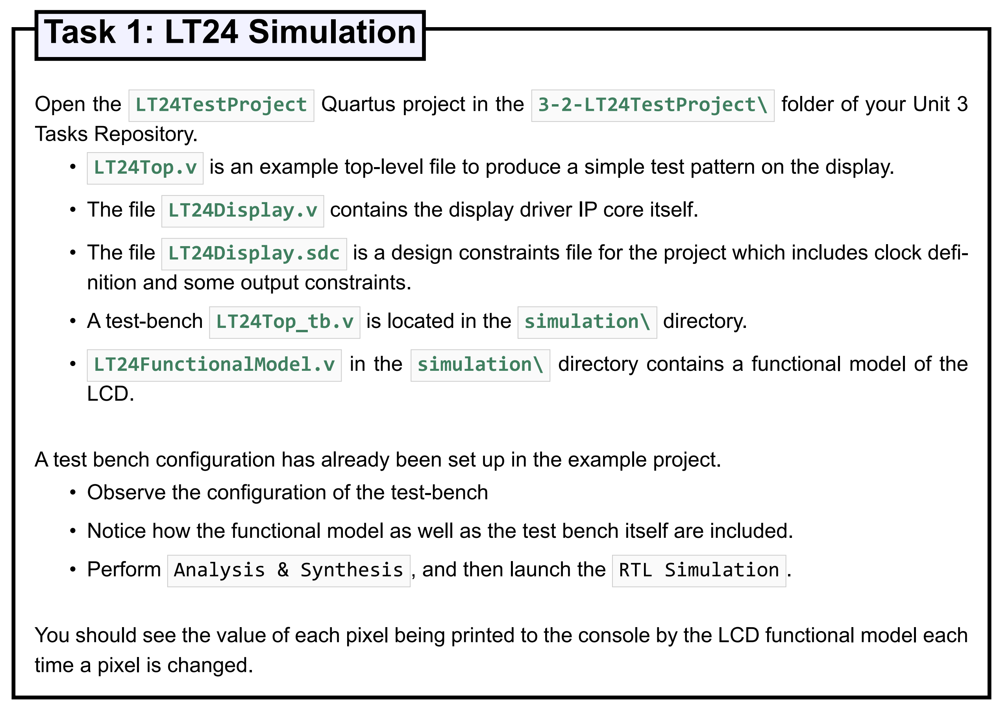
LT24 Tasks

Slide 29
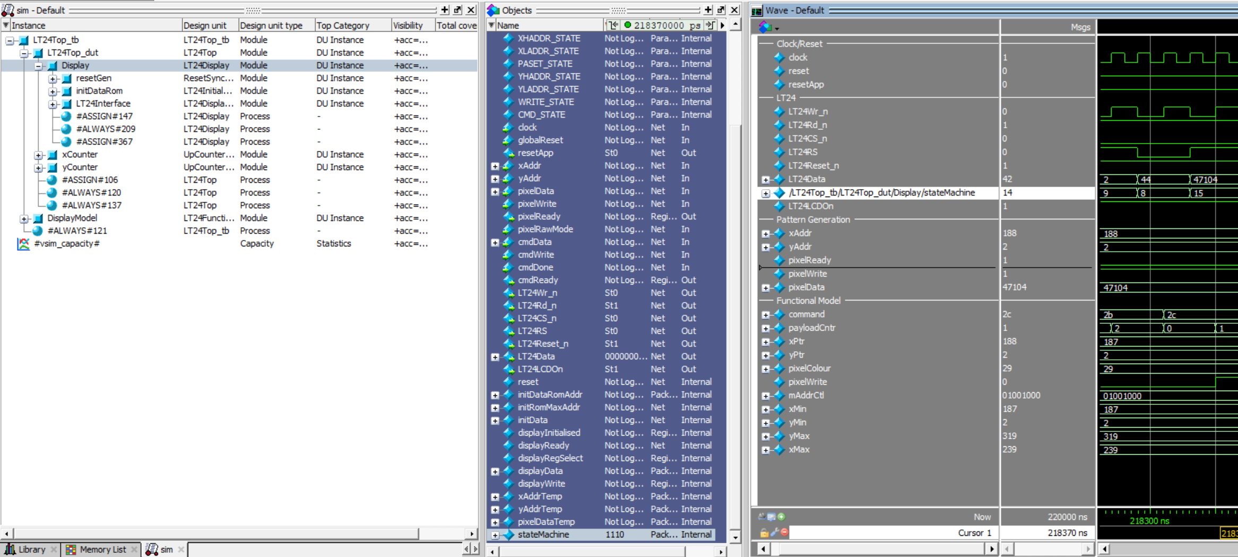
Adding Internal Signals to ModelSim

Slide 30
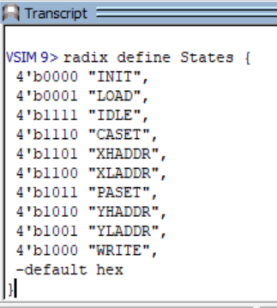
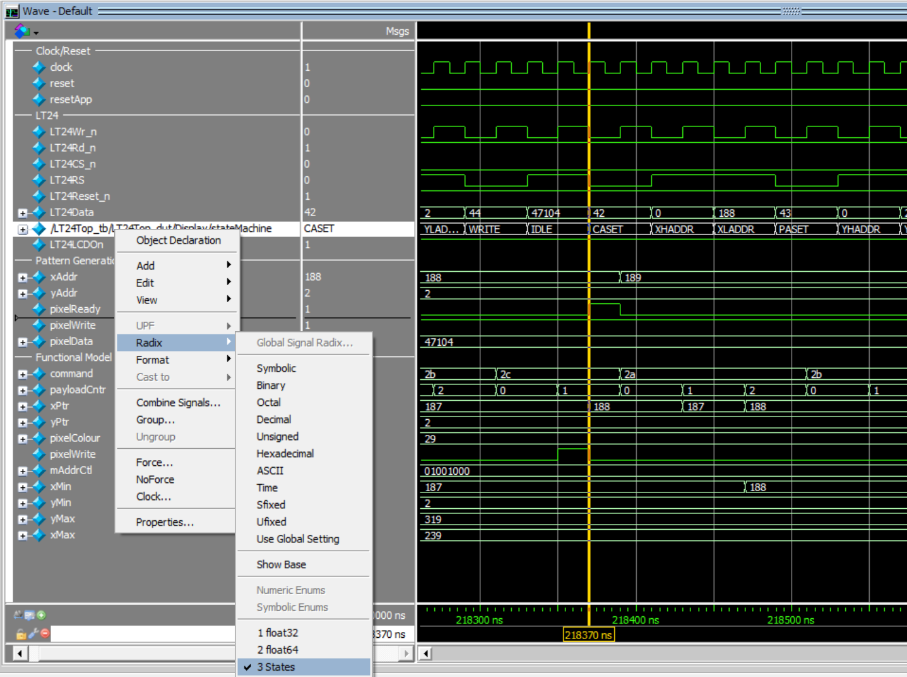
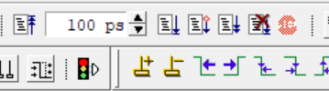
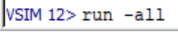
State Names in ModelSim
or

Slide 31
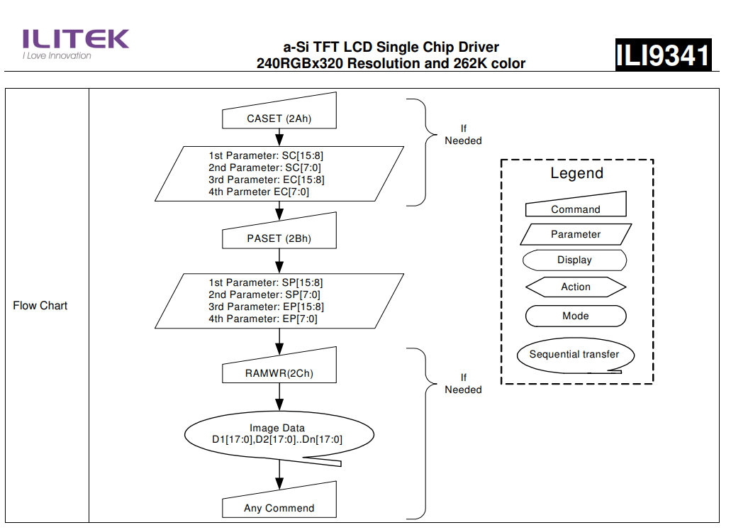
0x2A = 42
START X_ADDRESS = SC
0x2B = 43
START Y_ADDRESS = SP
0x2C = 44
ANY NUMBER OF PIXELS

Slide 32
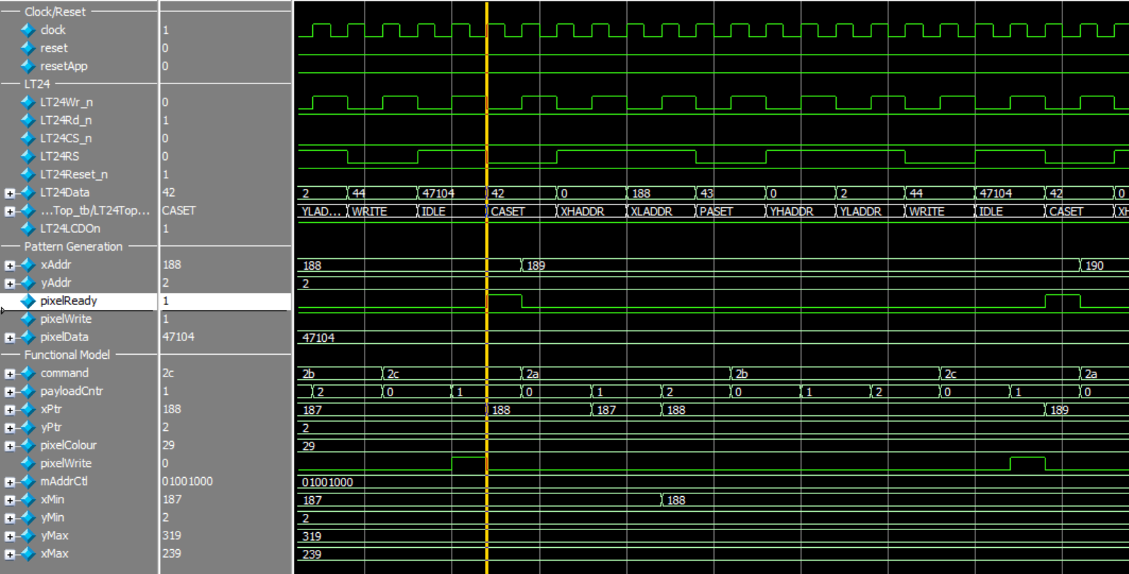

Slide 33
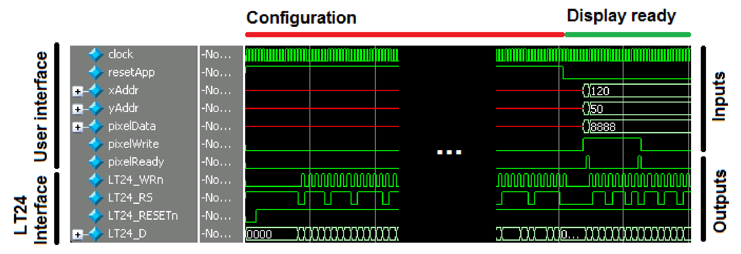
Simulation Showing LT24 Output Signals
Notes:
In the example, once configuration is complete, the resetAppis de-asserted (set low) –– this should be used as the reset signal to any logic in your own design. The user logic presents the xAddr, yAddrand pixelDatathen sets pixelWritehigh until the module sets the pixelReadyoutput high. During this time, the user must not change any of the inputs. The image shows the optimised writing of two pixels whereby the value of xAddr, yAddrand pixelDatais changed once pixelReadyis asserted yet pixelWriteis held high throughout

Slide 34
Simulation Showing LT24 Output Signals
Notes:
In the example, once configuration is complete, the resetAppis de-asserted (set low) –– this should be used as the reset signal to any logic in your own design. The user logic presents the xAddr, yAddrand pixelDatathen sets pixelWritehigh until the module sets the pixelReadyoutput high. During this time, the user must not change any of the inputs. The image shows the optimised writing of two pixels whereby the value of xAddr, yAddrand pixelDatais changed once pixelReadyis asserted yet pixelWriteis held high throughout

Slide 35
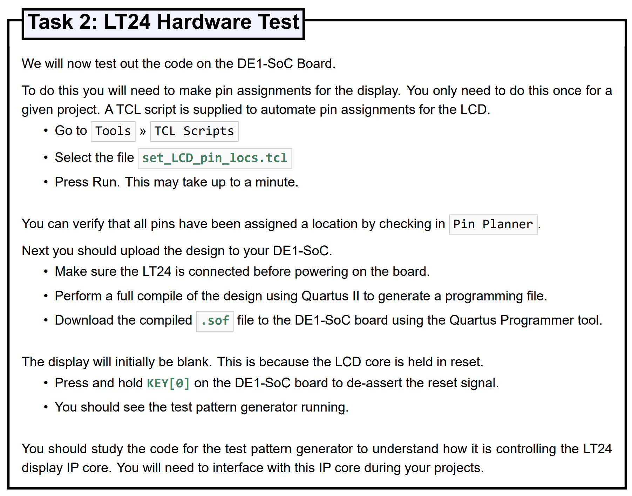
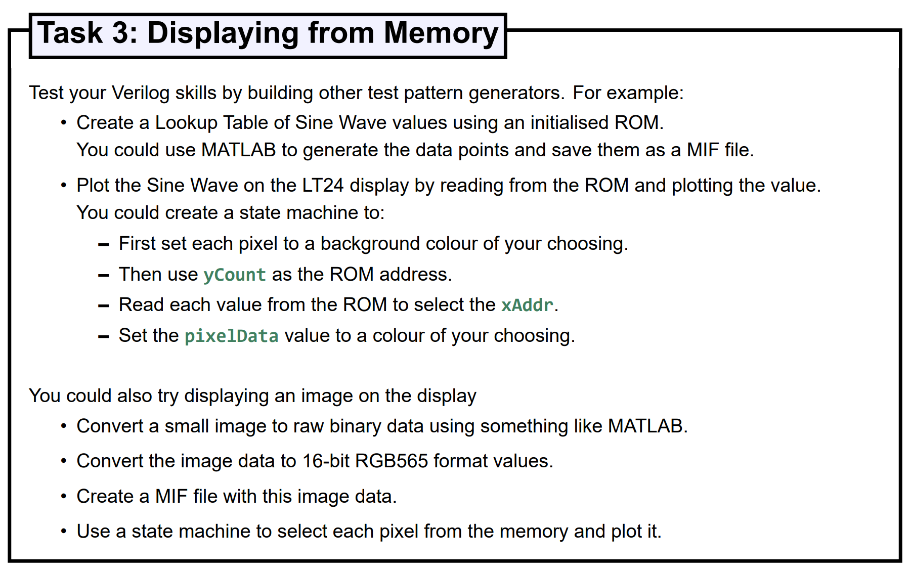
LT24 Tasks

Slide 36
Have fun and enjoy the embedded modules!

